Slide 1
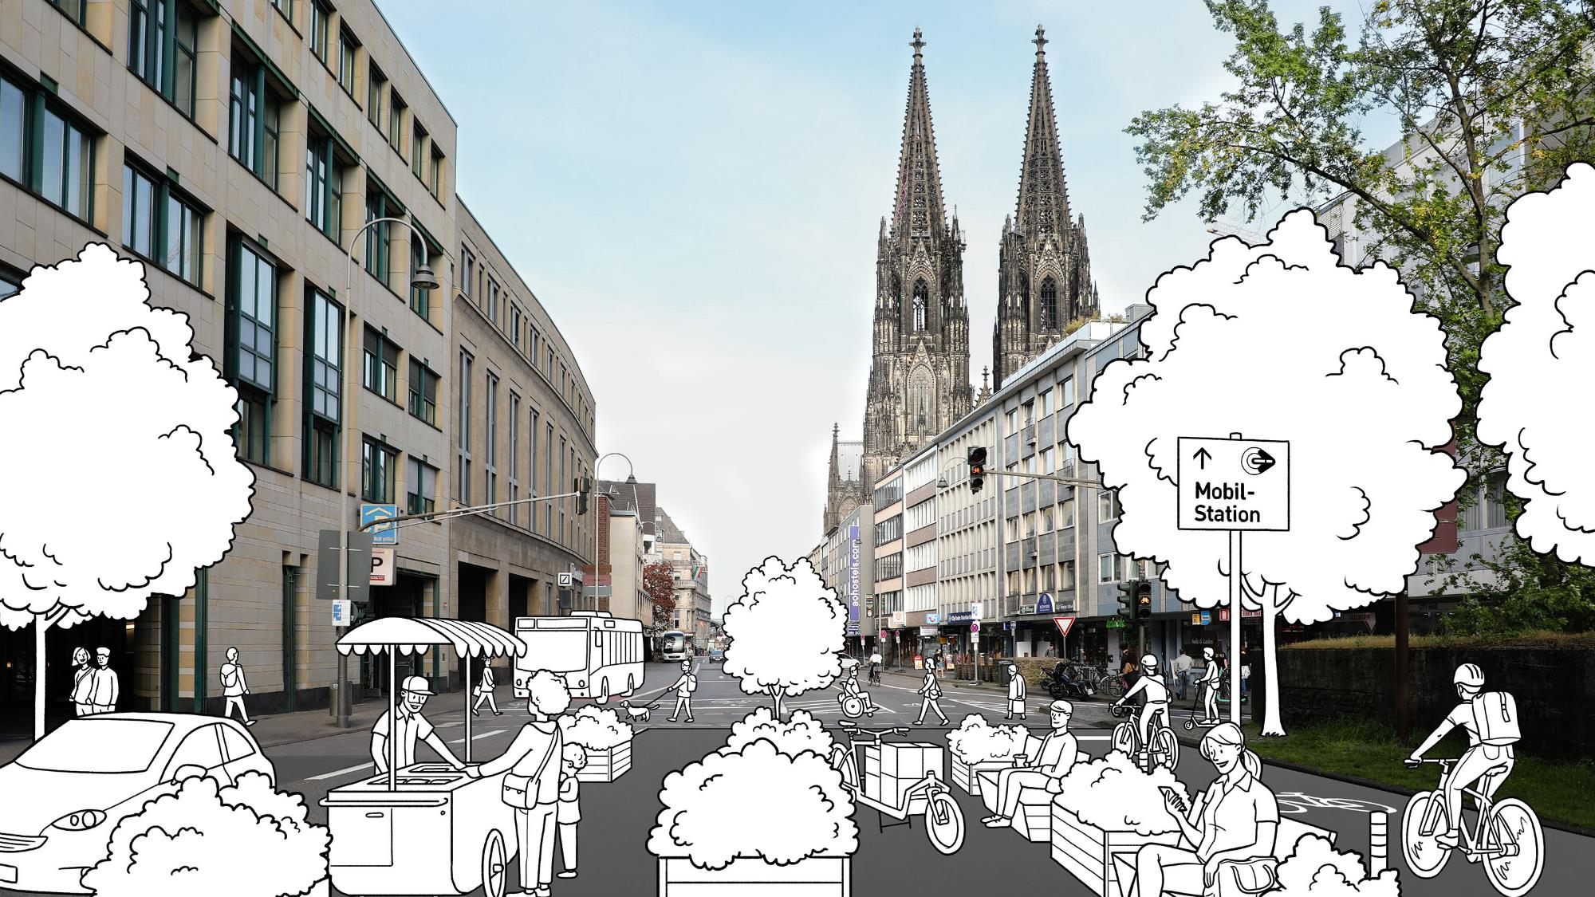


Titelseite
How sustainable urban mobility plans can enhance walkability in historic cities
From walkable to drivable to livable
World Conference of Historical Cities |19th Edition
12.11.2024
Barbara Pauli and Friederike Christian | City of Cologne | Department for Sustainable Mobility Development
© Jan Buckard/Tippingpoints

Slide 2
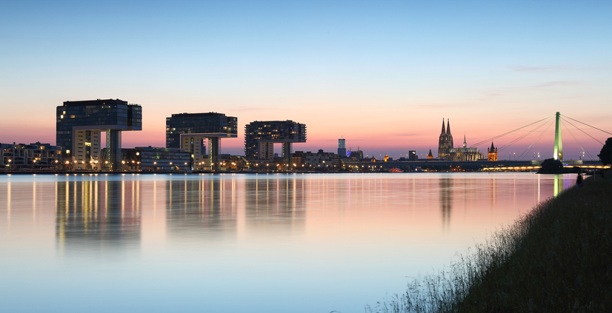
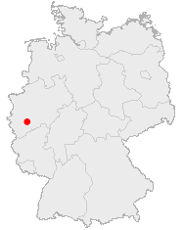
Geographical location and history of Cologne
© Stadt Köln

Slide 3
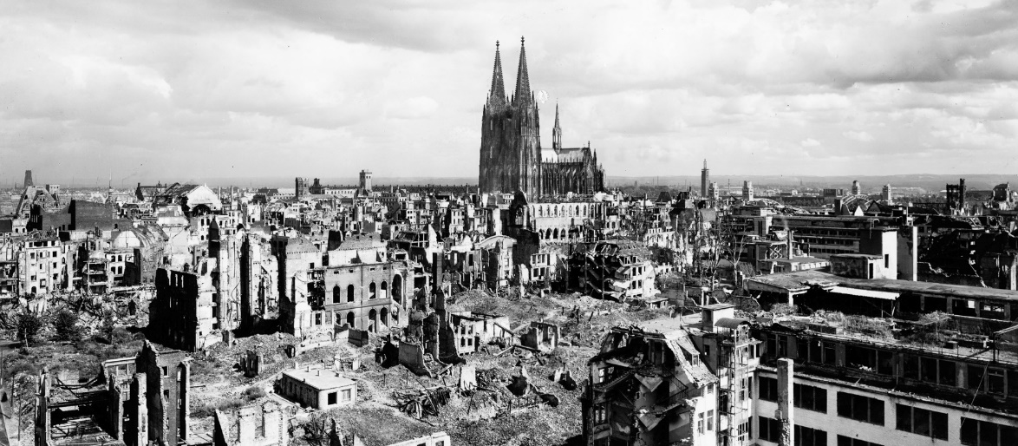
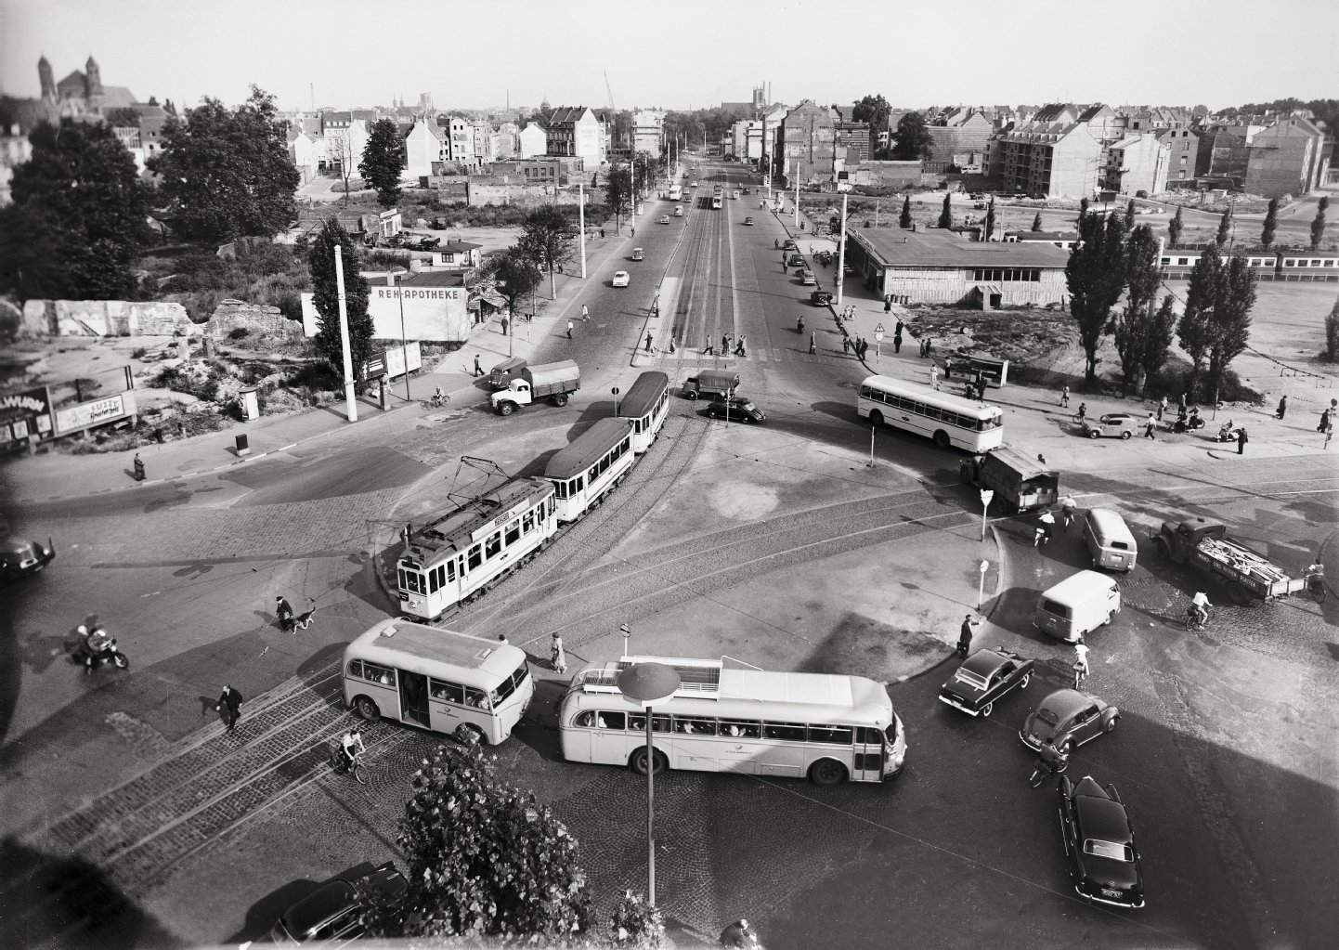
Geographical location and history of Cologne
Cologne in Spring 1945
The old town is characterized by narrow streets dating back to the Middle Ages
Cologne has been heavily destroyed during WWII
Barbarossaplatz 1955
Rapid reconsruction in the 1950s led to a car focused cityspace
Notes:
Bilderquellen:
Zerstörte Kölner Innenstadt: Wie die Dome in Köln und Aachen den Zweiten Weltkrieg überlebten - katholisch.de
Barbarossaplatz 1955: Bildband „Köln nach dem Krieg“: Neue Blicke auf Köln nach dem Zweiten Weltkrieg | Kölner Stadt-Anzeiger (ksta.de)

Slide 4
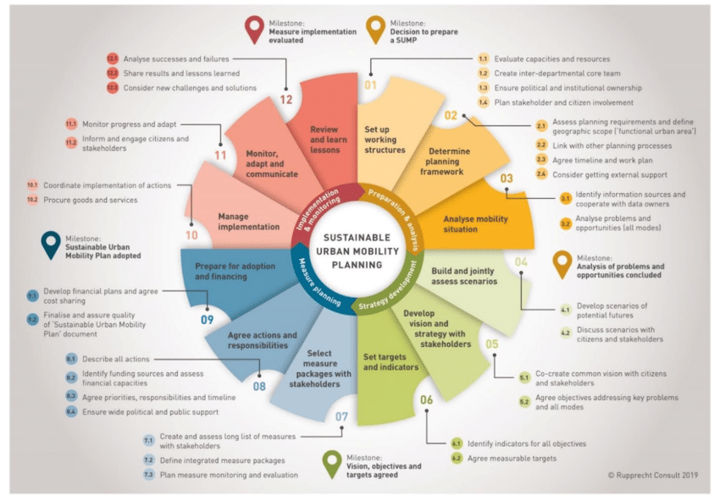
Sustainable Urban Mobility Plans (SUMPs)
A SUMP is a cross-modal mobility strategy that is guided by a consciously formulated and broadly supported goal and includes a clear implementation and evaluation plan
SUMP as an EU target – mandatory by 2027
Key feature: people-centered approach
In Cologne, the SUMP replaces the transportation concept from 1992
Contribution to Cologne’s target of climate neutrality by 2035
Notes:
Warum wir den Plan erarbeiten - Stadt Köln (stadt-koeln.de)
Warum wir den Plan erarbeiten - Stadt Köln (stadt-koeln.de)
All 432 major cities in the trans-European transport network should have developed SUMPs by 2027. Cologne is one of them.
In Cologne the SUMP to replace the overall transportation concept from 1992
The sustainable mobility plan is intended to replace the overall transportation concept from 1992. With it, we are continuing the goals of the “Köln mobil 2025” strategy paper.
Climate neutrality by 2035 → 28% of greenhouse gases in Cologne come from transport - an important contribution to must be made

Slide 5




„Better through Cologne“ –
The Sustainable Urban Mobility Plan – Step 1
WP 1
Basics
WP 2
Vision and objectives
WP 3
Analysis
WP 4
Strategy
1.1 Evaluation of concepts
1.2 Evaluation of political decisions
1.3 Evaluation of the existing data
1.4 Evaluation of the basic road network
2.1 Vision and objectives
2.2 Target indicators
3.1 Status quo analysis
3.2 Analysis of opportunities and weaknesses
4.1 Illustration of traffic development
4.2 Scenario development
4.3 Scenario assessment
4.4 Target scenarios and target values

Slide 6
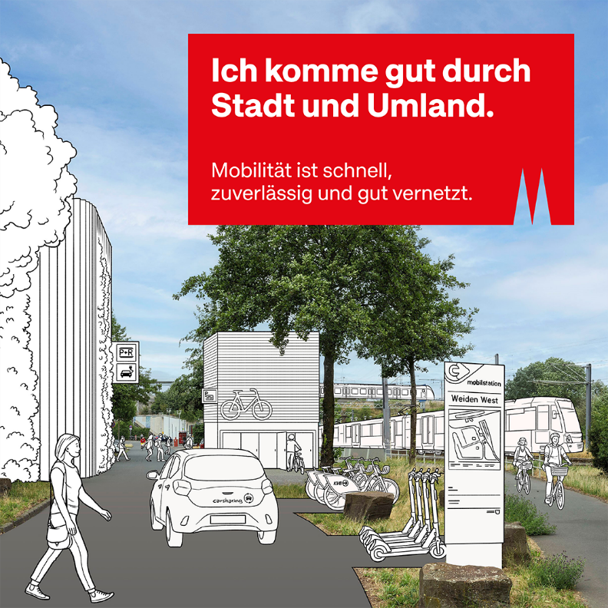
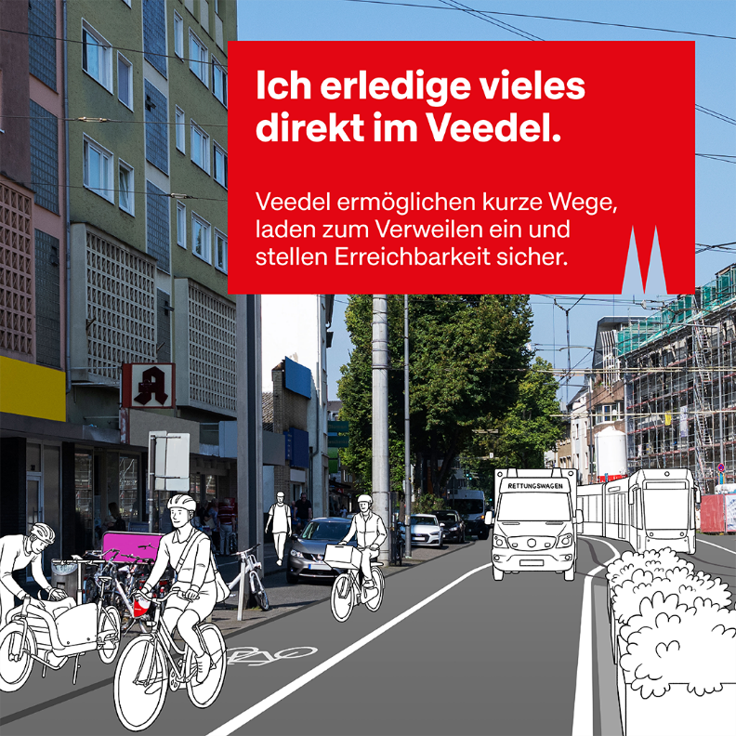
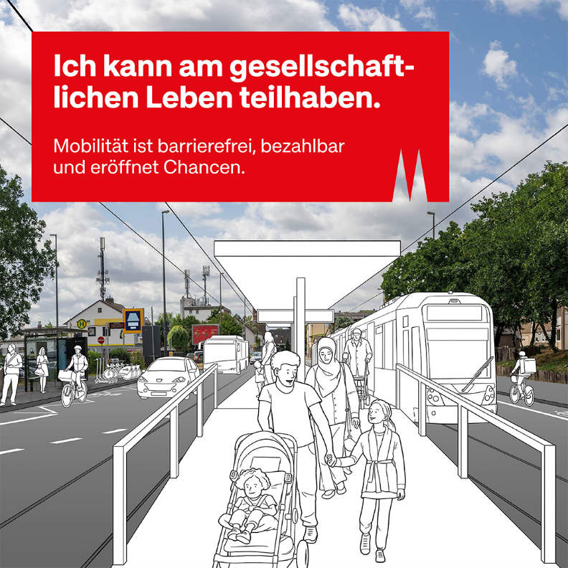
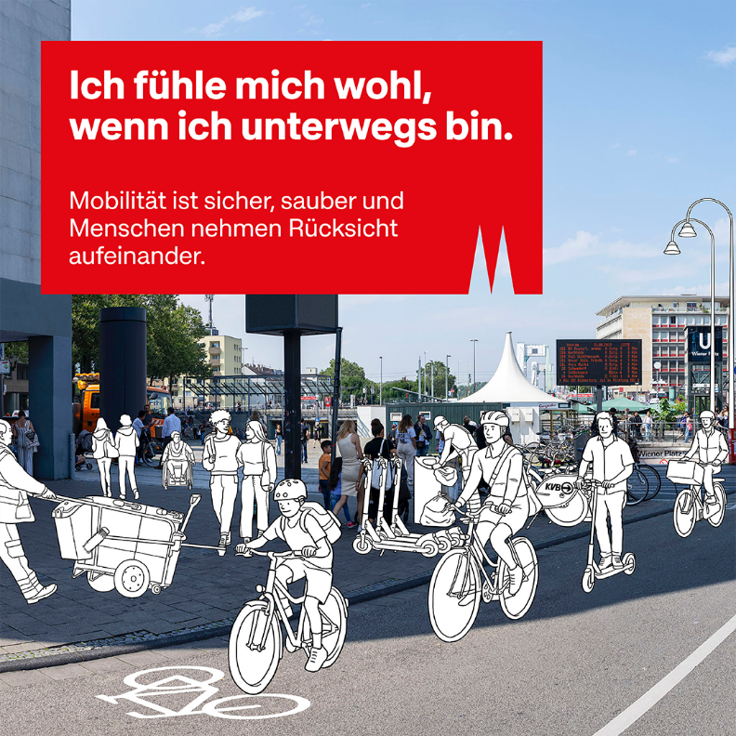
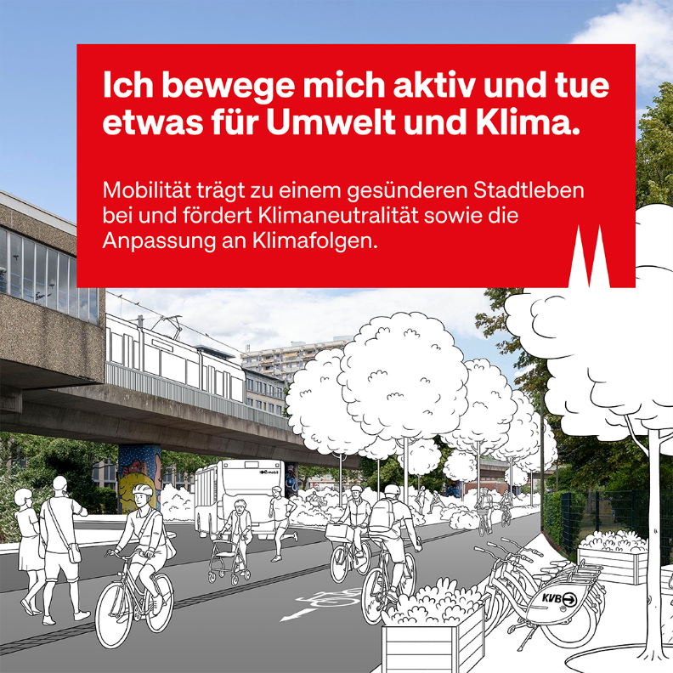
I can get around the city and surrounding area easily:
Mobility is fast, reliable and well connected
I move actively in my neighborhood:
Neighborhoods enable short distances,
invite people to spend time
and ensure accessibility
The vision „Better through Cologne“
© Jan Buckard/Tippingpoints
© Jan Buckard/Tippingpoints
I can participate in social life:
Mobility is accessible, affordable and opens up opportunities
I feel good when I'm on the move:
Mobility is safe, clean and people show
consideration for each other
I am active and by that I do something
for the environment:
Mobility contributes to healthier urban living and
promotes climate neutrality and
adaptation to climate impacts
© Jan Buckard/Tippingpoints
© Jan Buckard/Tippingpoints
© Jan Buckard/Tippingpoints

Slide 7
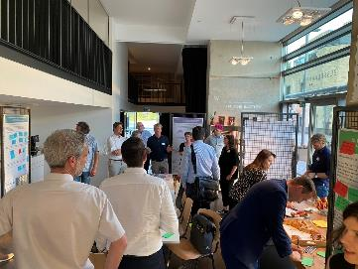
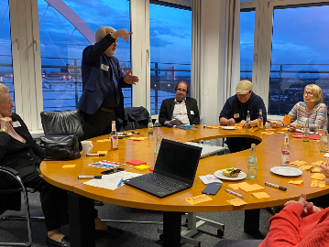
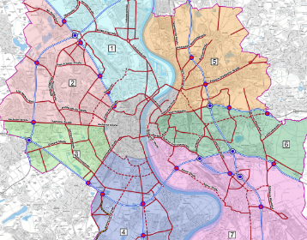
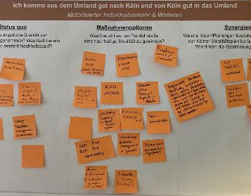
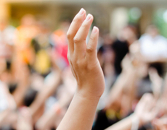
Participation is an essential part of our sustainable urban mobility plan
Participation of stakeholders
Mobility advisory board
Consultation of the city administration and the experts during the entire process.
26 specialist stakeholders from business, science & society
Political representatives
Round table mobility & Society
Focus on socially responsible mobility and the diversity of Cologne.
25 citizens who are invited based on a random sample
Civil society organizations, companies, trade unions
Forum for the basic road network
Consultation on the basic road network and focus on car mobility.
Associations and companies from the mobility, logistics and service sectors
Rescue services
Political representatives
Regional forum
Comparison of urban planning with the activities of the region and the federal state.
Neighboring municipalities
Metropolitan region, networks
Future Mobility Network NRW
Go.Rheinland, Straßen.NRW, Autobahn GmbH
Scoping
Interim evaluation of mobility planning & process
Stakeholders already involved
Other stakeholders (gastronomy and hotel industry association, integration advisory board)
© Stadt Köln
© Stadt Köln
© Stadt Köln
© Stadt Köln
© Day of Victory Studio/ Shutterstock

Slide 8

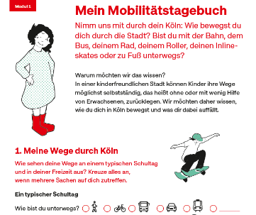
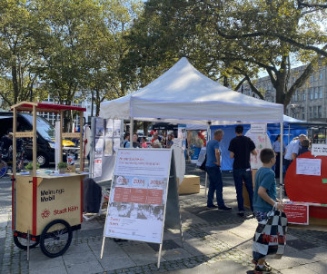
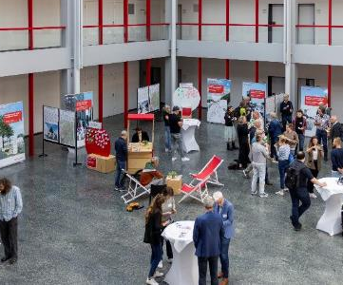
Participation is an essential part of our sustainable urban mobility plan
Public participation
Online-
participation
Accessible offer to include the perspectives of as many people as possible.
All interested citizens and specialists
Child and youth participation
Accessible offer to include the perspectives of young people.
Children (+/-) 3.-4. grade level
Youth (+/-) 7.-8. grade level
Active participation
Inclusion of the perspectives of citizens who rarely use opportunities to participate.
Neighborhoods in need of development
Other districts
Polis Mobility Camp
Public mobility forum
Public debate room on the sustainable mobility plan.
All interested citizens and specialists
© Stadt Köln
© Stadt Köln
© Stadt Köln
© Stadt Köln

Slide 9




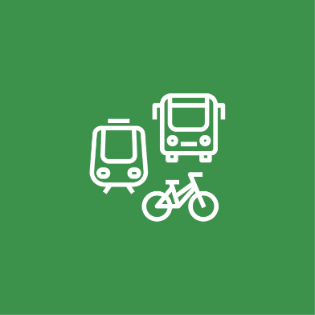


Fields of action in the SUMP of Cologne
Walking
Cycling
Public Transport
Motorized individual traffic
Inter- and multimodality
Commercial and delivery traffic
Spatial planning and land use
Notes:
Noch nicht fertig!

Slide 10
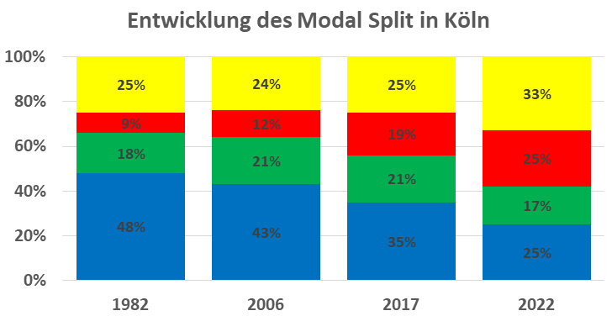
Walkability in Cologne
“More importance should be placed on walking. In most cases, other means of transportation are in the focus.” – Participant of the online participation 2024
Development of the modal split in Cologne
“Wherever people are out and about and spend their time there is life: In this sense, we need lots of places for people in the city.” – Participant of the online participation 2024
motorised transport
public transport
cycling
walking

Slide 11
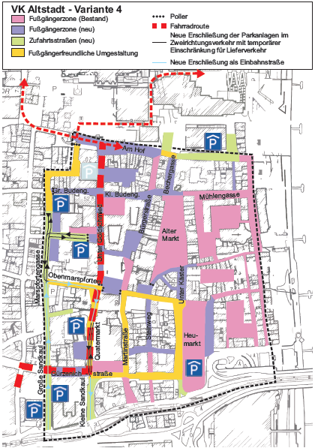
Examples from the old town of Cologne
Redistribution of traffic areas - Cologne sets new standards for active mobility
Old Town Traffic Management Concept
Objectives
Enhance quality of life in the old town
  Strengthen pedestrian and bicycle traffic
  Reduce public parking spaces
  Decrease motor vehicle traffic
Implementation
  Measures are implemented in multiple steps
  Redesign and adaption of streets for better urban experience
© Stadt Köln
Notes:
More spaces for pedestrians and cyclists
More spaces for parking bikes,
cargo-bikes and e-scooter
- More spaces for open air gastronomies

Slide 12
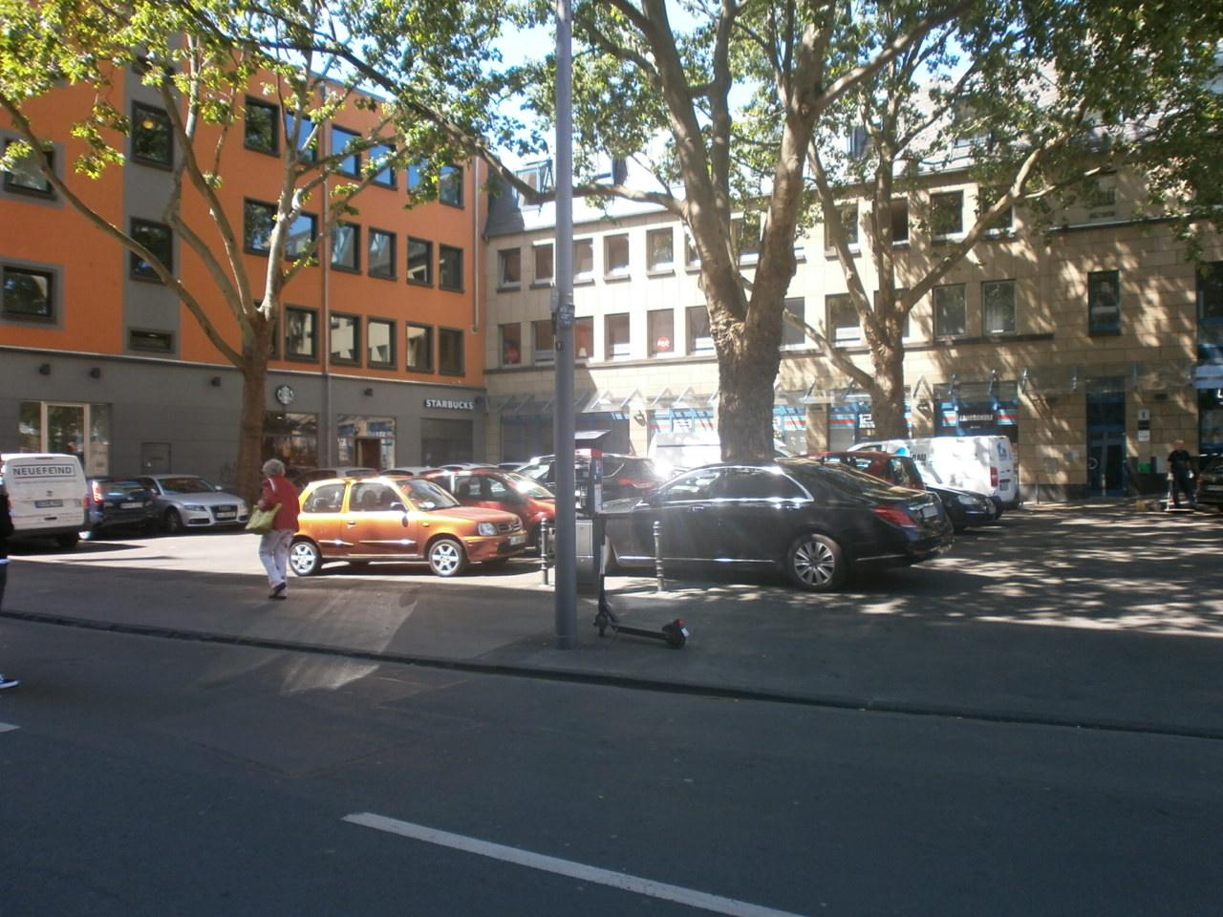
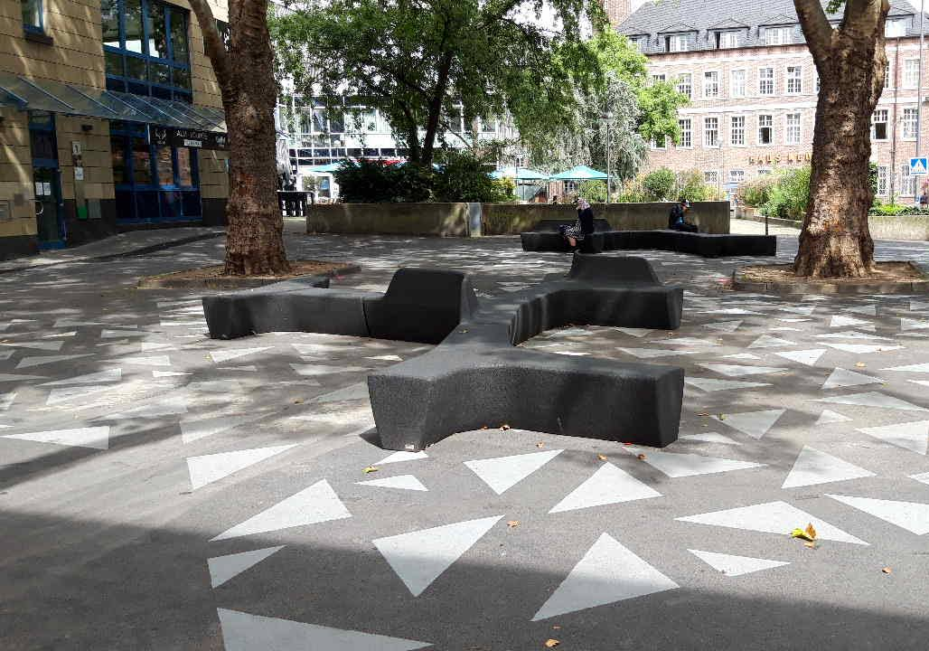
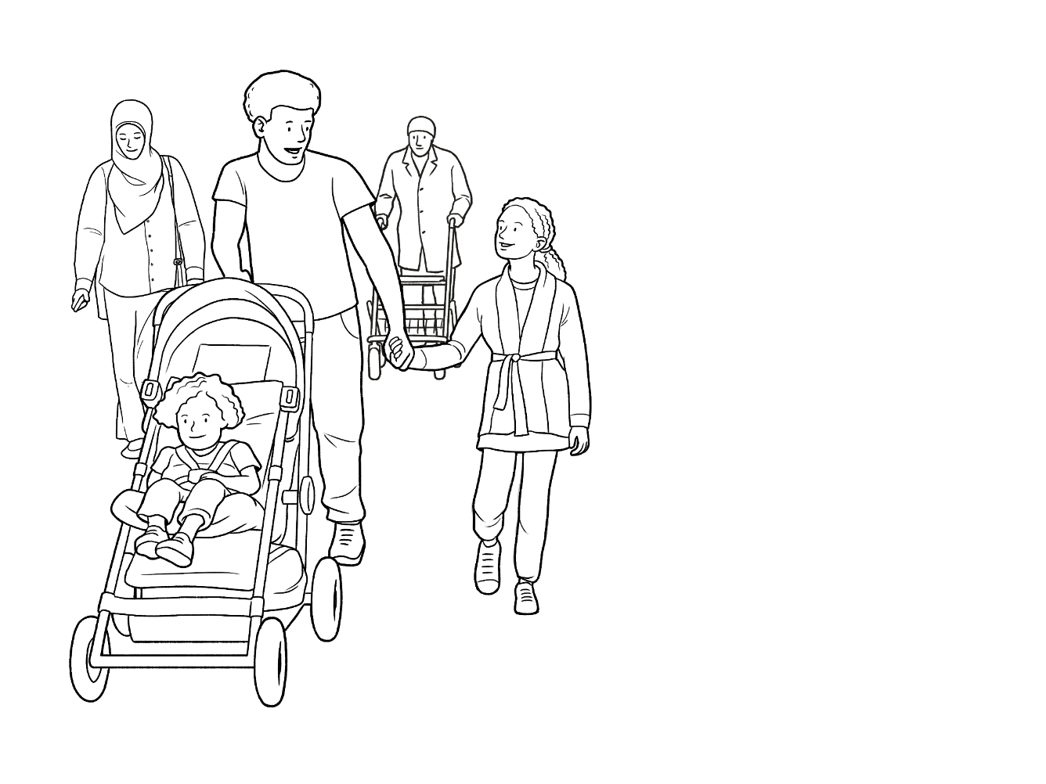
Examples from the old town of Cologne
Removal of parking spaces by minimal structural adjustments
→ public space without need for consumption
space to rest
Before
After
© Stadt Köln
© Stadt Köln

Slide 13
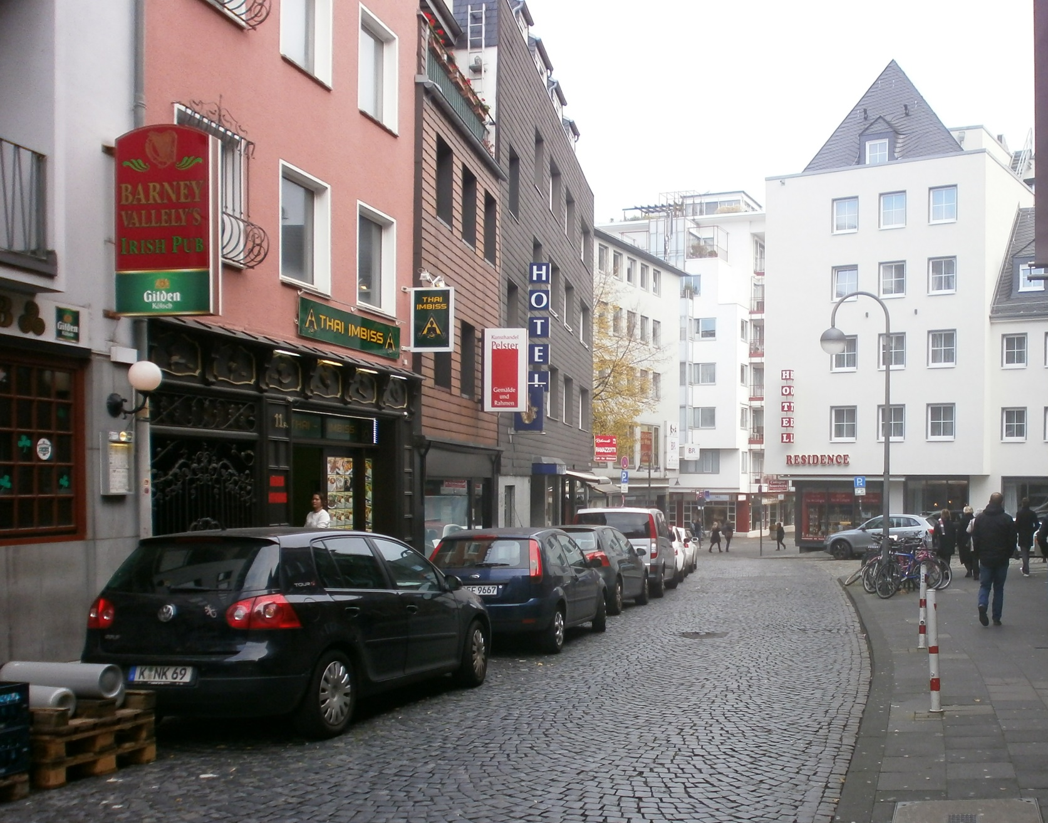
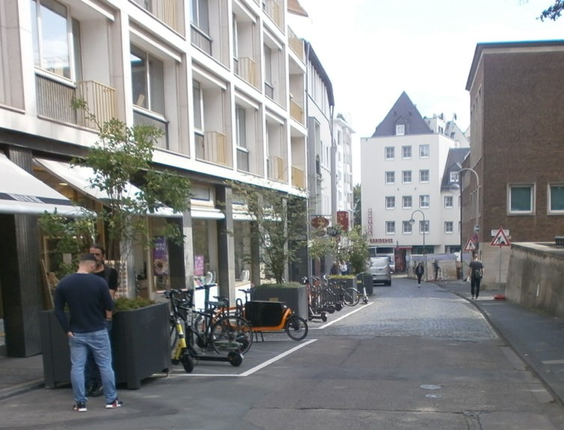
Examples from the old town of Cologne
Removal of parking spaces by minimal structural adjustments and placing temporary trees
→ new parking spaces for bicycles and e-scooters
→ improving walkability
Before
After
© Stadt Köln
© Stadt Köln

Slide 14
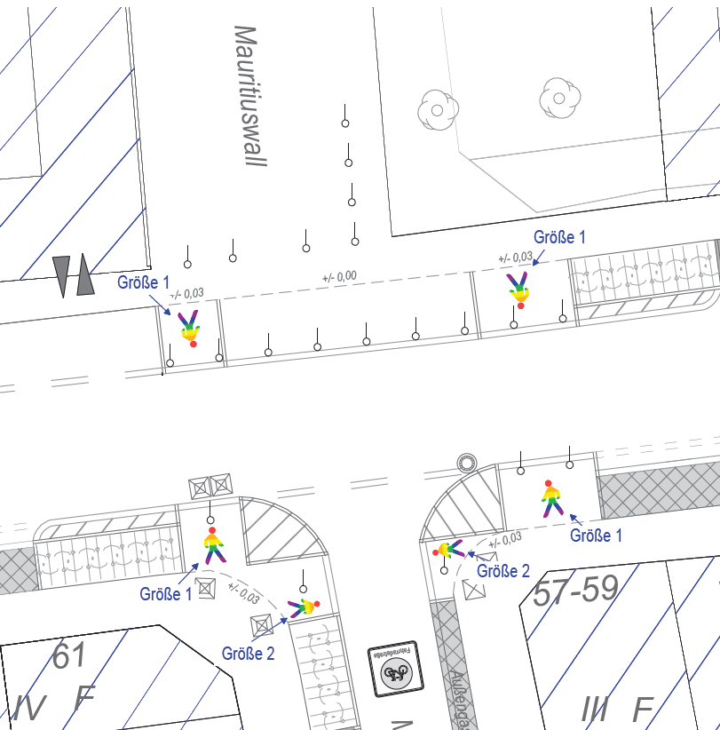
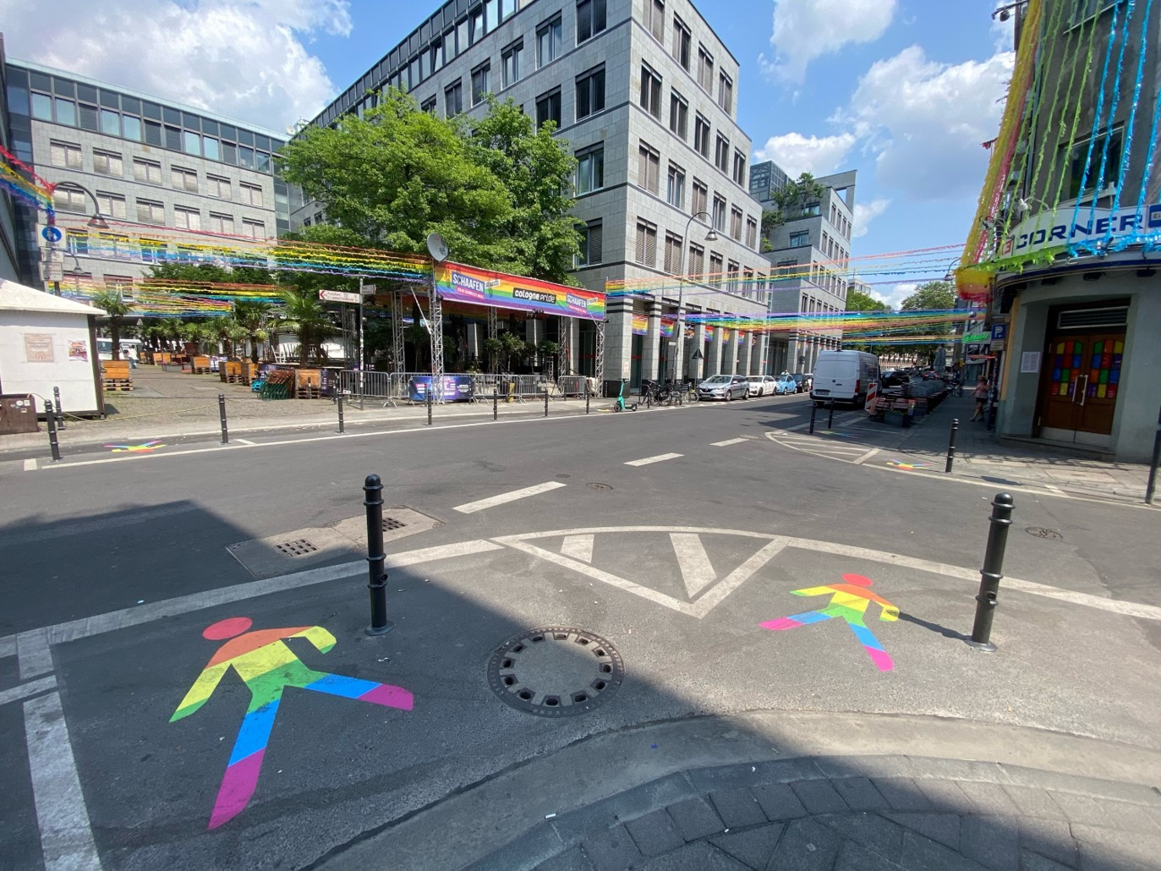
Examples from the inner city of Cologne
Removal of parking spaces and implementation of „free corners“
→ improving walkability
© Stadt Köln
© Stadt Köln

Slide 15
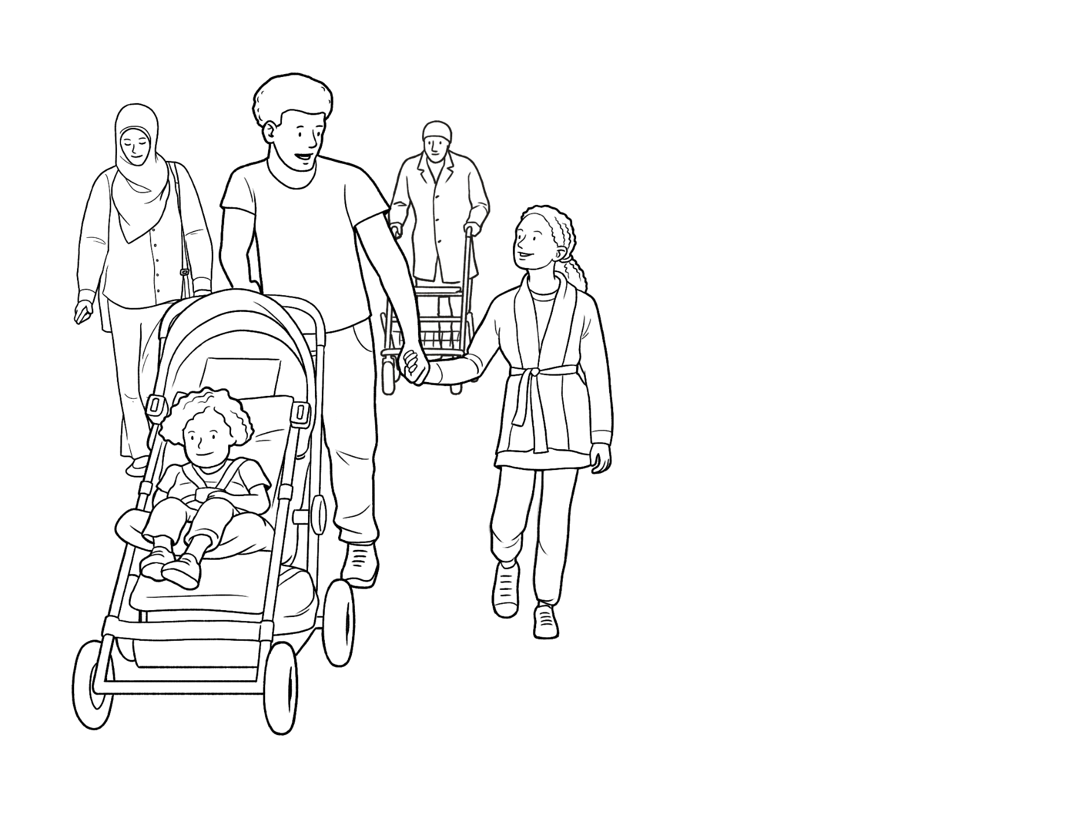
Conclusion and next steps
Challenges to overcome due to historic cityscape
Narrow streets → Narrow sidewalks
Historic paving stones → bumpy sidewalks/ roads
High maintenance of buildings and infrastructure
→ Major challenges arise from the different demands placed on the limited space
Next steps of the SUMP are developing and implementing measures to overcome the challenges with the help of a broad participation process
For example:
creating more pedestrian zones
changes in traffic management
Notes:
Gesellschaftlicher Wandel findet statt
Herausforderungen gesellschaftlicher Art erklären
We are looking forward to prepare the city's mobility for the future, to create spaces in which we as residents enjoy spending time and to improve the walkability and thus also the livability of the city.
Die Challenges, die hier genannt sind, sind ja eher nur baulicher Art und könnte man auch zum Einstieg des Vortrags eher nennen (bei historischer Einführung). Im Ausblick würde ich eher sagen, was wir für (geselschaftliche) Herausforderungen haben - Menschen wollen mehr Fußwege, aber auch keine Einschränkunge bei Autofahren etc. Und bei den Next Steps oder Chancen für die Zukunft noch mal mehr betonen, was der SUMP dazu beitragen kann etc.

Slide 16
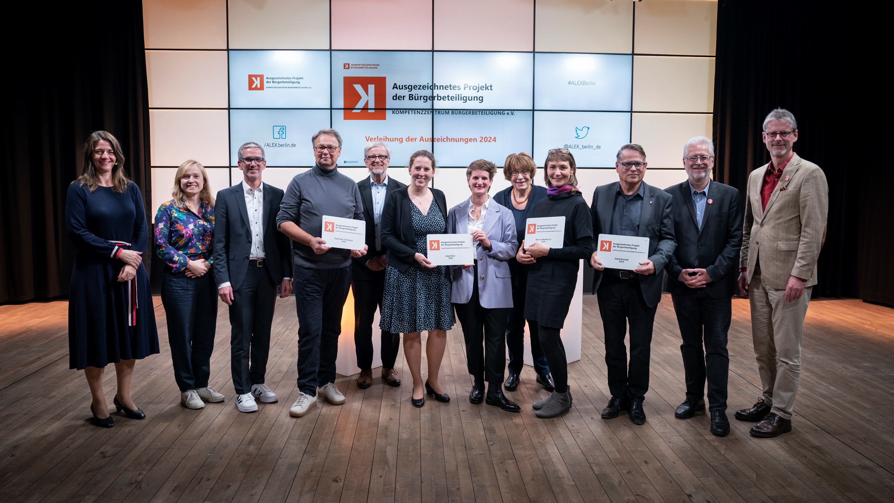

#+
Thank you for listening!
We are here for your questions
#+
Award-winning citizen participation project
More information
https://mobilitaetsplan.koeln
© Kompetenzzentrum Bürgerbeteiligung/ Tanea Sommer

