Slide 1
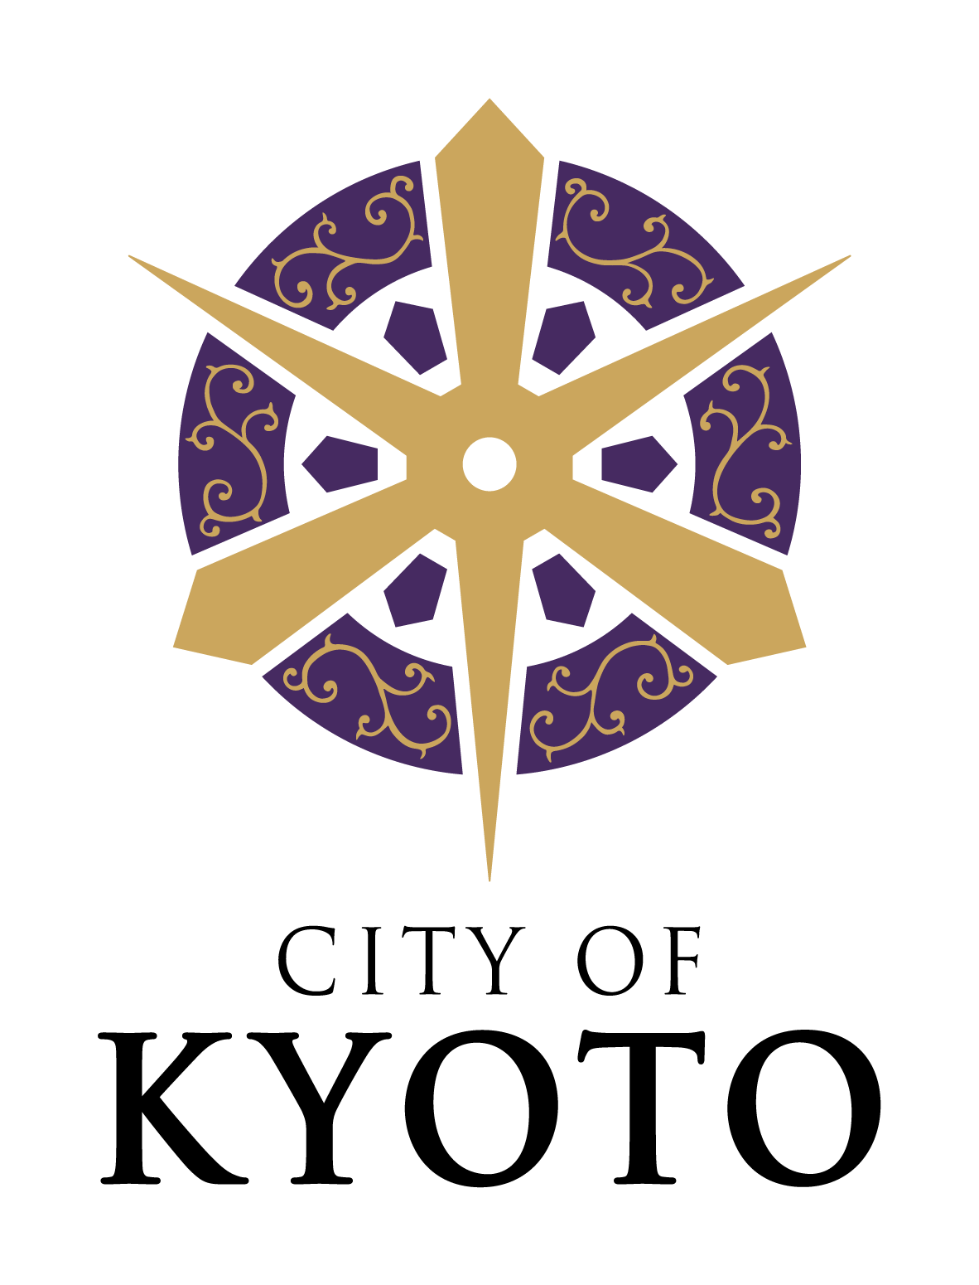
Enhancing Walkability to Increase Attractiveness of a Global City, Kyoto
November 12, 2024
MATSUI Koji
Mayor of Kyoto

Slide 2
Declaration of Kyoto as a City Open to the Free Exchange of World Cultures (1978)
Excerpts
- Any city is in need of some ideal.
- A free city for international cultural exchange is one where peoples of any country may assemble freely and in peace, regardless of race, creed or social system, for the purpose of cultural exchange.
- Kyoto, an ancient capital with a history of over one thousand years, cannot merely take pride in past glories, nor live isolated. She must be always renewed culturally and continue to create her own unique culture.
- We, the citizens of Kyoto, would like calmly to make this resolution and pledge our efforts towards what we can to do for the realization of this ideal.

Slide 3
Our Vision
“An Outstanding Global City, Kyoto”
A city to be chosen by people from around Japan and the world for living and working.
A city where diverse talents come together to create new values.

Slide 4
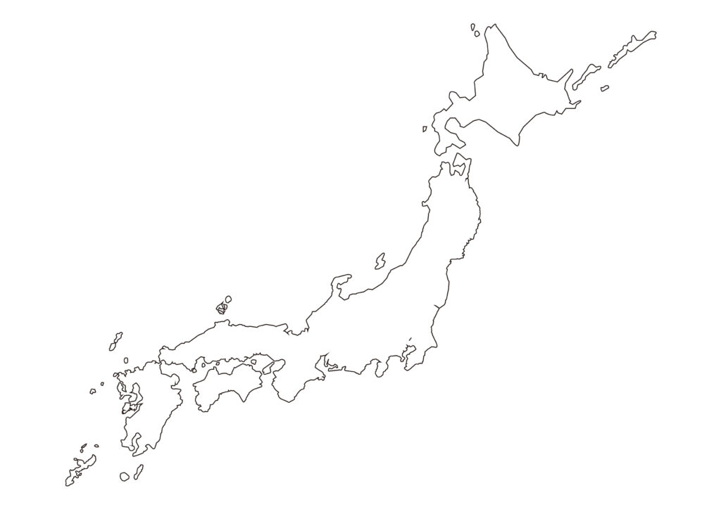
Our Location
Located in the central area of Japan, with good access to Tokyo and Osaka.
KYOTO
TOKYO
OSAKA

Slide 5
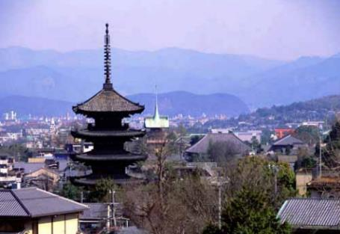
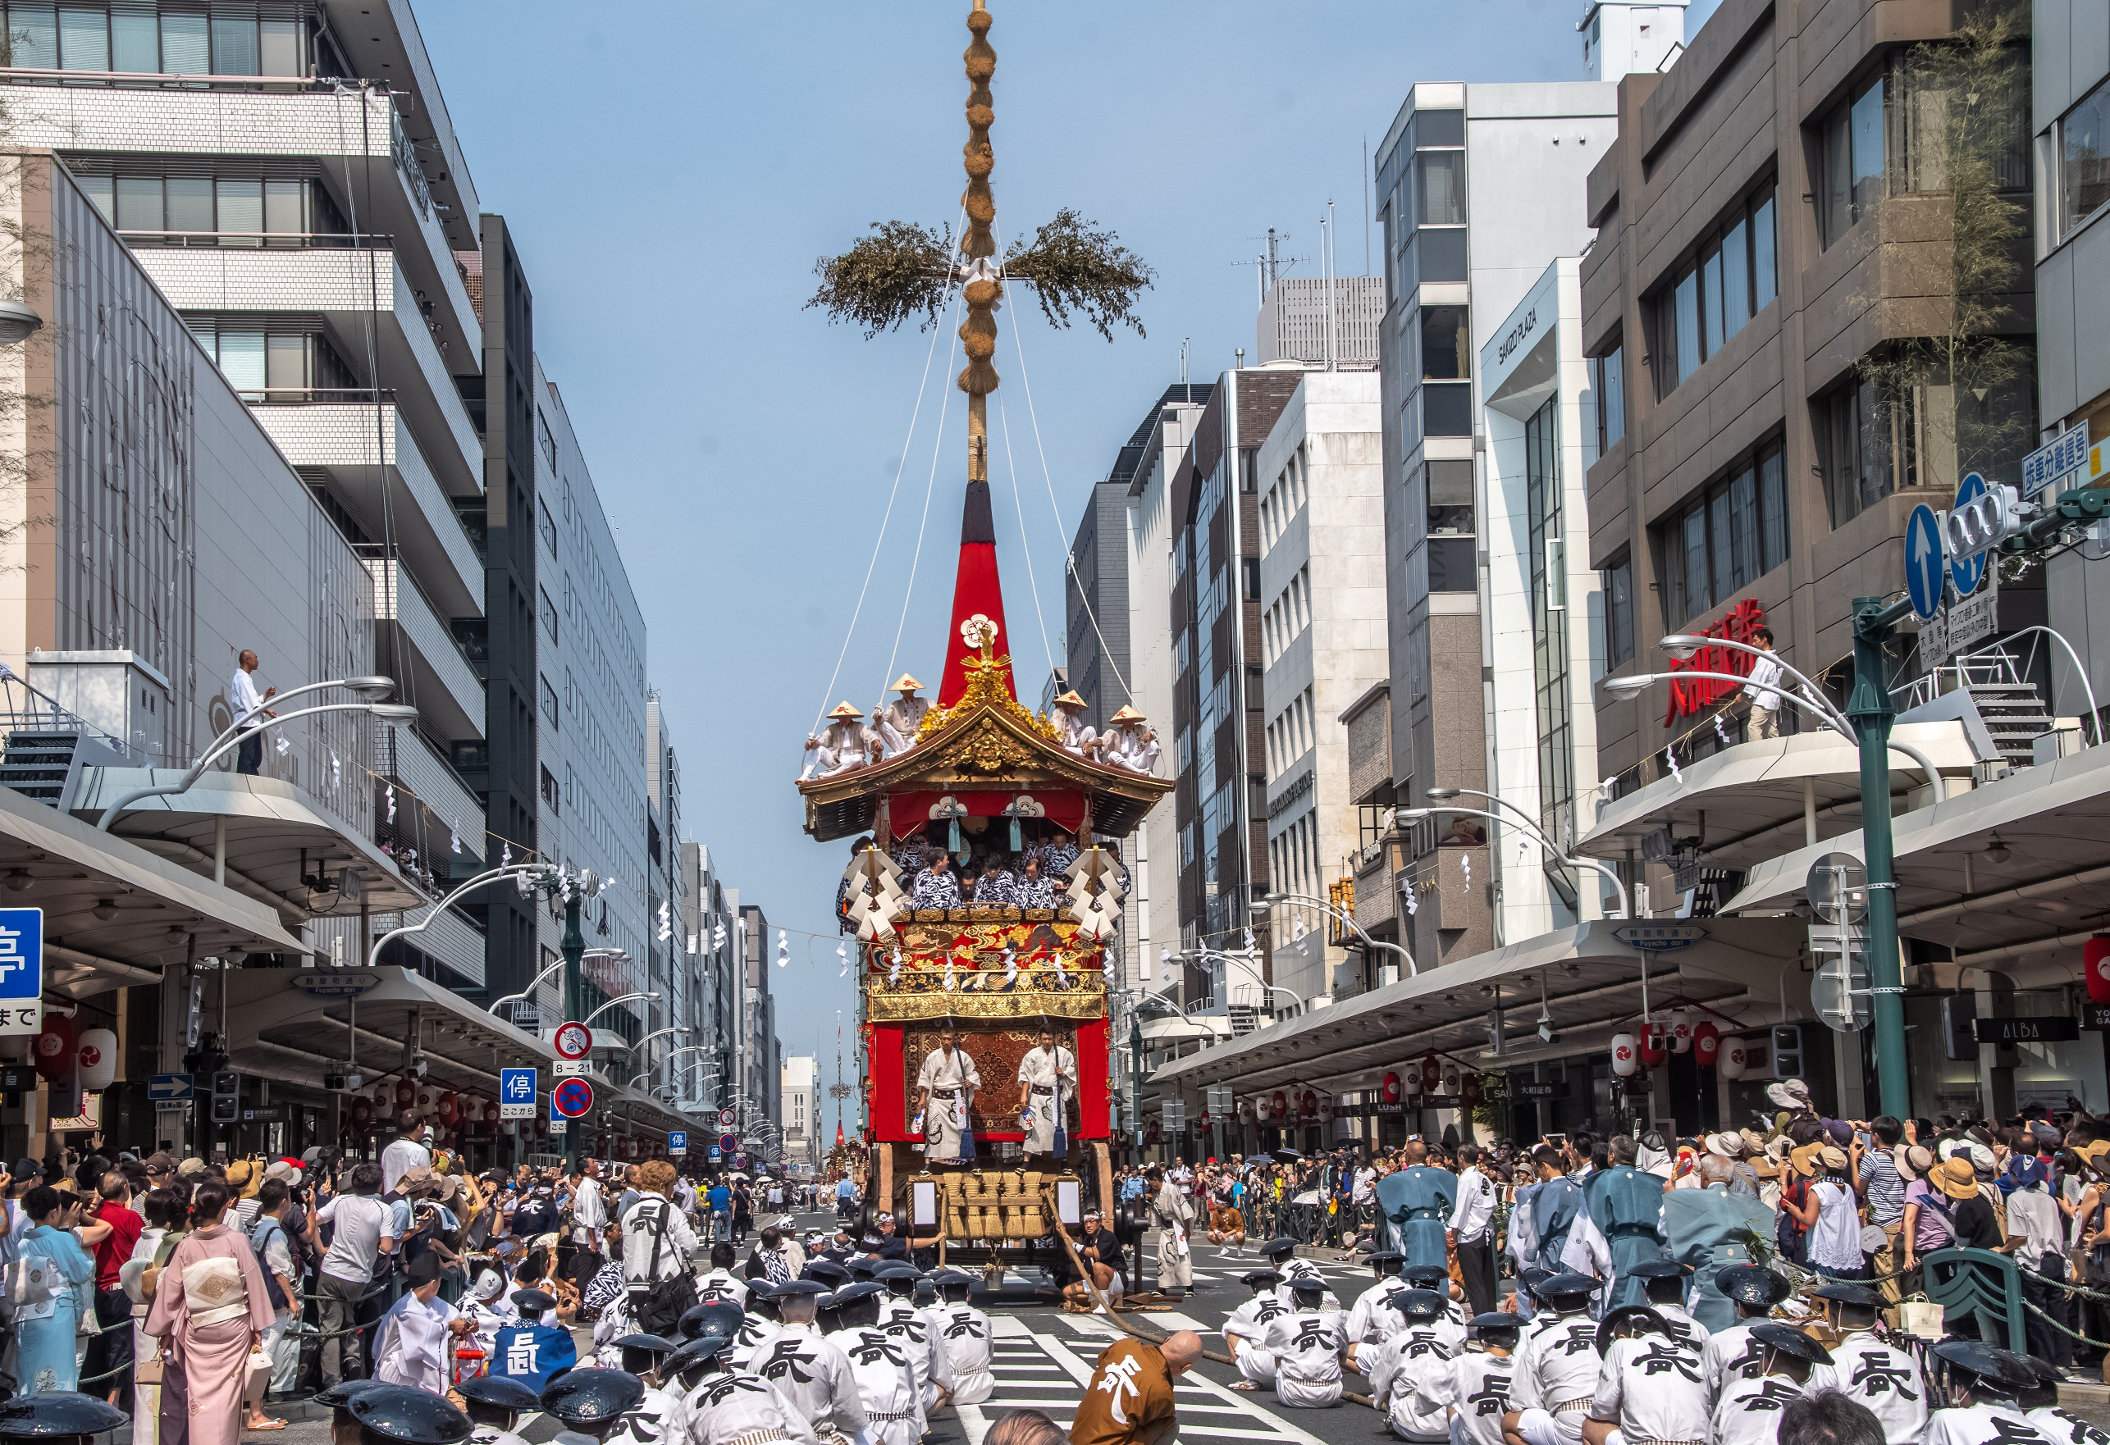
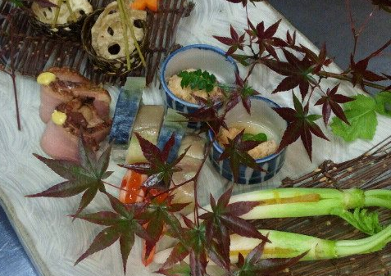
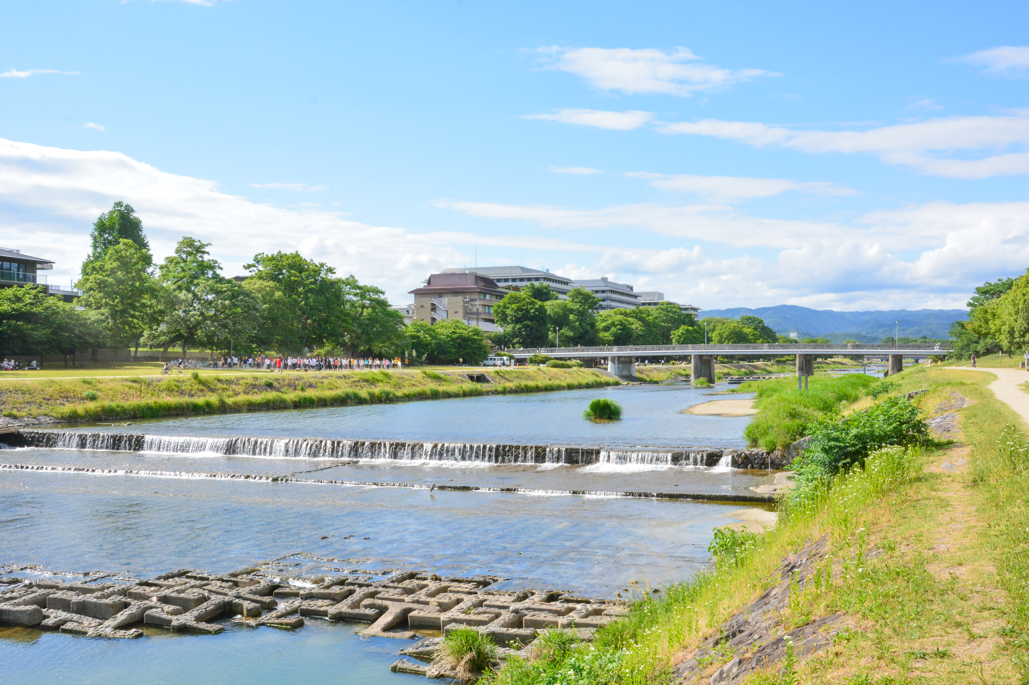
Our Strengths
A world-class international city of culture and tourism
Famous for its history and culture
A center of art, culture, and tradition with a history as the ancient capital of Japan for over a millennium.
UNESCO World Heritage “Historic Monuments of Ancient Kyoto ”
Population of approx. 1.5 million people, and over 50 million tourists per year (2023)
Rich in nature
(Mountains and the Kamo River running through the city center)
©KYOTO IMAGE BANK

Slide 6
As an Academic Center of Japan
The highest ratio of students to the population in Japan, which is almost double that of Tokyo
36 universities and colleges are located in the city center.
About 150,000 students live in the city, which account for 10 % of the population.
There are Japan’s top universities, and art universities including municipal one.
More than half of the Japanese Novel Prize laureates are related to Kyoto.
10.6%
Japan No.1
5.9%
Nobel Prize
laureates
related to Kyoto
More than half of the 28 Japanese Nobel Prize laureates are related to Kyoto
15
28
Kyoto
Tokyo
Fukuoka
Kobe
Percentage of Students in the Population
Number of Nobel Prize Laureates
6

Slide 7
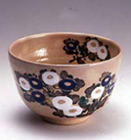
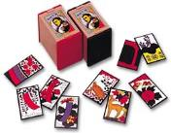
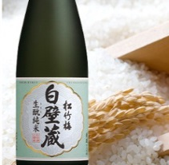






A City of High-tech Companies with Traditional Craftsmanship
7

Slide 8
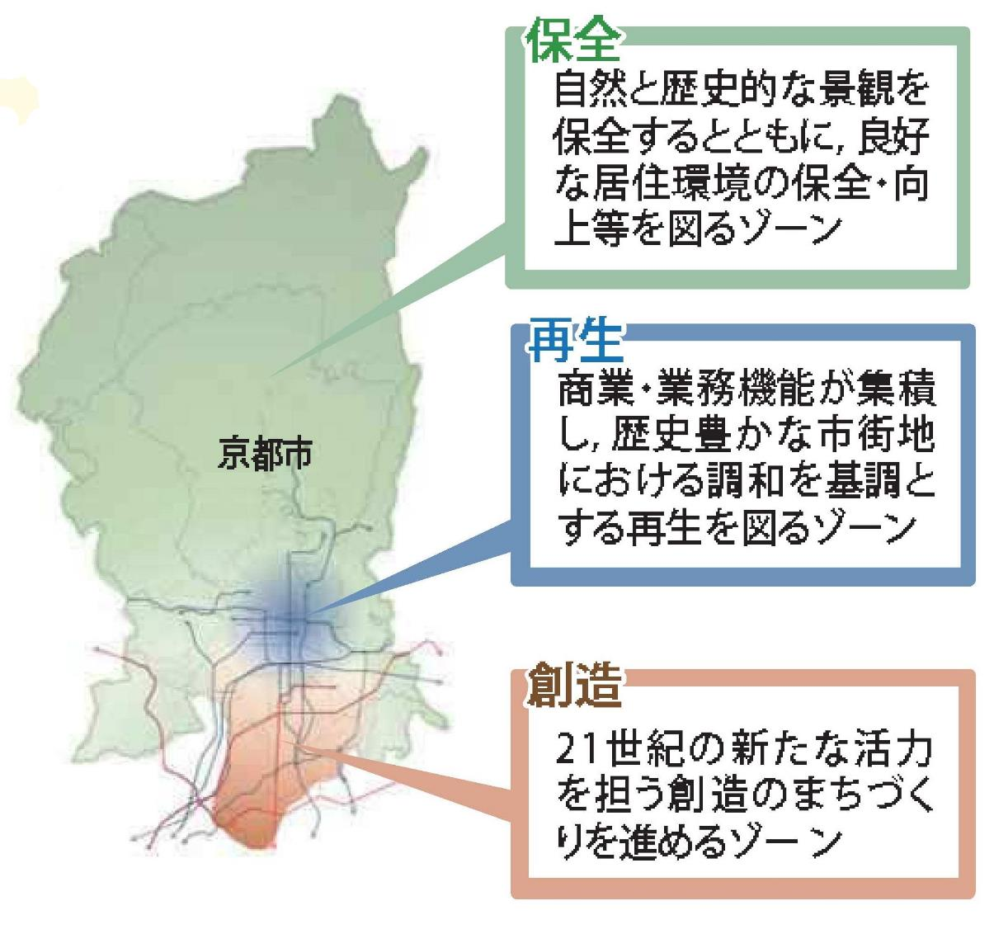
City Planning Policy
● Promote a creative urban development, preserving the “uniqueness of landscape” of Kyoto.
● In 2023, the city planning was extensively revised mainly for the “Creation Zone.” (i.e. Restrictions on building volume)
Conservation Zone
A zone to conserve and enhance good living environment, preserving nature and historical landscapes.
Revitalization Zone
A historic area to be revitalized in harmony with commercial and business facilities.
Kyoto City
● Promote urban development and create a wide variety of workplaces, constructing modern office buildings and renovating Kyo-machiya townhouses.
● Aim for a business city which attracts people from around the world.
Mountainous
Area
KYOTO
station
Creation Zone
A zone for a creative urban development to create a new drive for the 21st century.
8

Slide 9
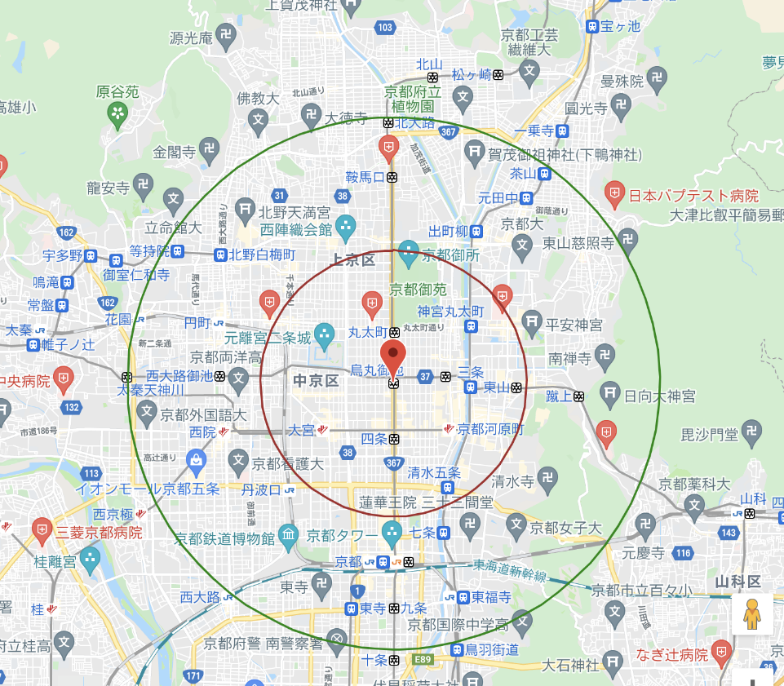
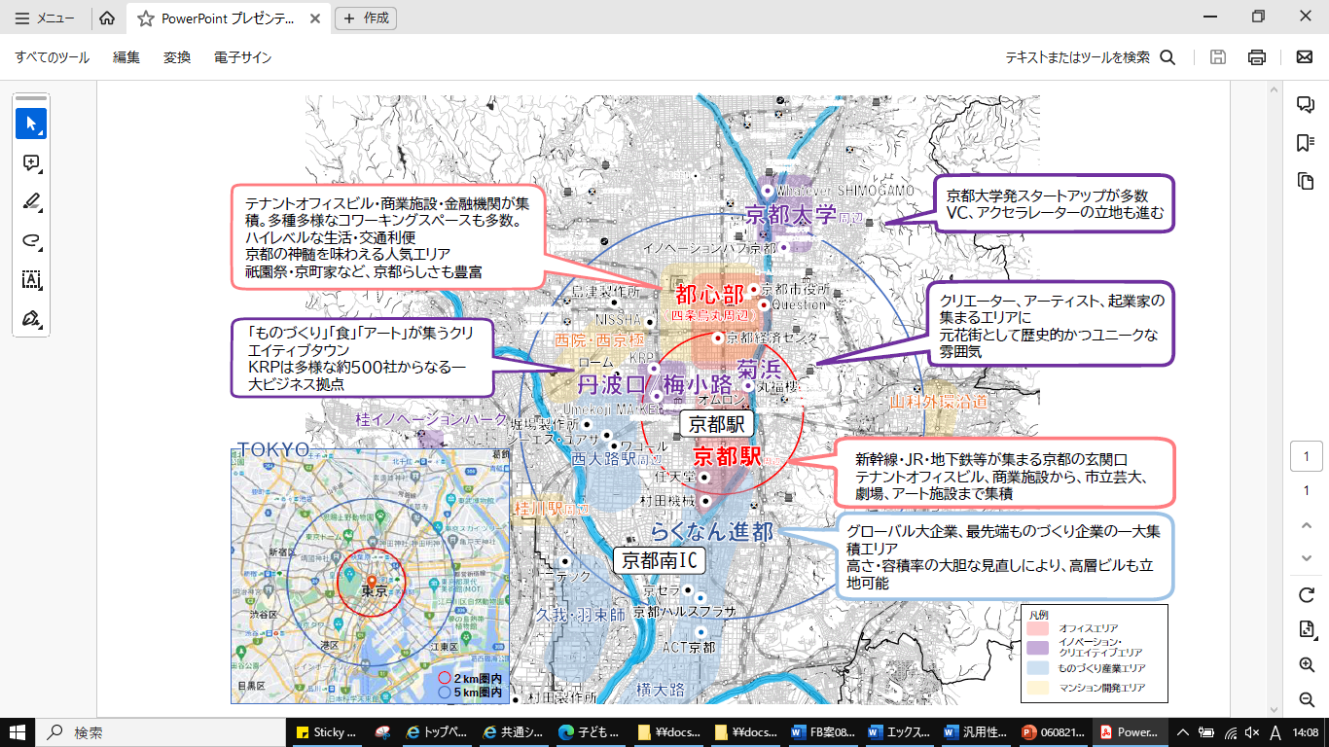
A Compact City
The city center is packed within a 4 km radius, that can be travelled within 30 minutes by bicycle. It is an administrative and economic center, offering easy access to cultural property and nature.
Kyoto University
Kyoto Imperial Palace
Office Area
Areas
Office Area
Innovation and Creative Area
Business Base
Monozukuri Industry Area
Condominiums Development Area
Kyoto Station
2km
4km
Source: Google maps
Kamo River

Slide 10
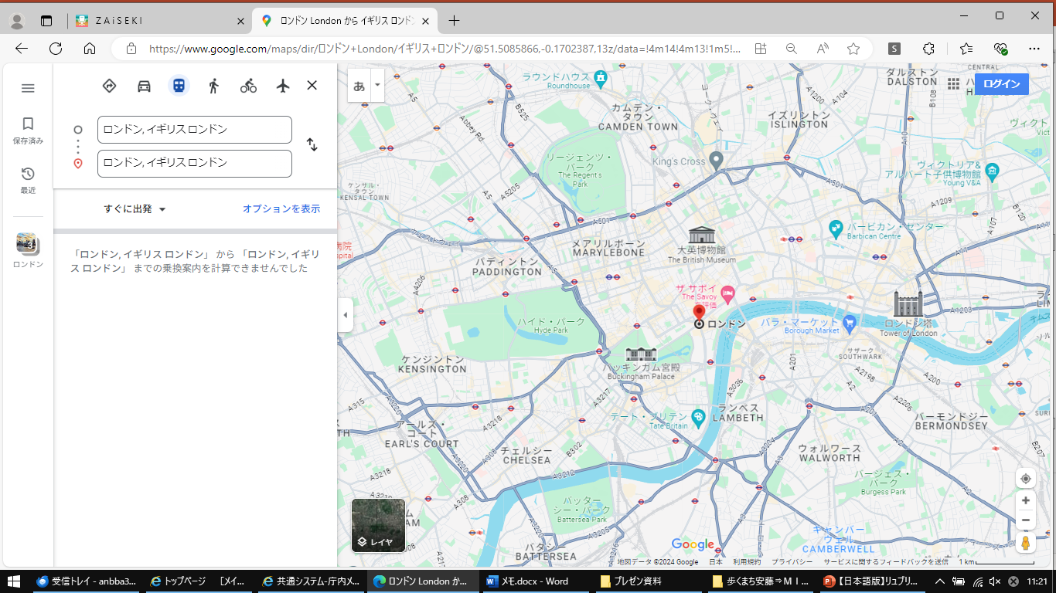
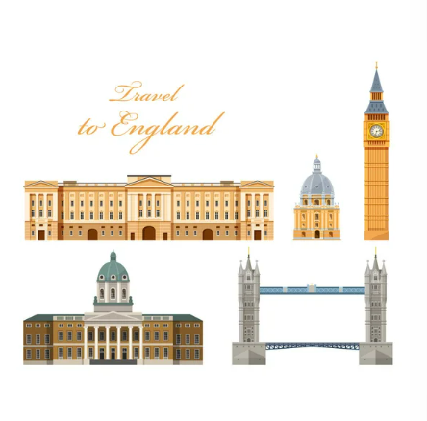

London
2 km radius: Business district, shops, and tourist attractions
4 km radius: Approximately the same size as Zone 1 of the London Underground
Westminster Abbey
Big Ben
The British Museum
London
London Bridge
St. Paul’s Cathedral
Buckingham Palace
2km
4km
Source: Google maps

Slide 11
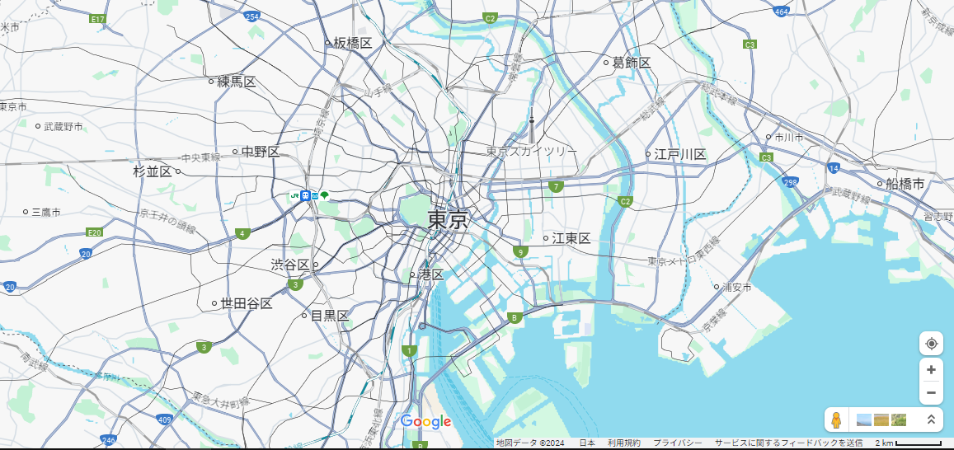
Comparison to Tokyo
The 2km radius called the “Central 3 Wards” is the political and financial center of Japan, with few residents. The 8 km radius includes sub-center with commercial areas.
Tokyo Skytree
Tokyo
Shibuya
2km
4km
8km
Source: Google maps

Slide 12
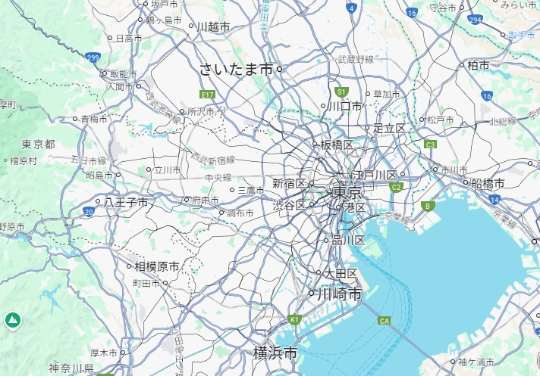
Greater Tokyo Area
Tokyo metropolitan area extends 40 km and forms a metropolitan megalopolis.
Tokyo FC Stadium
Tokyo Disney Land
Tama City
2km
4km
8km
10km
20km
40km
Source: Google maps

Slide 13
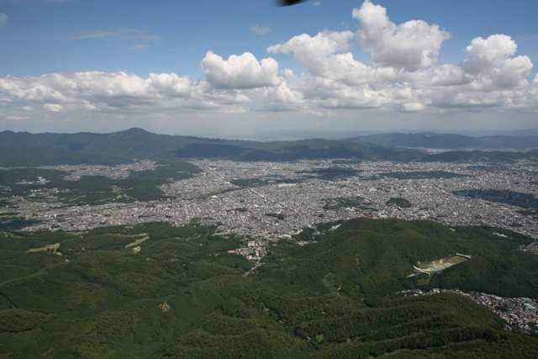
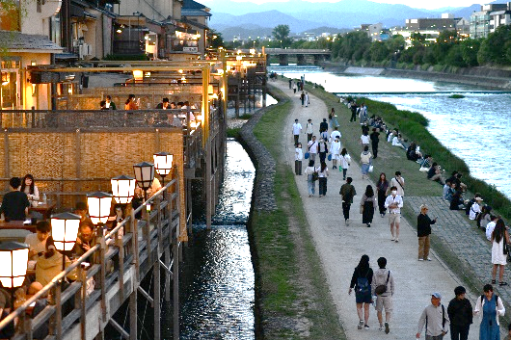
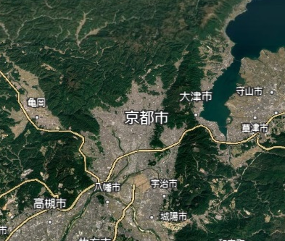
Walk and Enjoy Kyoto’s Nature
The Kamo River, which runs through the city, is a place for relaxation for citizens.
Kyoto Basin surrounded by mountains
Kyoto City
©KYOTO IMAGE BANK
Uji City
The Kamo River at the city center
Source: Google Earth

Slide 14
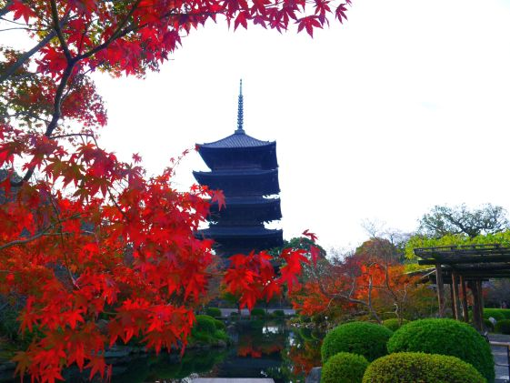
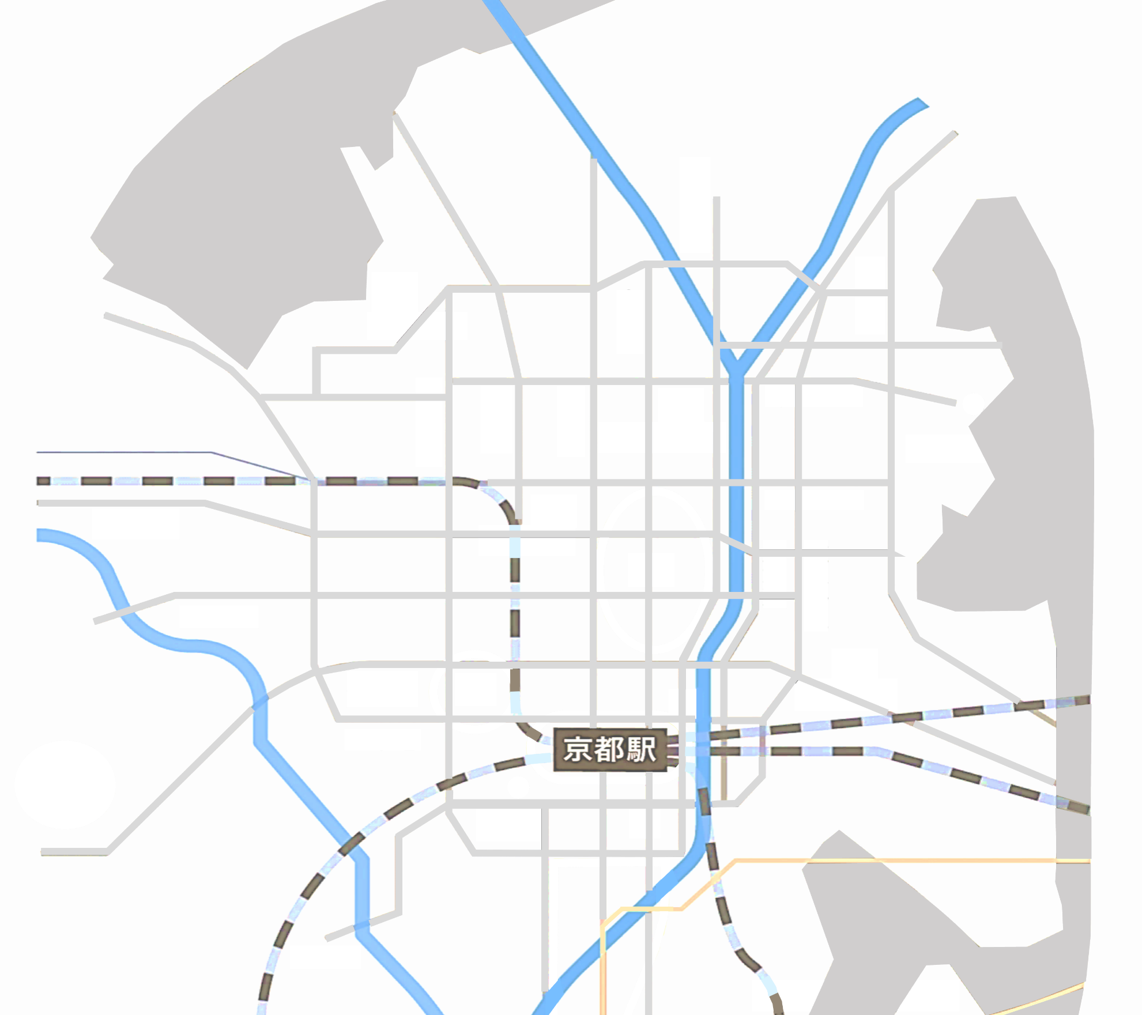
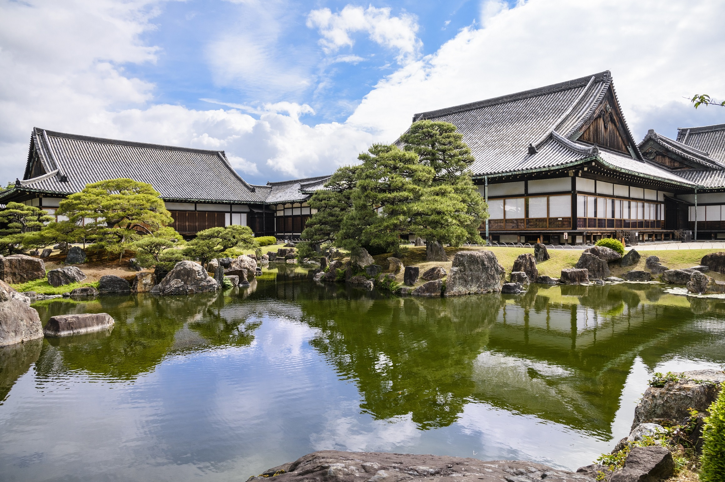
Walk and Enjoy Kyoto’s History
14 UNESCO World Heritage Sites
around the city.
To-ji Temple
Kamigamo-jinja Shrine
Kosan-ji Temple
Shimogamo-jinja Shrine
Kinkaku-ji Temple
Ryoan-ji Temple
Ninna-ji Temple
千本通
堀川通
烏丸通
河原町通
今出川通
Ginkaku-ji Temple
©To-ji Temple (Kyo-ou-gokoku-ji Temple)
Tenryu-ji Temple
西大路通
Nijo-jo Castle
川端通
丸太町通
天神川通
御池通
Nijo-jo Castle
東大路通
四条通
Kiyomizu-dera Temple
Koke-dera Temple
Nishi Hongwan-ji Temple
五条通
七条通
九条通
Kyoto Station
十条通
国道1号
To-ji Temple
Daigo-ji Temple
2km
4km
©Nijo-jo Castle Office

Slide 15
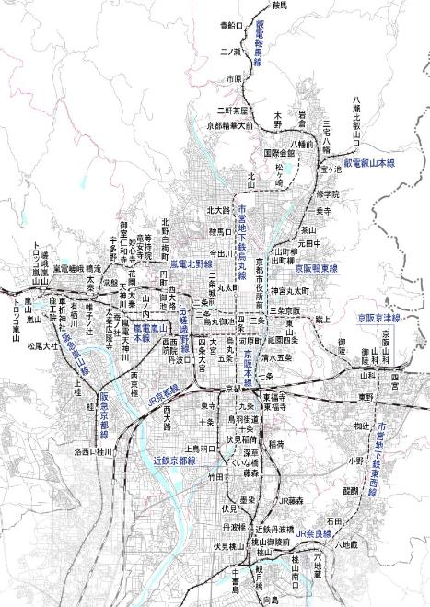
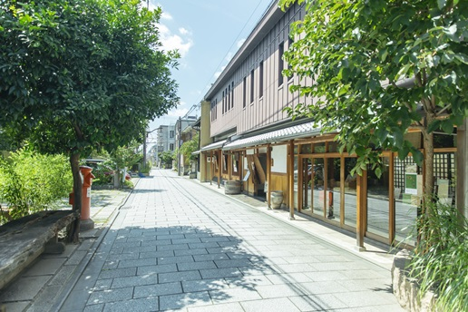
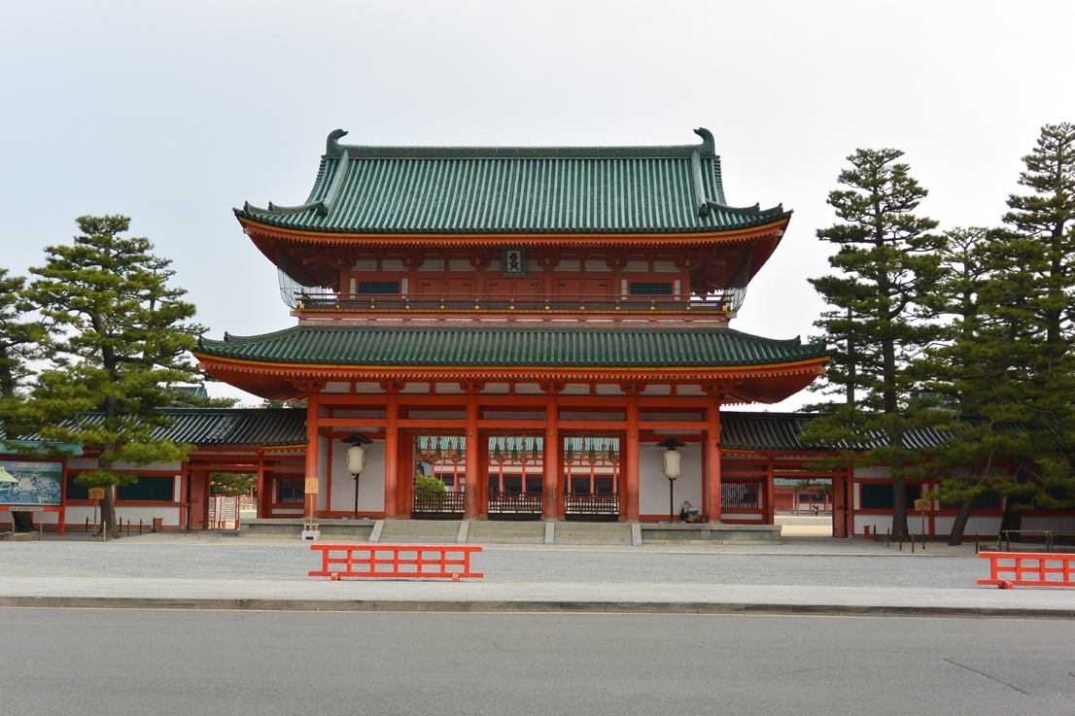
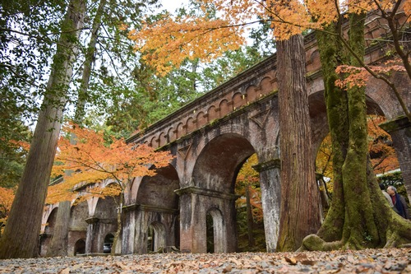
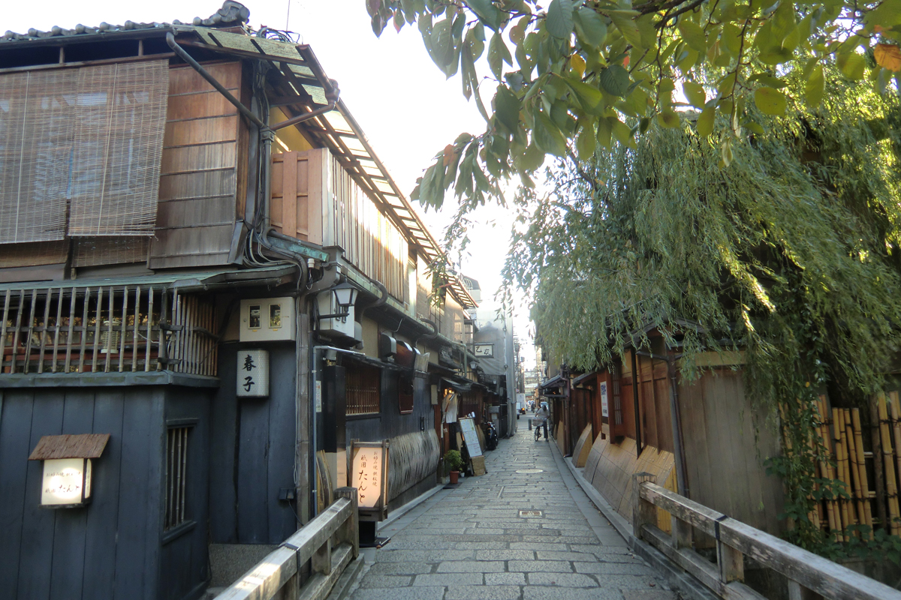
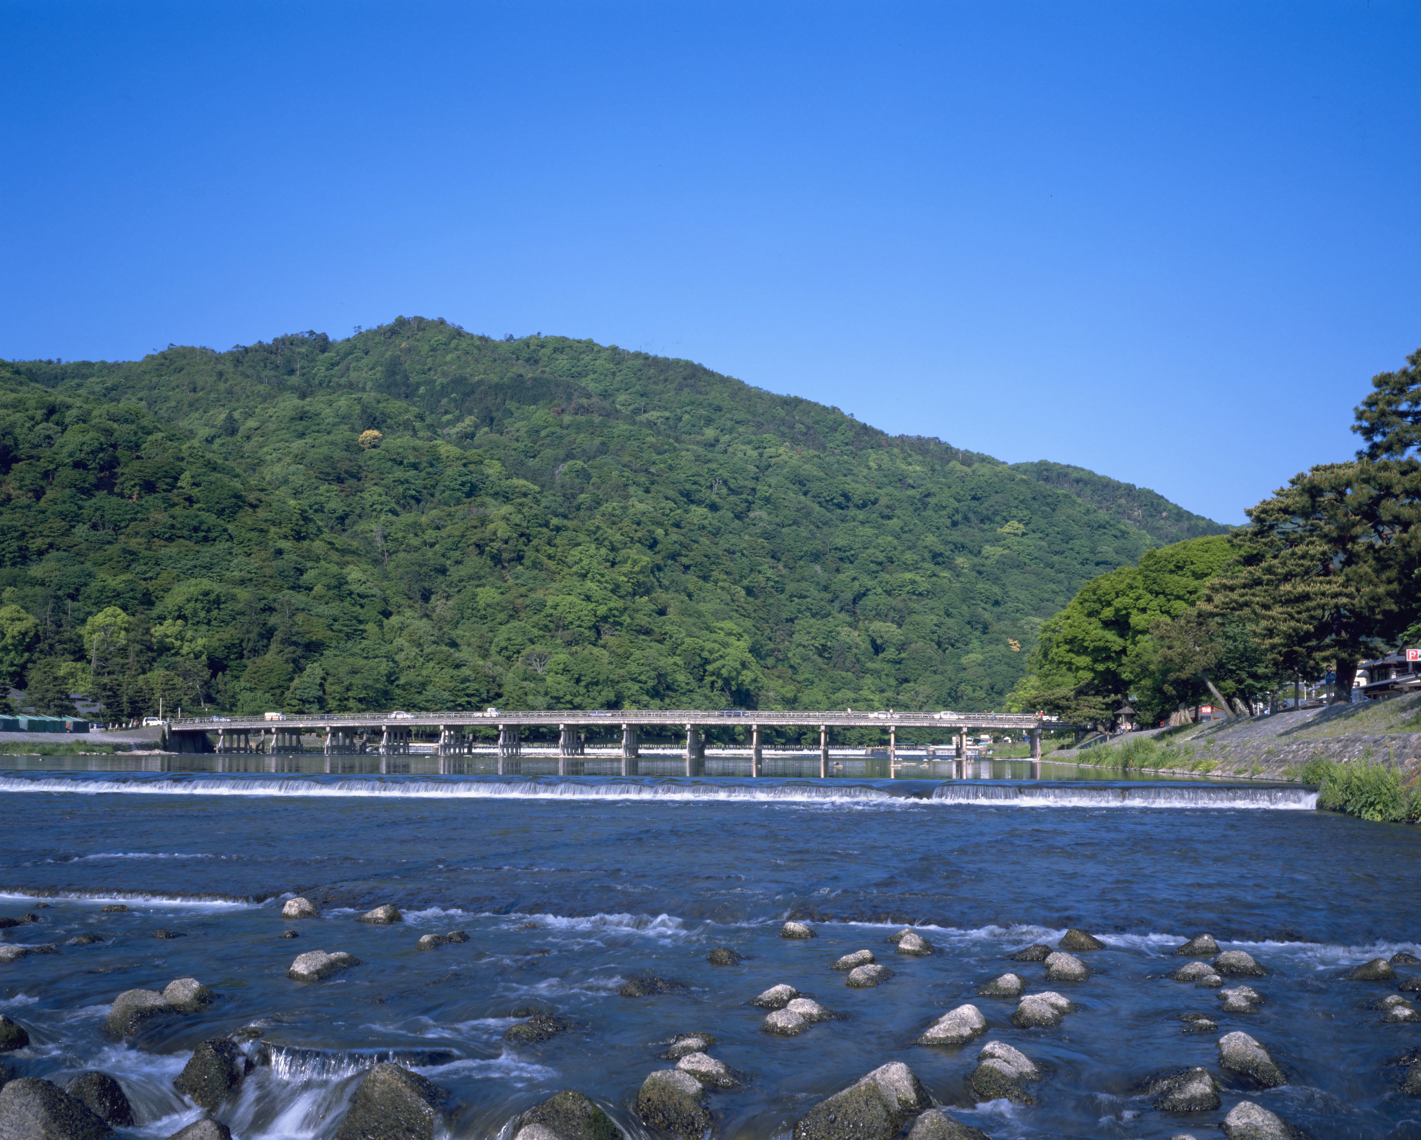
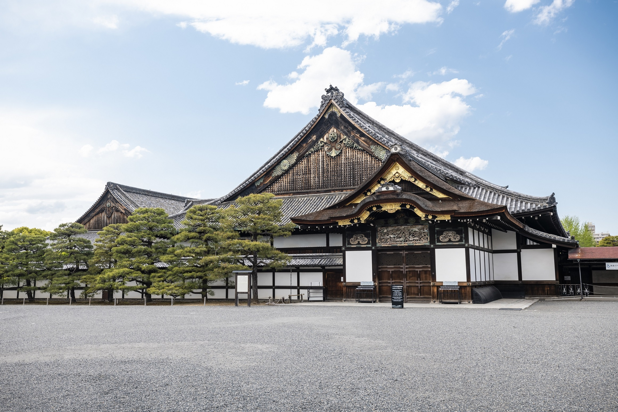
Places to Experience Kyoto’ s History of a Thousand Years
©Kyoto Media Support Center
©Heian Jingu Shrine
Nishijin
Heian Jingu Shrine
©Water Supply and Sewerage Bureau, City of Kyoto
Nanzen-ji Temple Suirokaku Aqueduct
Gion
Saga Aarashiyama
Nijo-jo Castle
To-ji Temple
©Kyoto Media Support Center
©KYOTO IMAGE BANK
2km
4km
©Nijo-jo Castle Office
©To-ji Temple (Kyo-ou-gokoku-ji Temple)

Slide 16
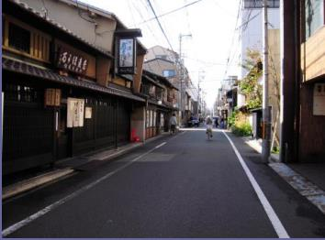
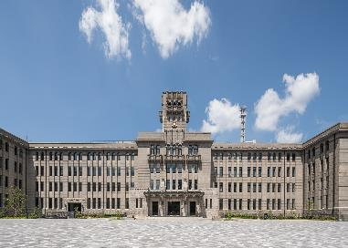
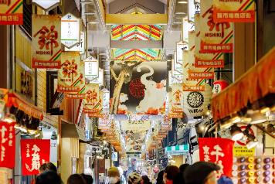
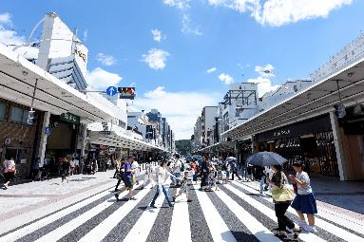
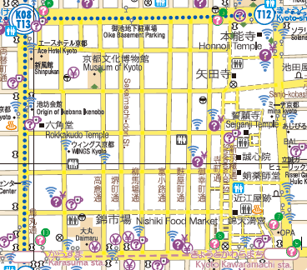
Places to Visit in the City Center
2km
4km
今出川通
Aneyakoji-dori Street
Kyoto City Hall
西大路通
千本通
堀川通
烏丸通
河原町通
川端通
丸太町通
天神川通
御池通
東大路通
四条通
五条通
七条通
九条通
十条通
国道1号
Nishiki Market
Shijo-dori Street
Tanoji District*
*The area bounded by main streets, Oike-dori to the north, Gojo-dori to the south, Horikawa-dori to the east and Kawaramachi-dori to the west, forming the kanji character for a paddy field.

Slide 17

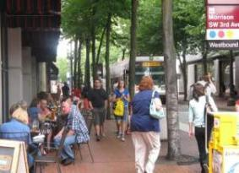
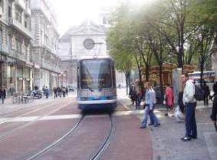
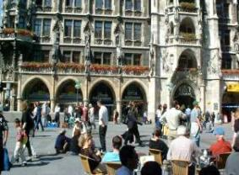
Kyoto’s Strategy for Urban Mobility
■ Japan became a “car-dependent society,” during the post-war rapid economic growth.
  ・ Urban development based on the use of cars
  ・ Large shopping centers constructed in the suburbs
  ・ Private cars became necessities of life.
■ Around the world, “society with the priority given to pedestrians and public transportation” was created.
  ・ By discouraging the use of private cars and encouraging the use of public transportation, cities developed as sustainable ones attracting more people to the town and creating a bustle.
The global trend is to shift from a “car-dependent society.”
Portland, USA
Grenoble, France
Munich, Germany
17

Slide 18





“Walkable Kyoto Strategy (2010)”
Basic Principles
Car-oriented city
Walkable City
Target
・A world-class accessible public transportation system
・A town filled with attractions for walking
・Each individual values walking in a daily life.
18

Slide 19
Decrease in the Percentage of Tourists to Kyoto
by Private Cars
1994
2010
2023
42％
29％
9％
19

Slide 20
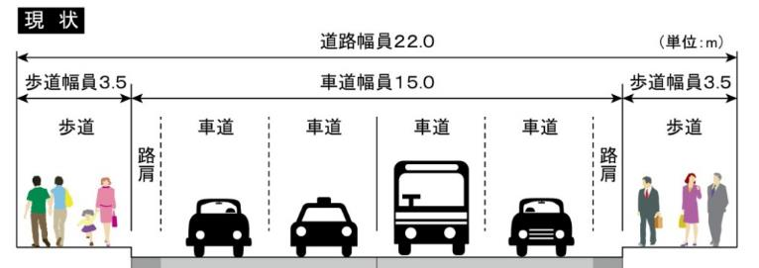
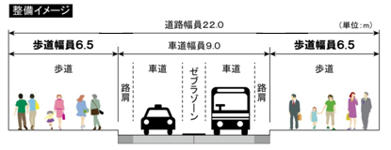
Project to Widen Sidewalks on the Shijo-dori Street
■ Outline
● Lane Specifications
Before
Road breadth 22.0
(Unit: m)
3.5
Roadway breadth 15.0
3.5
Sidewalk
Roadway
Roadway
Roadway
Roadway
Sidewalk
Shoulder
Shoulder
After
Road breadth 22.0
(Unit: m)
6.5
Roadway breadth 9.0
6.5
Sidewalk
Roadway
Zebra Zone
Roadway
Sidewalk
Shoulder
Shoulder
Notes:
20

Slide 21
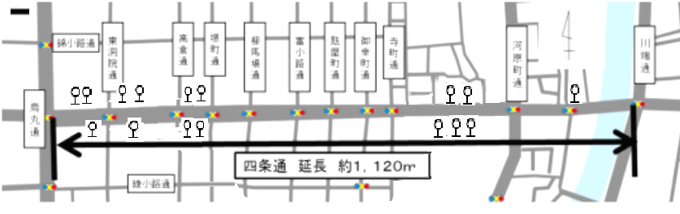
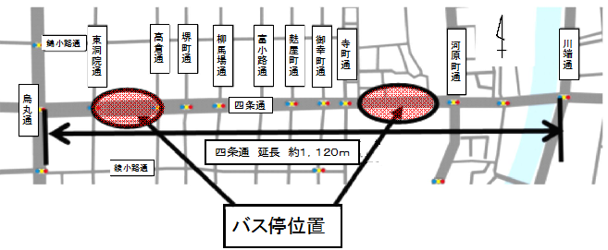
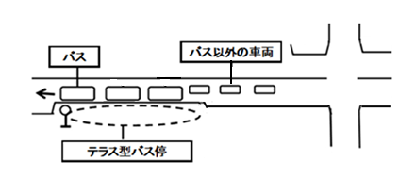
Project to Widen Sidewalks on the Shijo-dori Street
■ Outline
● Introduced a terraced bus stop where several buses can stop at a time.
Before
16 bus stops were dispersed.
Consolidated at two areas: Shijo Kawaramachi and Shijo Takakura
(4 terraced bus stops in total)
After
Bus
Other vehicles
Terraced Bus Stop
Terraced Bus Stops

Slide 22
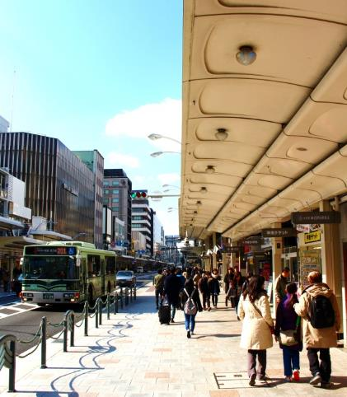
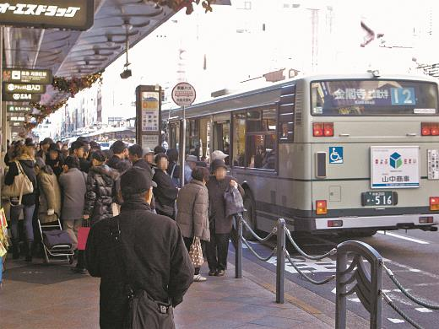
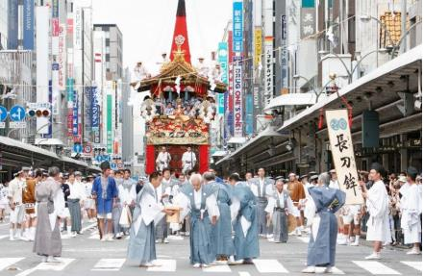
Project to Widen Sidewalks on the Shijo-dori Street
■ Changes in the Walking Environment
After （2015.11～）
Before （～2015.10）
2009
2018
Notes:
22

Slide 23
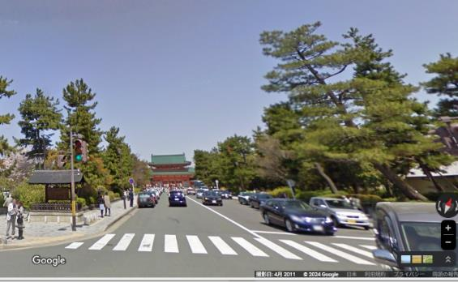
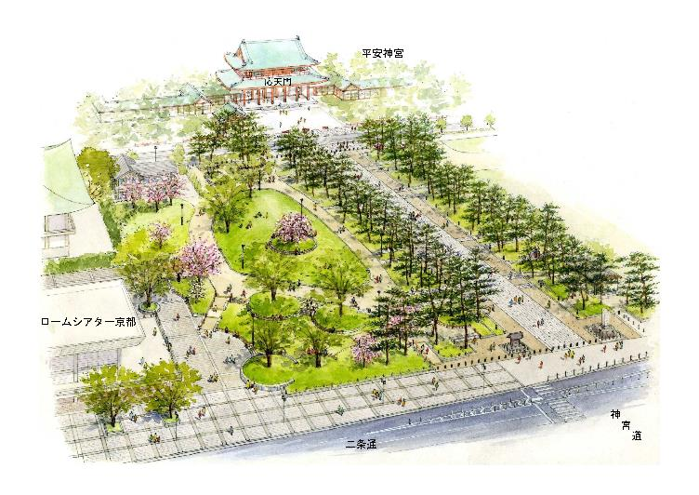
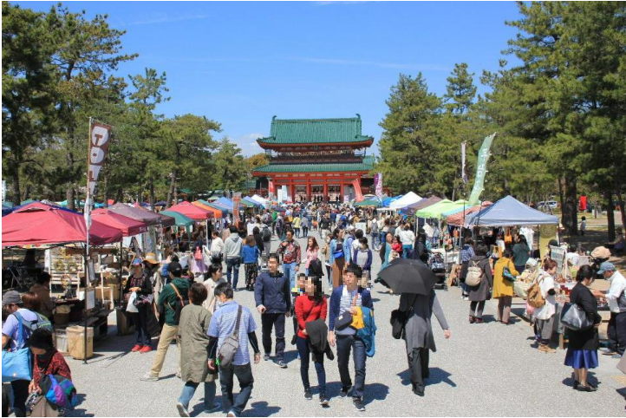
Redevelopment of the Jingu-michi Street and Okazaki Park (Okazaki Promenade)
● Created an integrated space of the street and the park area, preserving green space.
● Created vast open-space and shaped an excellent landscape.
● Built with consideration of the environment and universal design.
Before （～2015.8）
©︎Google
After （2015.9 ～ ）
※Image

Slide 24
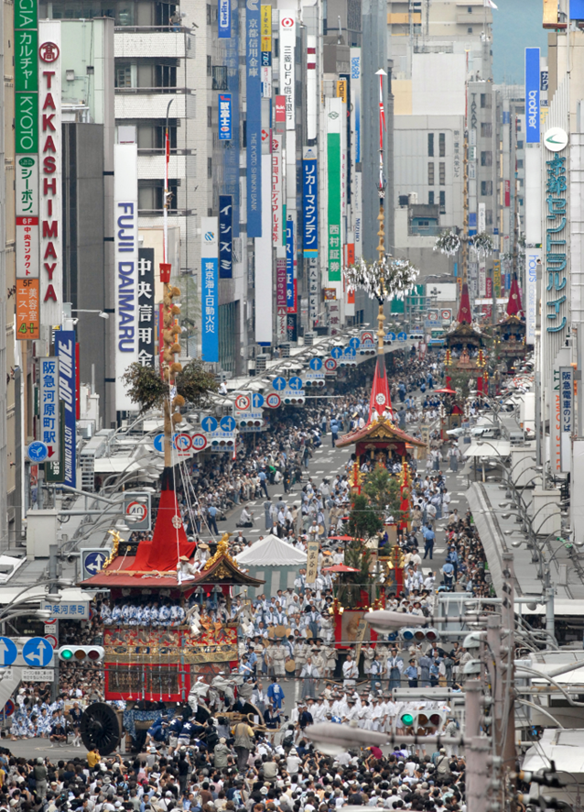
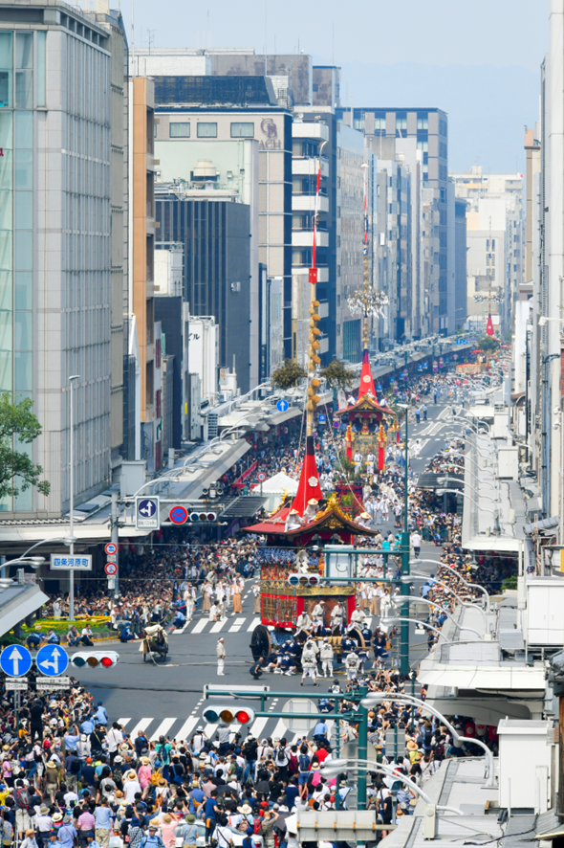
Aim for a Walkable City
– Restrictions on Outdoor Advertisement
■ Shijo-dori Street
2007
2018
Image Credit: The Kyoto Shimbun Co., Ltd.

Slide 25


Aim for a Walkable City
– Restrictions on Outdoor Advertisement
■ Pontocho Alley
2011
2021

Slide 26



Our Challenges
■ Traditional Landscape
Kyo-machiya townhouse, a symbol of Kyoto’s history, culture, and townscape
Kamishichiken
Gion Shinbashi
©KYOTO IMAGE BANK
©Kyoto Media Support Center
Hanamikoji
©KYOTO IMAGE BANK

Slide 27
Our Challenges
■ Traditional Landscape
UNESCO World Heritage Sites, and many temples and shrines
©Heian Jingu Shrine

Slide 28


Our Challenges
● Regulations are not yet adequately established in urban planning.
●Traditional townhouses have been demolished to build commercial buildings due to change of owners.
● Beautiful traditional townscapes are destroyed by new buildings.

Slide 29
Summary
To make Kyoto an
“Outstanding Global City”
◆ How can Kyoto‘s unique beauty be preserved?
● Conservation and preservation of traditional townscapes.
●How can we prevent undisciplined development that may spoil our traditional landscape?
◆ Accelerate the attraction of diverse people and businesses.
◆ Aim for a city where all people can experience the richness of life and the liveliness of the town, by continuing to refine Kyoto’s attractiveness.

