Slide 1
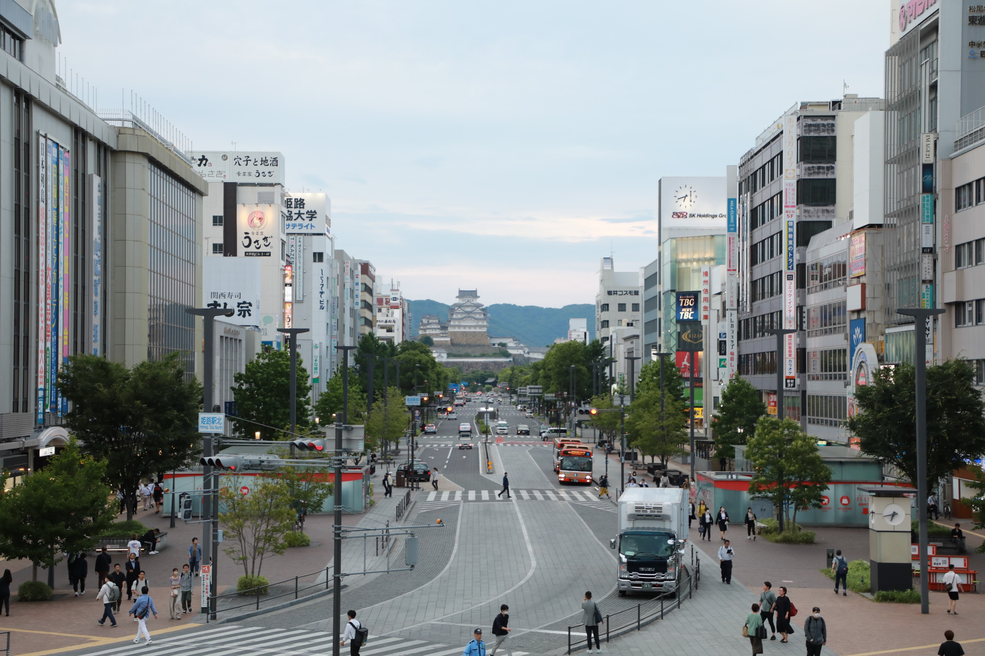
19th World Conference of Historical Cities: Roundtable
Walkability in Himeji City
Beginning with One Main Street
Hideyasu Kiyomoto, Mayor of Himeji City
Tuesday, November 12, 2024

Slide 2

1. Japan’s “Walking” Culture
2. The History of Himeji’s Main Street, Otemae-dori Street
3. Walkability Leading to Himeji Castle:
A Street You Want to Walk On
4. Expanding Walkability from Otemae-dori Street:
Connecting to the Next Generation

Slide 3
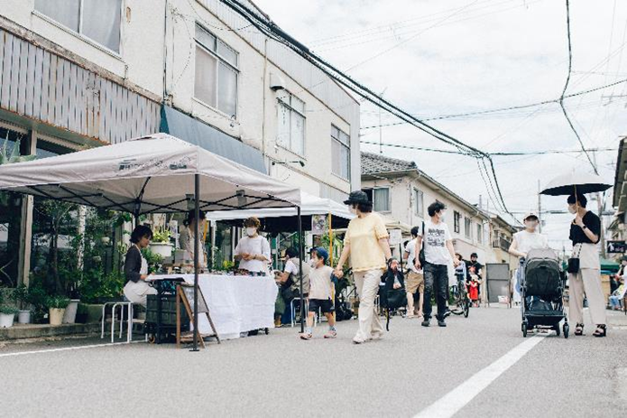
1. Japan’s “Walking” Culture
“We consider walking to be pleasant, healthy and recreational; the Japanese never go for walks and are very surprised to see us do something they consider a chore or a penance”.
Luís Fróis. (1585). The First European Description of Japan.
1500s
1870s
2000s
Walking culture introduced to Japan from the West
Town walking gaining attention

Slide 4
1. Japan’s “Walking” Culture
2. The History of Himeji’s Main Street, Otemae-dori Street
3. Walkability Leading to Himeji Castle:
A Street You Want to Walk On
4. Expanding Walkability from Otemae-dori Street:
Connecting to the Next Generation

Slide 5
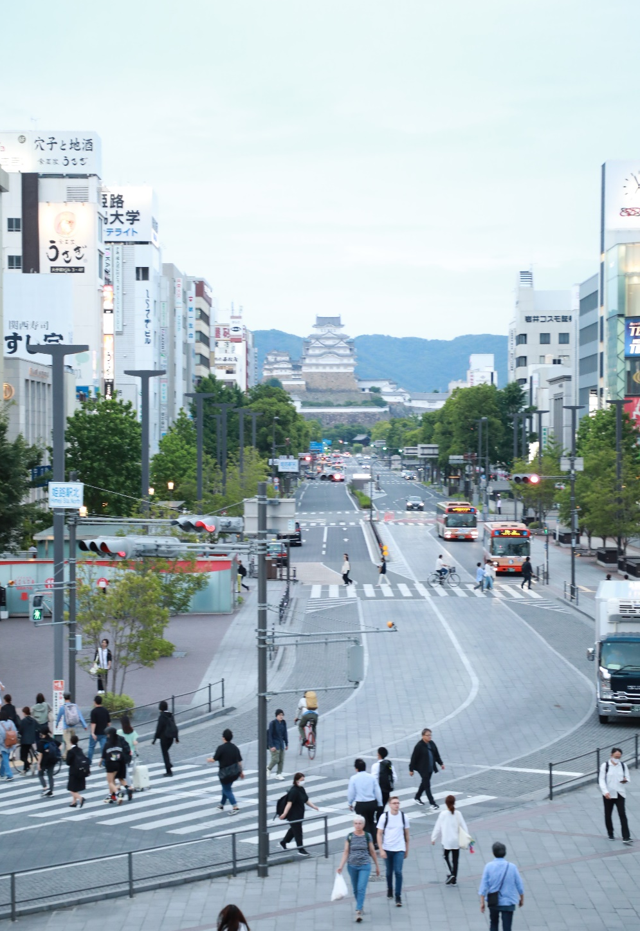
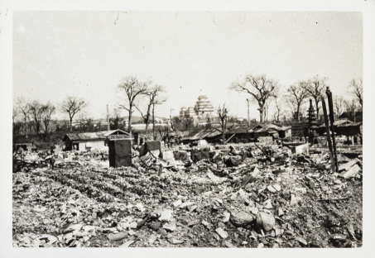
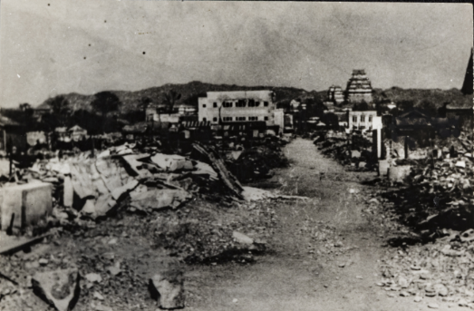
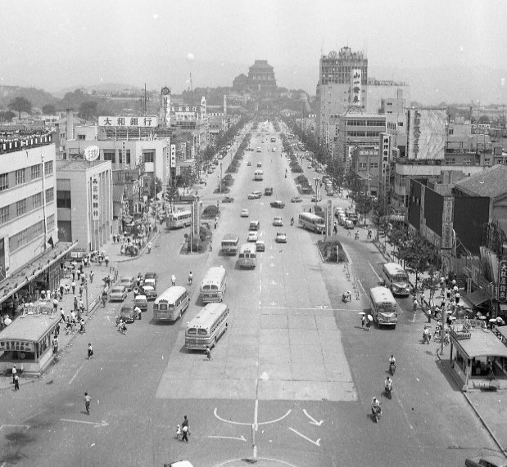
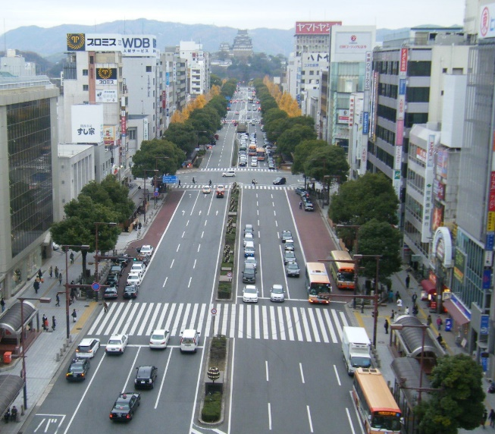
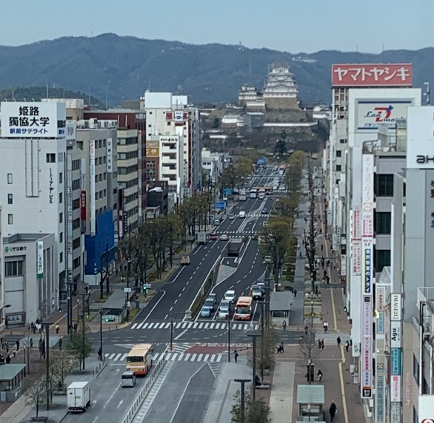
2. The History of Himeji’s Main Street, Otemae-dori Street
1945: The city centre was almost completely destroyed
Photo: Hyogo Prefectural Museum of History Collection (Hidekichi Takahashi Collection)
1955
1988
2020

Slide 6
1. Japan’s “Walking” Culture
2. The History of Himeji’s Main Street, Otemae-dori Street
3. Walkability Leading to Himeji Castle:
A Street You Want to Walk On
4. Expanding Walkability from Otemae-dori Street:
Connecting to the Next Generation

Slide 7
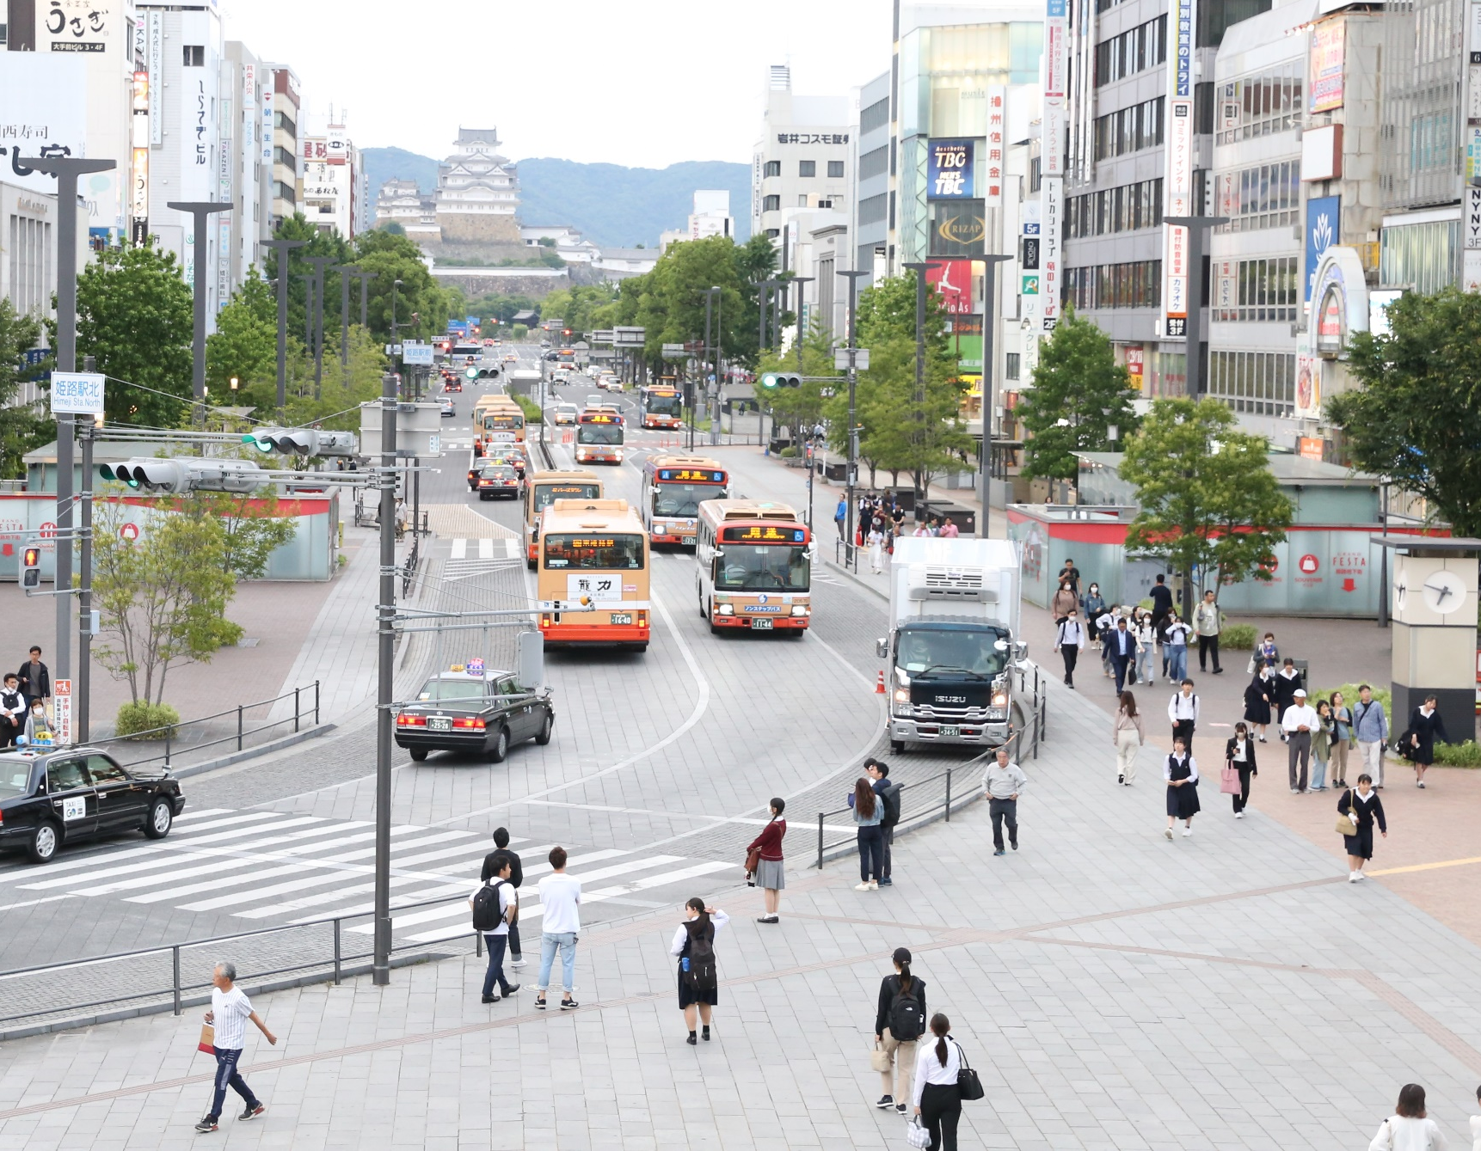
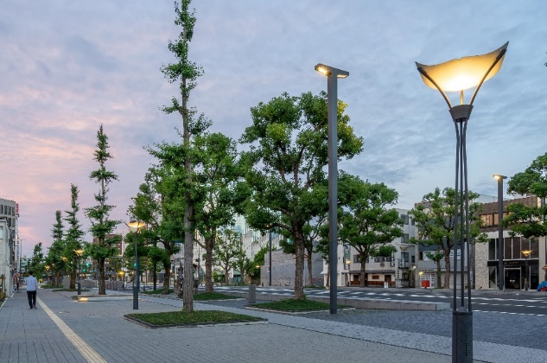
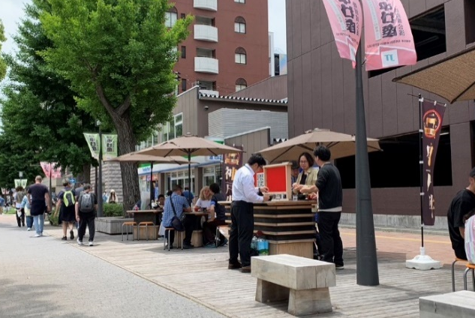
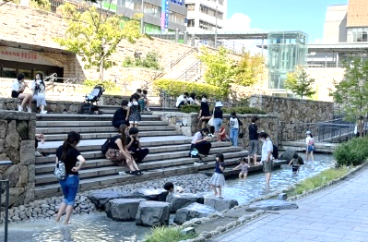
3. Walkability Leading to Himeji Castle: A Street You Want to Walk On
Zoning of Otemae-dori Street
Castle Front Garden Zone
Vibrancy Zone
Hospitality Zone

Slide 8
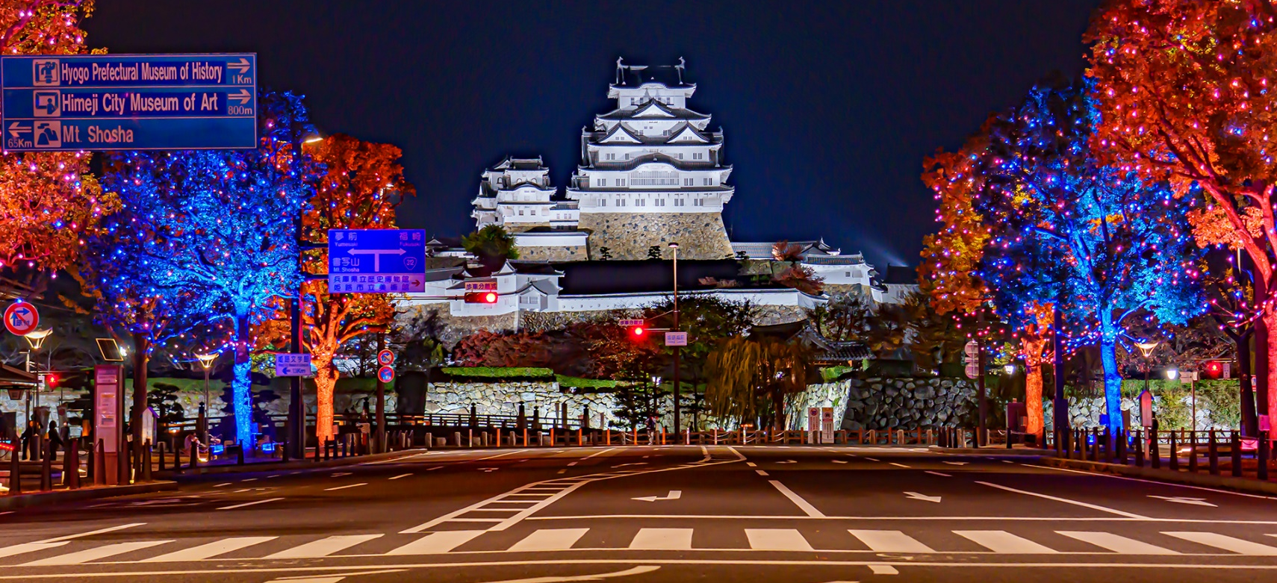
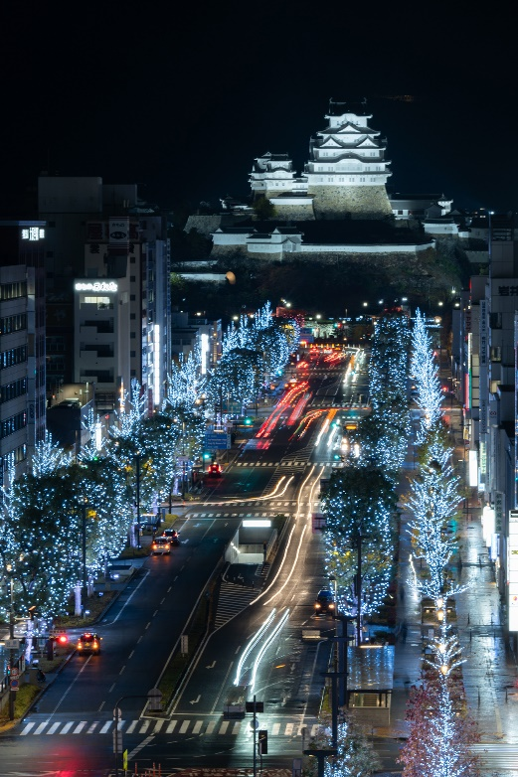
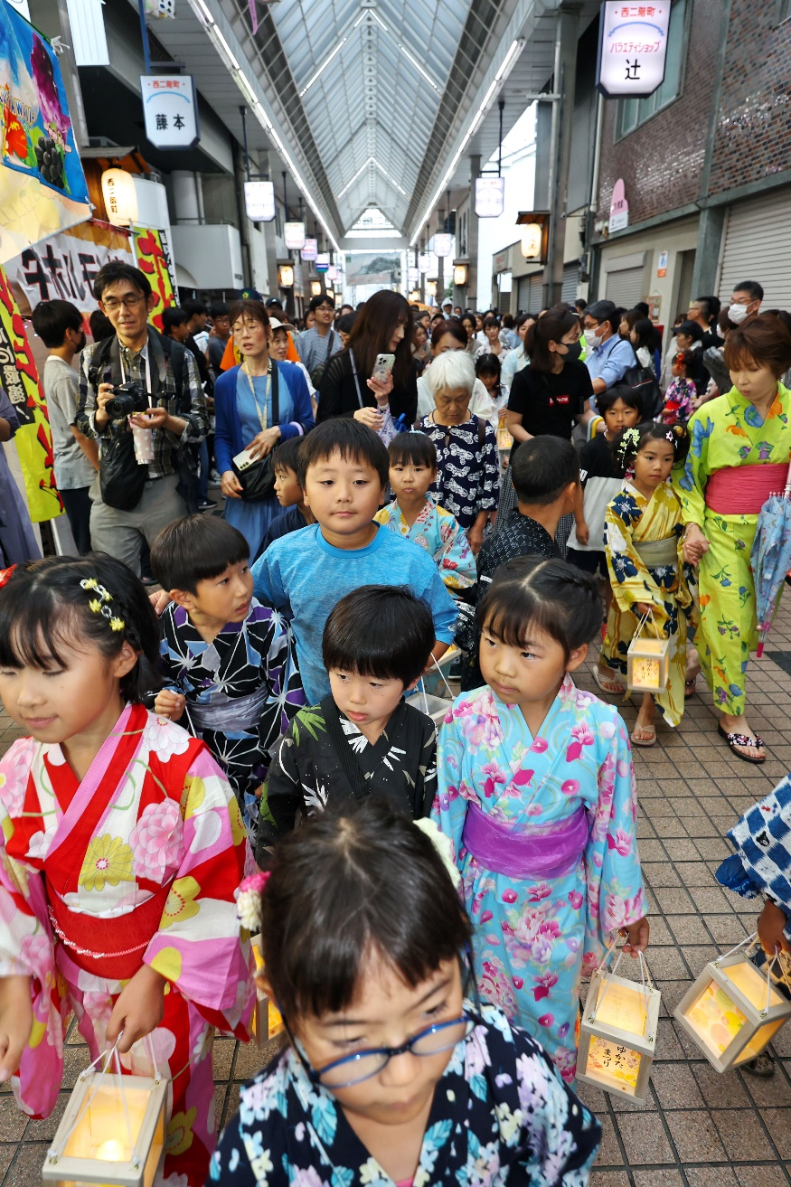
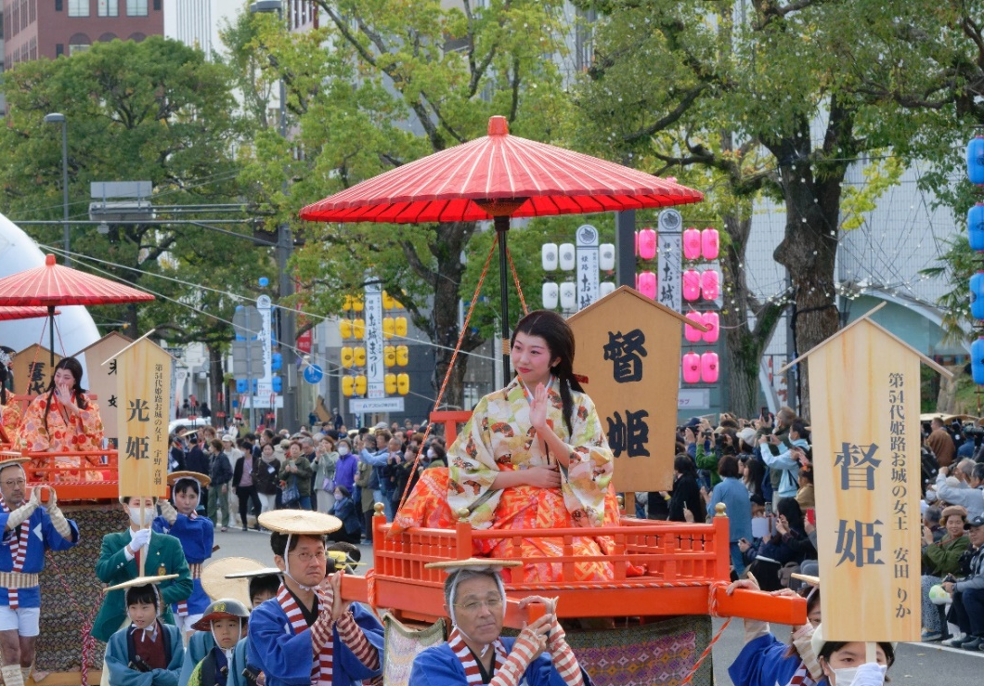
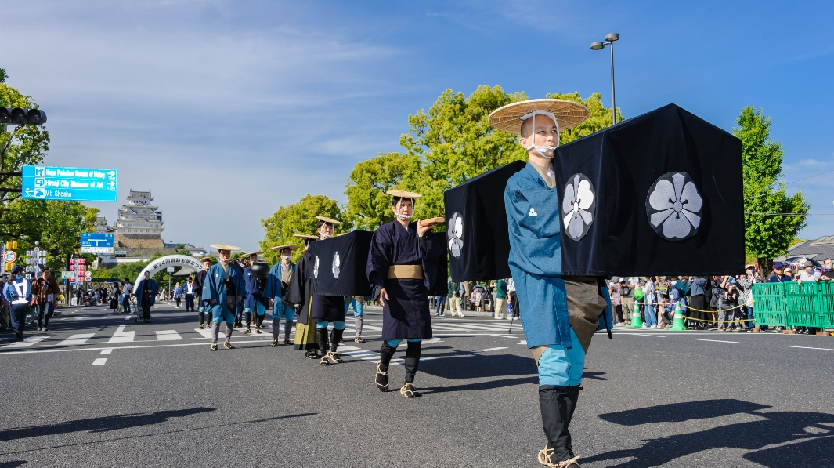
3. Walkability Leading to Himeji Castle: A Street You Want to Walk On
Tourism Events Utilising Otemae-dori Street

Slide 9
1. Japan’s “Walking” Culture
2. The History of Himeji’s Main Street, Otemae-dori Street
3. Walkability Leading to Himeji Castle:
A Street You Want to Walk On
4. Expanding Walkability from Otemae-dori Street:
Connecting to the Next Generation

Slide 10
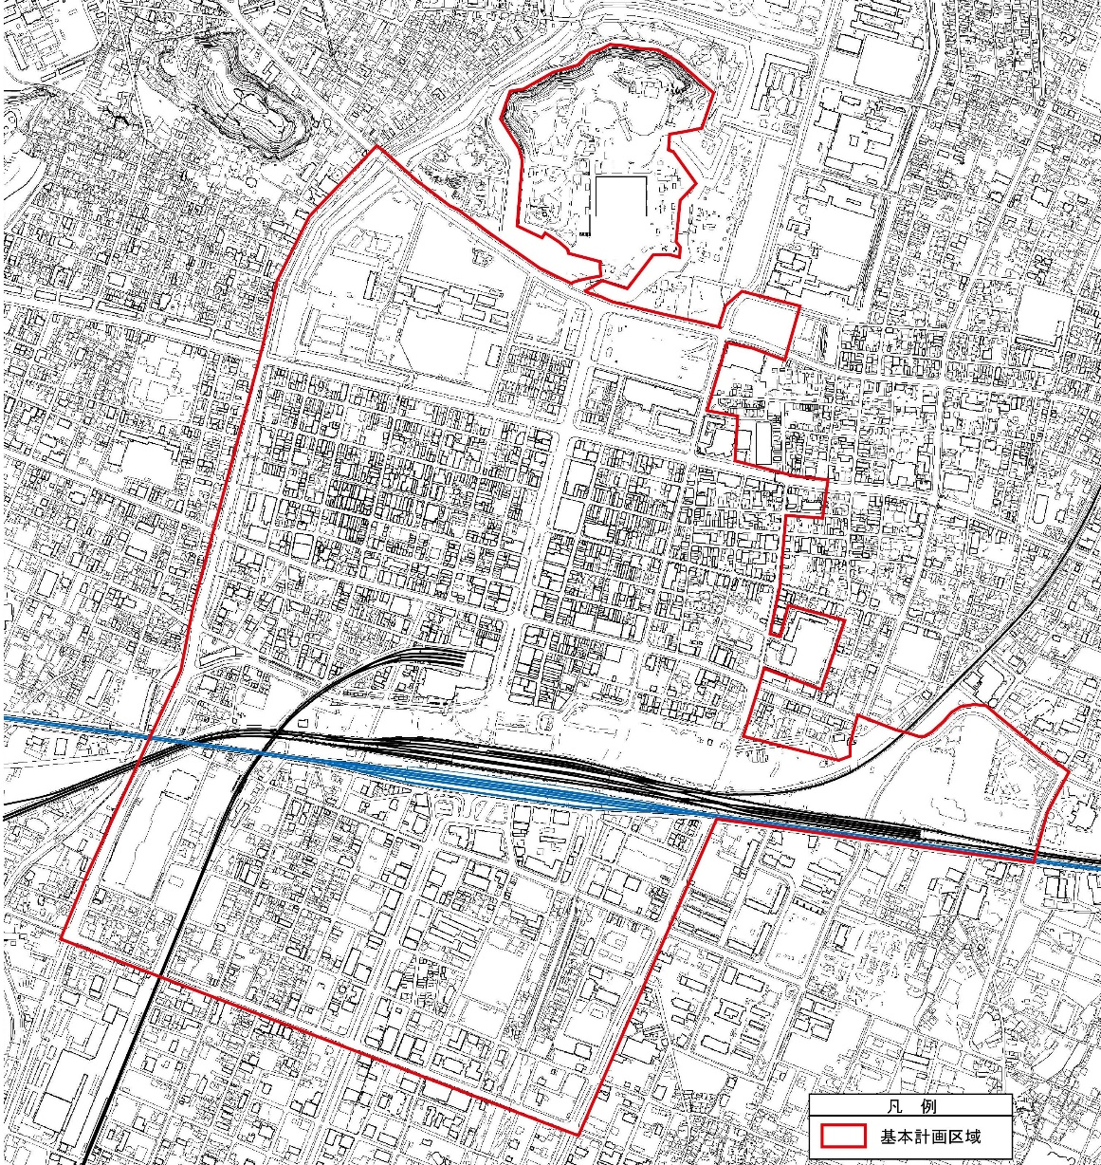
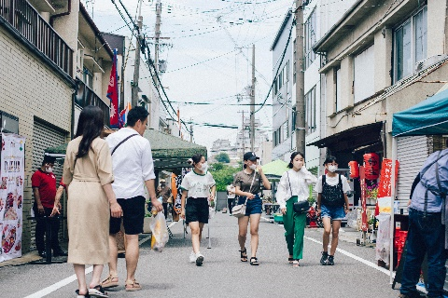
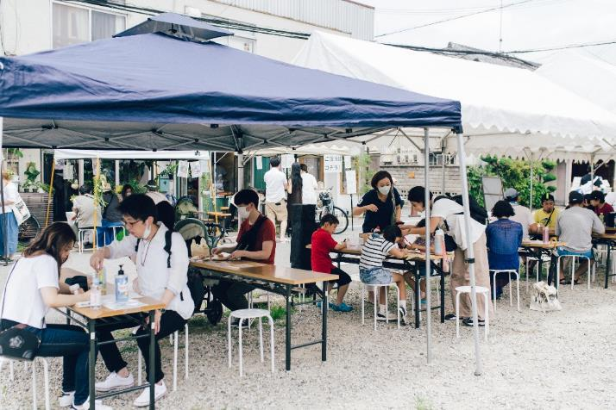
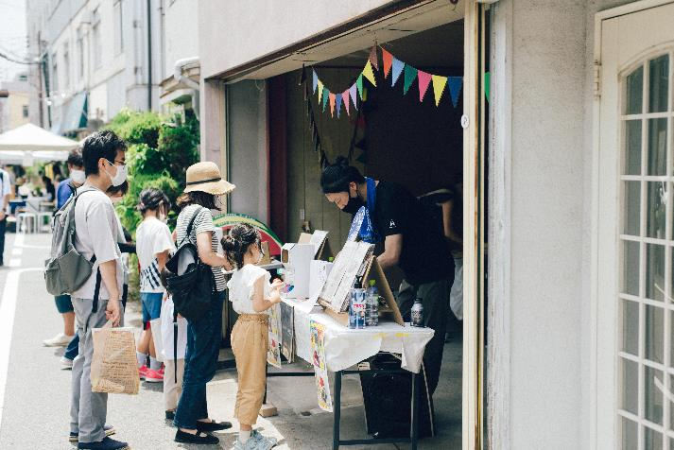
4. Expanding Walkability from Otemae-dori Street: Connecting to the Next Generation
Himeji Castle
Hakurocho
Otemae-dori Street
Himeji Station
― Basic Planning Area

Slide 11
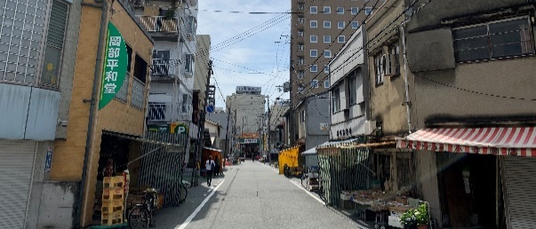
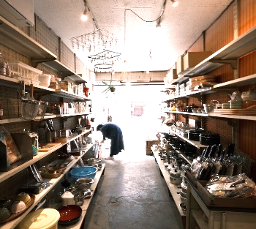
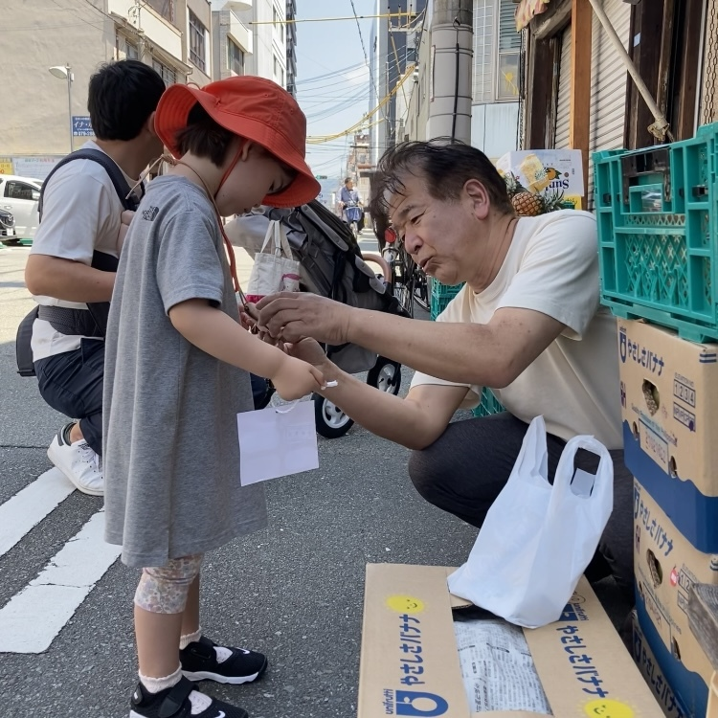
4. Expanding Walkability from Otemae-dori Street: Connecting to the Next Generation
Himeji Castle
Otemae-dori Street
Station West Area
Himeji Station
― Basic Planning Area

Slide 12
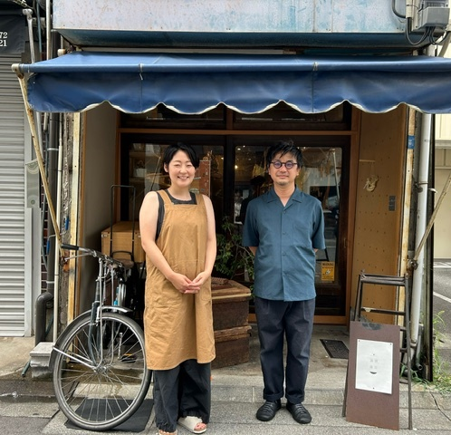
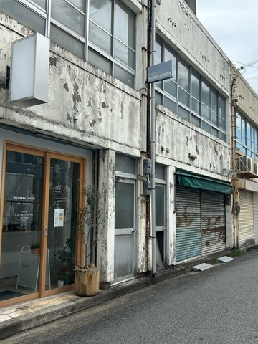
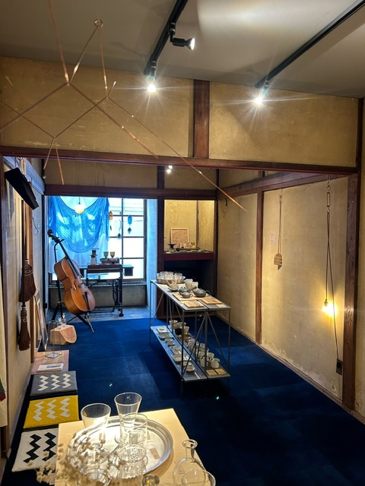
4. Expanding Walkability from Otemae-dori Street: Connecting to the Next Generation
Reflections on Renovation-based Development
Because we took over the entire store,
we were able to smoothly become part of the community.
The connections are still at the stage where they are forming lines from dots.
We hope to work together with other areas to create a broader and more extensive network.

Slide 13
Finally...
Walkability
The history and culture protected by the residents
For the next generation
Comfortable and enjoyable paths to walk
The community’s thoughts

Slide 14
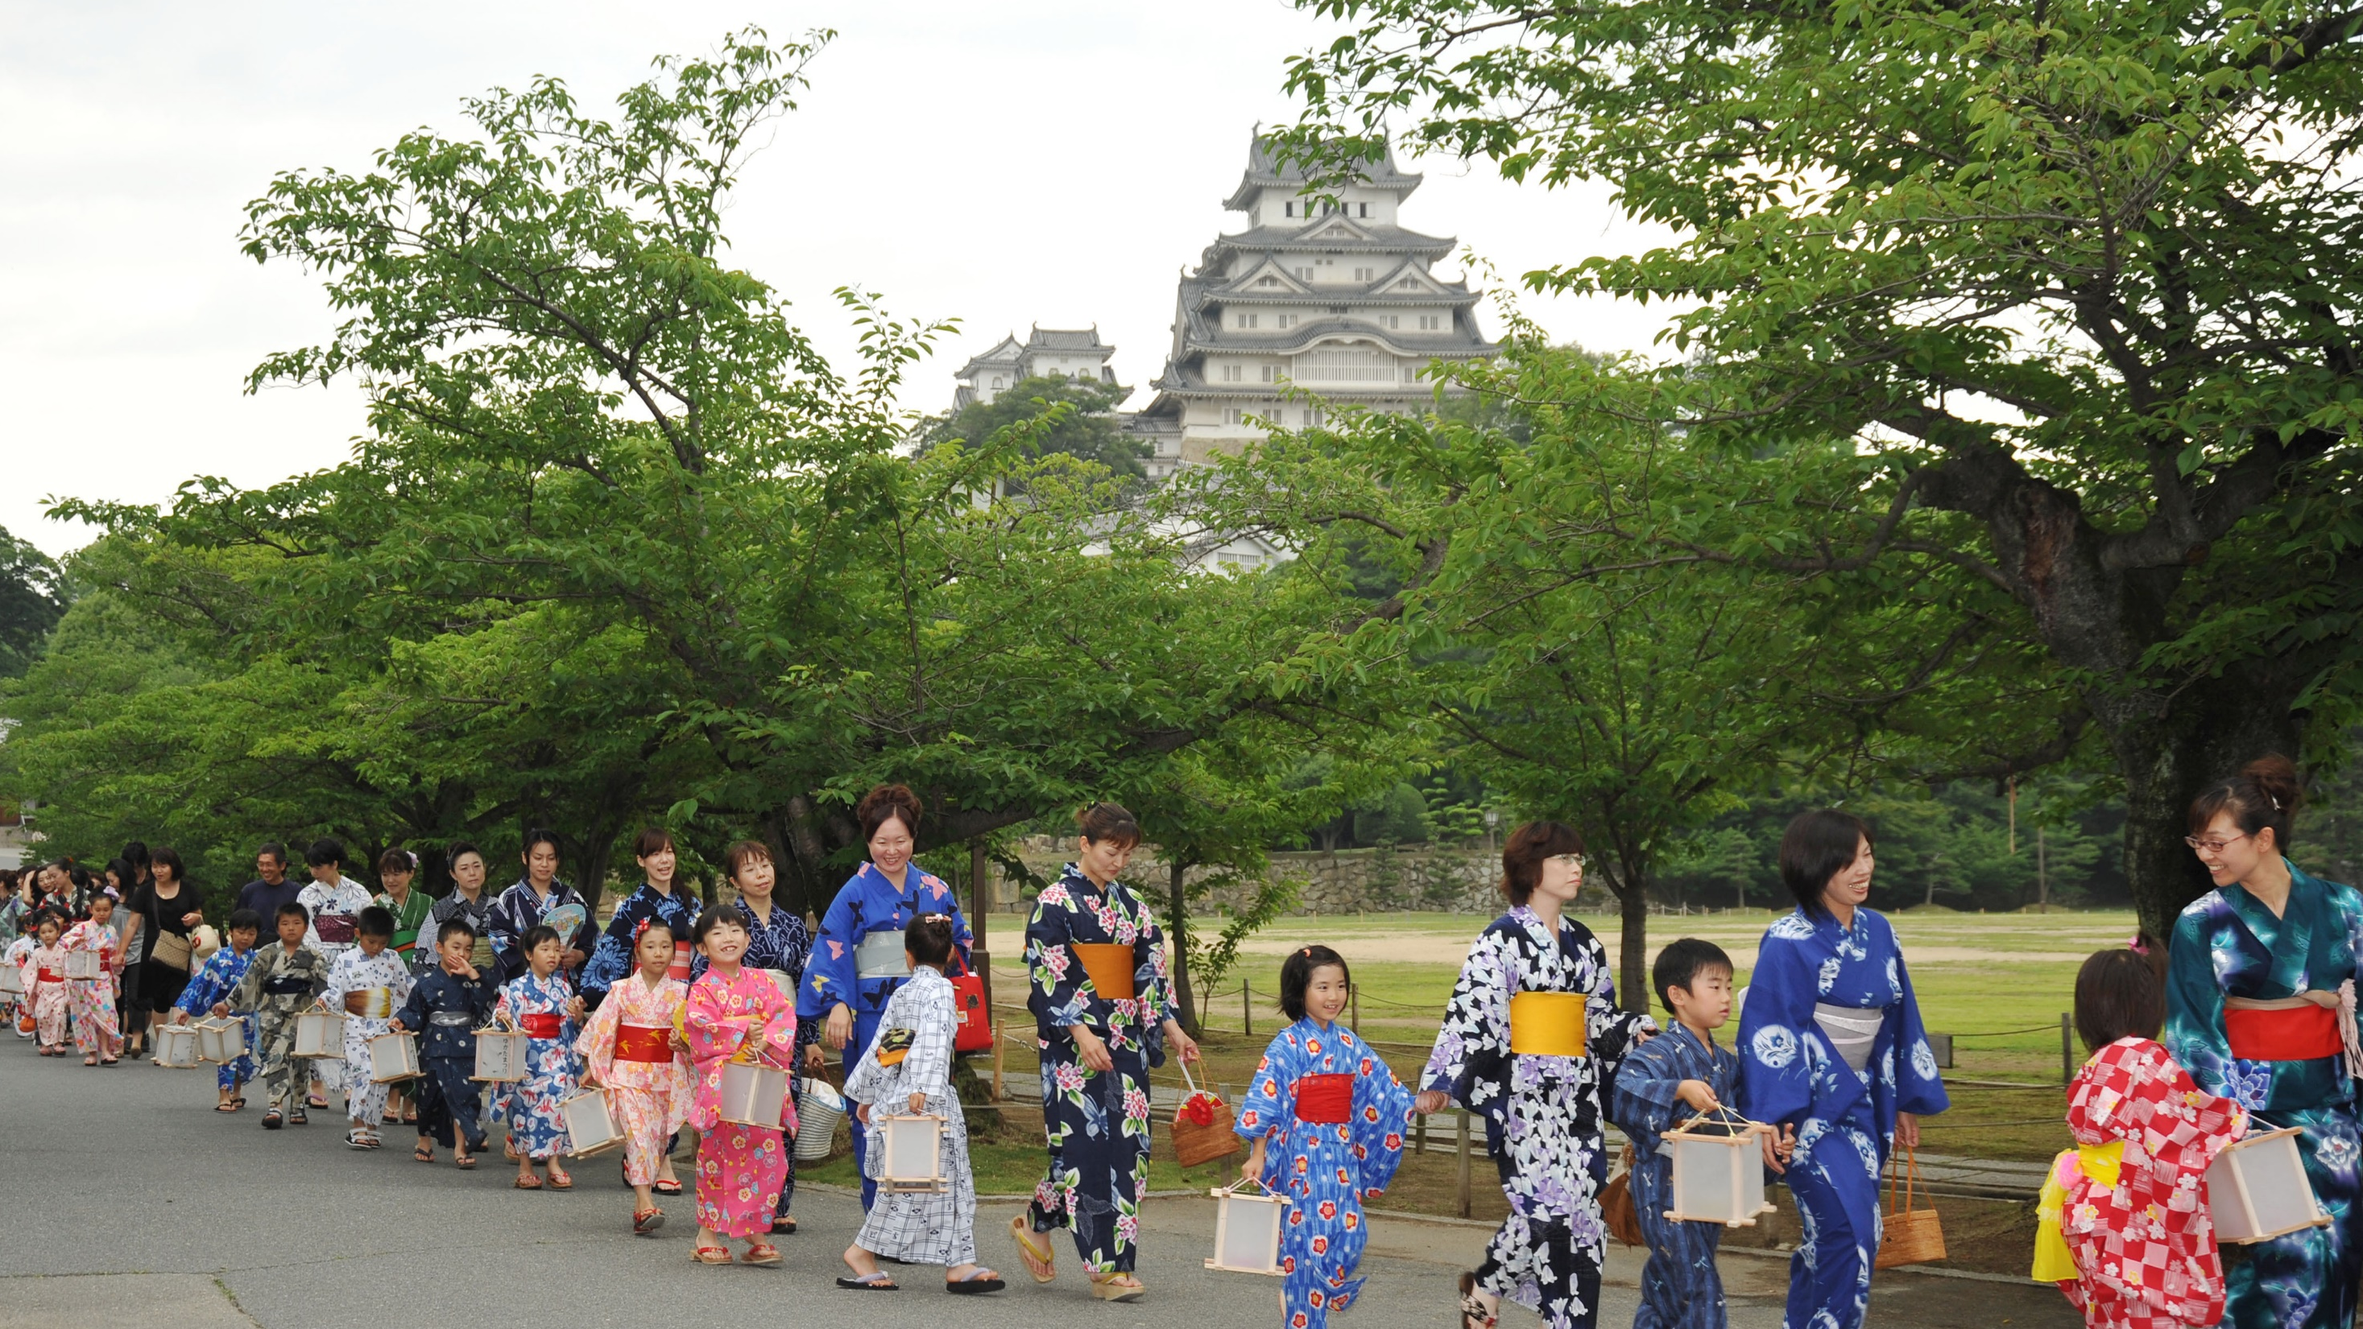
Thank you for your attention.
Hideyasu Kiyomoto, Mayor of Himeji City

