Slide 1
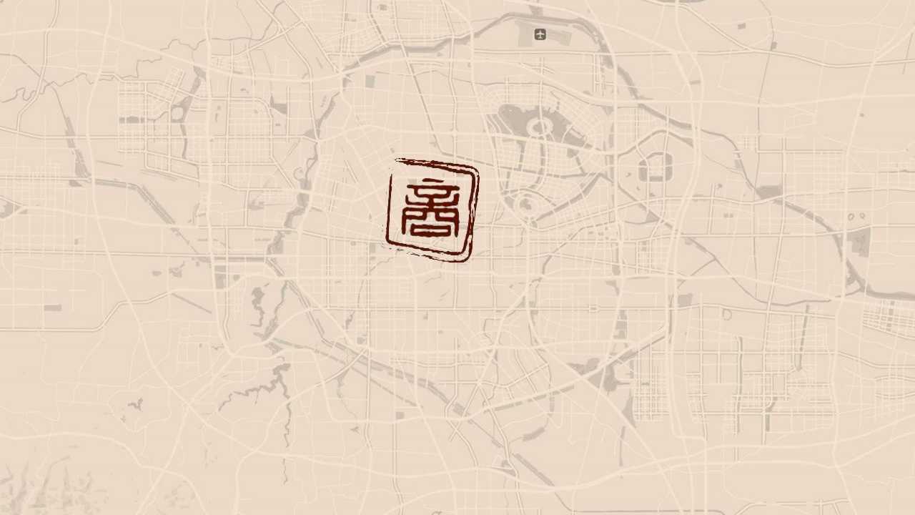
Walkability is an important factor affecting the attraction of historic urban areas
步行是影响历史城区吸引力的重要因素
-- Introduction to the experience of pedestrian planning and construction in the historical urban area of Zhengzhou Shang Dynasty Site
--郑州商城遗址历史城区步行规划建设经验介绍

Slide 2
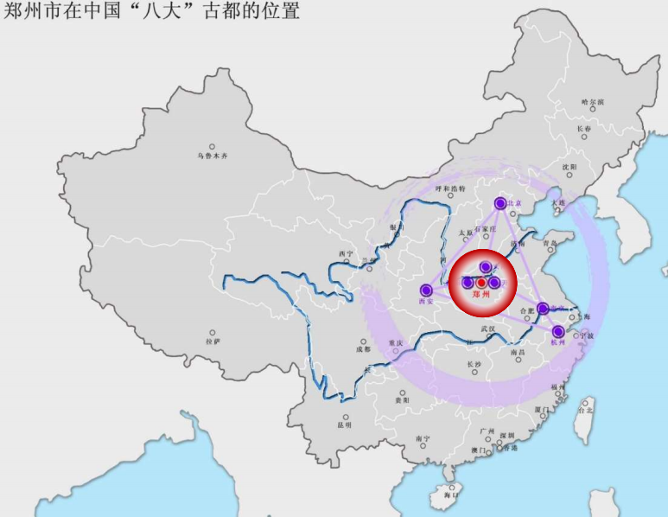
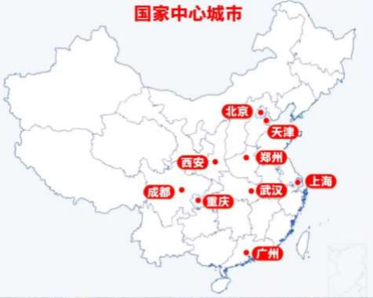

一 Introduction of Zhengzhou 郑州简介
Zhengzhou is the capital of Henan
Province in china and the national geographical
center, is one of the eight ancient capitals and nine national central cities in China.
郑州是中国河南省省会，位居国家经济地理中心， 有“天地之中”之称，是中国八大古都和新兴九大国家 中心城市之一。
郑州市在中国“八大”古都的位置
郑州市在中国“九大”国家中心城市的位置

Slide 3
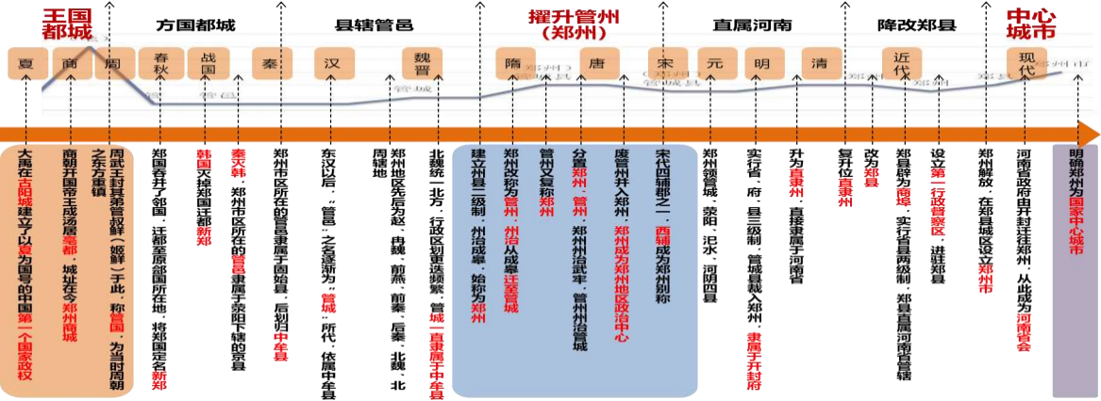
一 Introduction of Zhengzhou 郑州简介
With a long history and splendid culture, Zhengzhou is the capital and the land of the Xia, Shang and Zhou Dynasties. It
has a civilization history of 5,300 years and a city history of 3,600 years. It is an important birthplace of Chinese civilization, with over 10,000 cultural relics and the second largest number of national cultural relics protection units in the country.
郑州历史悠久、文化灿烂，是夏商周的建都立国之地，有5300年的文明史、3600年的建城史，是华夏文明的重要发祥地，拥有各类文物点1 万余处，国家级文物保护单位数量居全国第二。

Slide 4
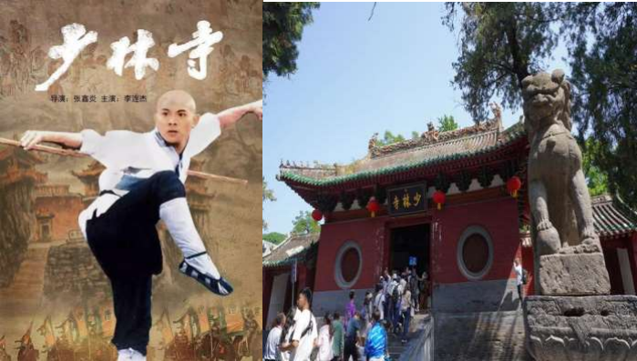
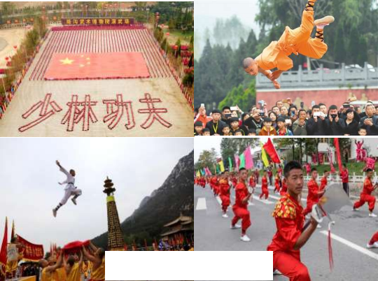
一 Introduction of Zhengzhou 郑州简介
Songshan Shaolin Temple in Zhengzhou which is built in 495 AD is one of the four ancient temples in China and the
birthplace of Shaolin Kung Fu.
" Shaolin Temple in Zhengzhou, the Kung Fu of the World ", Shaolin Kung Fu has become Zhengzhou's international city card.
建于公元495年的郑州嵩山少林寺是中国四大名寺之一，是少林功夫的发源地。“郑州的少林、世界的功夫”，少林功夫已然成为郑州在国 际上的城市名片。
中国郑州国际少林武术节

Slide 5
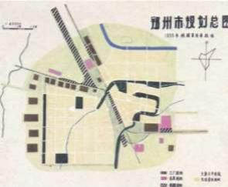
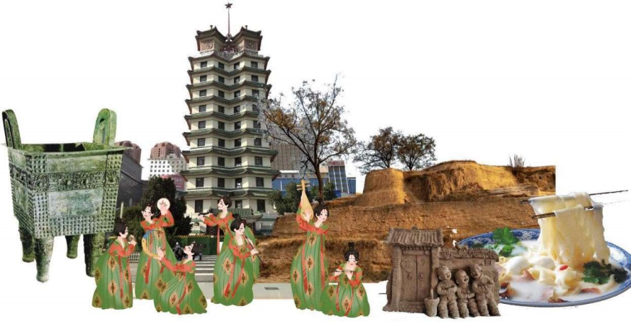
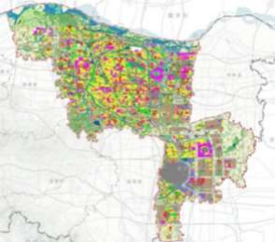
一 Introduction of Zhengzhou 郑州简介
Zhengzhou is both ancient and young, a small city of 558 thousand people that became the provincial capital city in 1954. After 70 years of rapid development, it has now become a modern, international and beautiful provincial capital city with 13 million people, possessing unique cultural and historical heritage charm.
1954
郑州是古老的，又是年轻的，从1954年成为省会城市的55.8万人小城市，通过70年快速发展， 现在已成为1300万人的现代化、国际化美丽省会城市,具有独特的文化和历史传承魅力。
2023

Slide 6
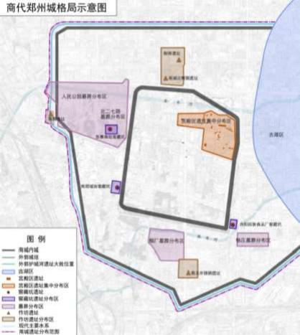
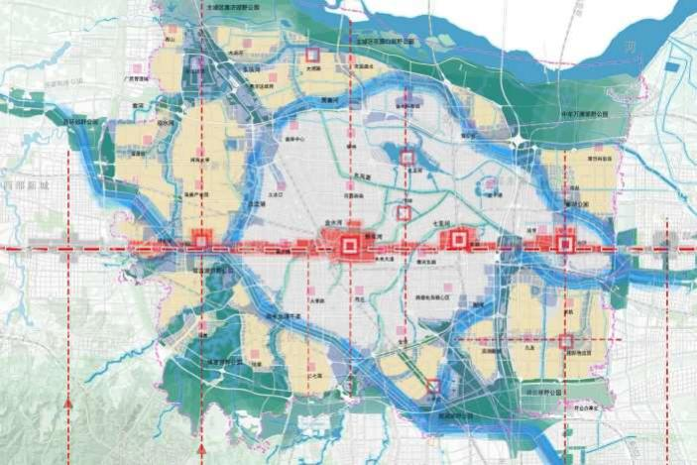

一 Introduction of Zhengzhou 郑州简介
Located in the core area of the city and covered an area of 3.5 square kilometers, the Shang Historical Area is the oldest urban city in China, representing the origin of Chinese urban civilization, and is an important factor for Zhengzhou to be included in the "Eight ancient capitals in China".
郑州商城遗址历史城区位于城市核心区，面积3.5平方公里，是中国最古老的都市城邑，代表着中华城市文明的起源，是郑州列入“中国八大 古都”的重要因素。
口祭祀遗迹 手工业区 贵族墓葬区 贵族居住区 平民居住区 平民墓葬区 手工业区
郑州主城区空间结构分析图

Slide 7
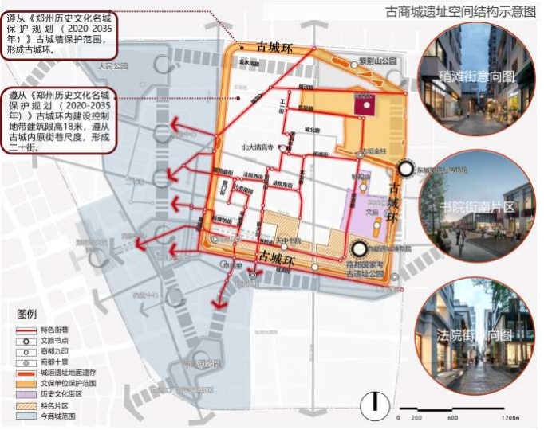
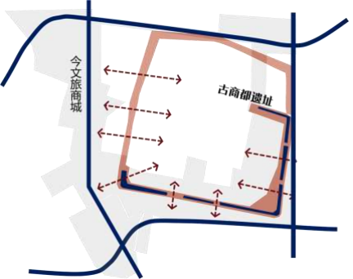
二 Experiences of Zhengzhou：Revive the vitality of the historic city
郑州经验：街区是可以漫步的、城区是有温度的
1.Strictly protect the existing urban pattern and street texture, avoid excessive and disorderly development
1.严格保护既有城市格局和街道肌理，避免过度和无序开发
The plan will take the 3,600-year-old Shang
Historical Area as the core resource, surrounding it with a ring road and 20 streets, forming the "ancient Shang city" within the ancient city wall.
将商城遗址历史城区作为核心资源，围绕一环二十街，形 成历史城区城墙内“古商城”。
一环·二十街示意

Slide 8
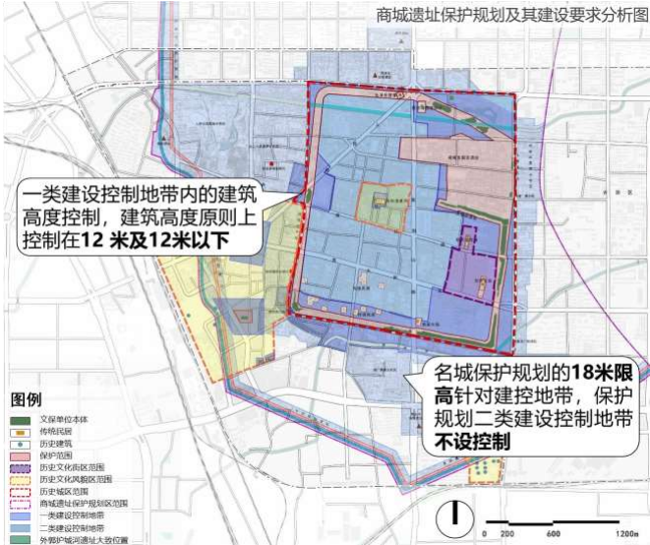
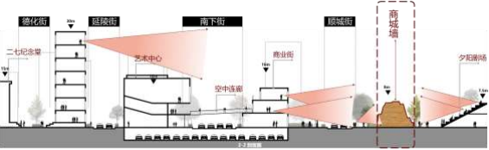
二 Experiences of Zhengzhou：Revive the vitality of the historic city
郑州经验：街区是可以漫步的、城区是有温度的
1.Strictly protect the existing urban pattern and street texture, avoid excessive and disorderly development
1.严格保护既有城市格局和街道肌理，避免过度和无序开发
Strict spatial protection requirements were established, with building heights controlled below 12 meters within the ancient city wall perimeter.
严控区域的保护要求，严控开发高度，城墙周边建筑高度 控制在12米以下。

Slide 9
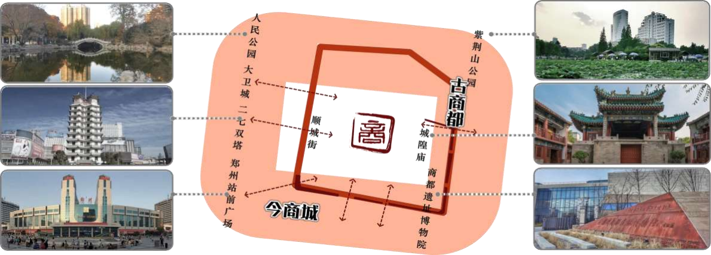
二 Experiences of Zhengzhou：Revive the vitality of the historic city
郑州经验：街区是可以漫步的、城区是有温度的
1.Strictly protect the existing urban pattern and street texture, avoid excessive and disorderly development
1.严格保护既有城市格局和街道肌理，避免过度和无序开发
The site of the Shang Historical Area will be transformed into cultural and tourism resources, and the city outside the historic city wall will form an interactive "borderless scenic spot".
将商城遗址转化为文化、旅游资源，和历史城区城墙外城市形成互动的“无界景区”。

Slide 10
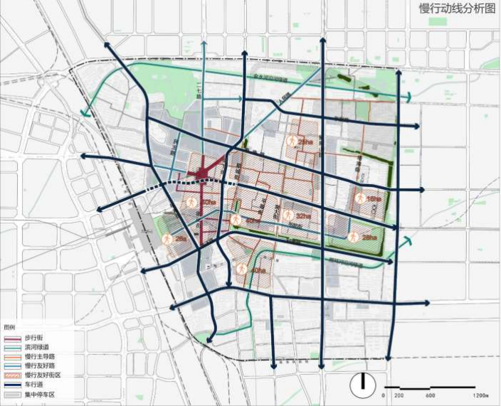
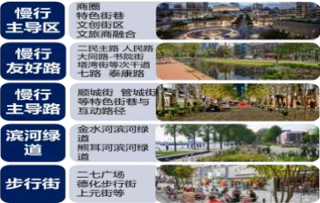
二 Experiences of Zhengzhou：Revive the vitality of the historic city
郑州经验：街区是可以漫步的、城区是有温度的
2.Determine walking as the leading mode of transportation in the historic urban area
2.确定步行作为商城遗址历史城区内的主导交通方式
Build 8 walking leading areas, each of which is controlled between 16-40 hectares. Branch roads and characteristic streets and alleys within them were set up as walking-oriented roads, and secondary roads as walking-friendly roads. And the pedestrian network density of the area reaches 18 kilometers/square kilometers.
规划建设8个慢行主导区，单个面积控制在16-40公顷，其 内部支路及特色街巷设置为慢行主导路，次干道设置为慢行友 好路。区域步行网络密度达到18公里/平方公里。

Slide 11
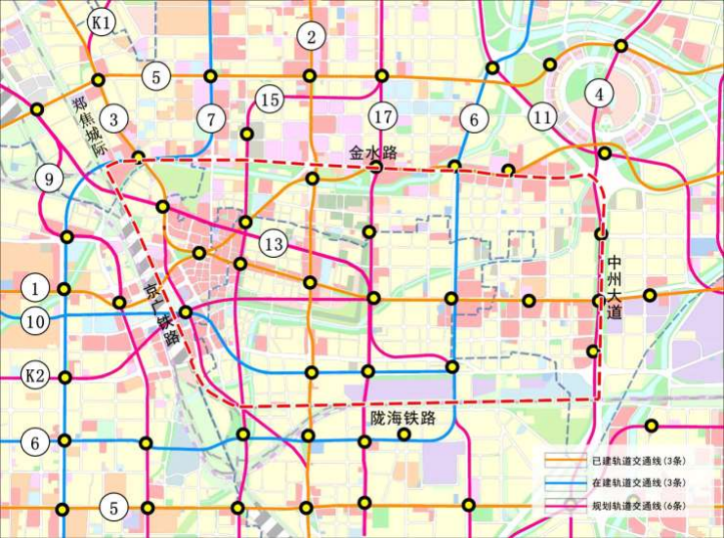
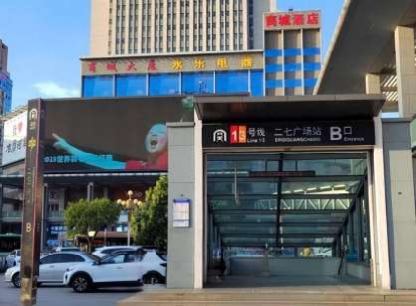
二 Experiences of Zhengzhou：Revive the vitality of the historic city
郑州经验：街区是可以漫步的、城区是有温度的
2.Determine walking as the leading mode of transportation in the historic urban area
2.确定步行作为商城遗址历史城区内的主导交通方式
2 urban express lines and 5 urban general
lines were planned to achieve the driving force of the region on the whole city. The rail network density is four times the average density of the central urban area.
规划7条轨道交通线，其中2条城市快线，5条城市普线， 规划轨道网络密度是中心城区平均密度的4倍。
轨道交通线网及站点图
Site
轨道交通站点实景

Slide 12
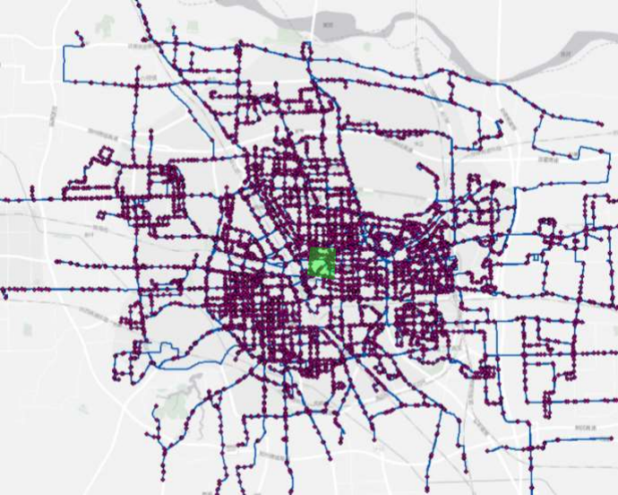
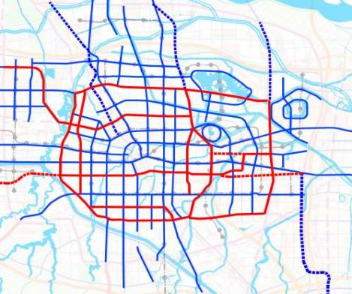

二 Experiences of Zhengzhou：Revive the vitality of the historic city
郑州经验：街区是可以漫步的、城区是有温度的
2.Determine walking as the leading mode of transportation in the historic urban area
2.确定步行作为商城遗址历史城区内的主导交通方式
Strengthen the distribution function of buses,
with a coverage area of 100% within 500 meters of bus stops.
强化地面公交的快速集散功能，地面公交站点500米范 围内覆盖区域达到100%。
高频骨干线 分布图
Site
公交专用道近期实施计划图
地面公交线网及站点图

Slide 13
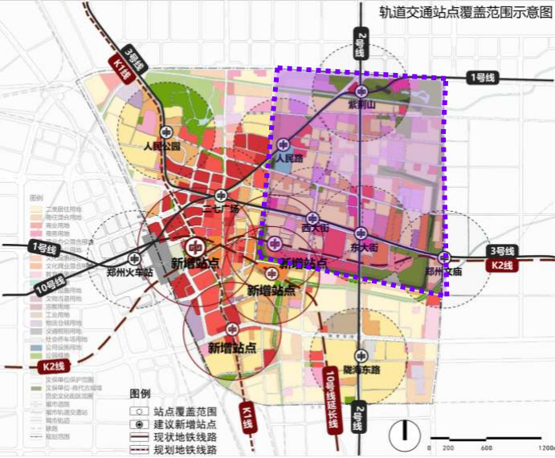
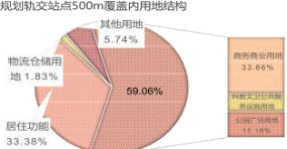
二 Experiences of Zhengzhou：Revive the vitality of the historic city
郑州经验：街区是可以漫步的、城区是有温度的
3. Focus on the development of rail transit stations to enhance the publicity of land use functions
3.围绕轨道交通站点进行重点开发，提升用地功能的公共性
Build a 300 meter community public service circle with the stations as the core, and to improve the development intensity and the publicity of land use functions, the proportion of commercial land within 500m of the stations is 34%. The proportion of population and job positions within 800 meters of the station to the total regional area is no less than 80%.
以站点为核心构建300米社区公共服务圈，提升开发强度 以及用地功能的公共性，规划站点500m内商务商业用地占比
34%，站点800m范围内人口及岗位数量占区域总量的比例不低
Site
于80%。

Slide 14
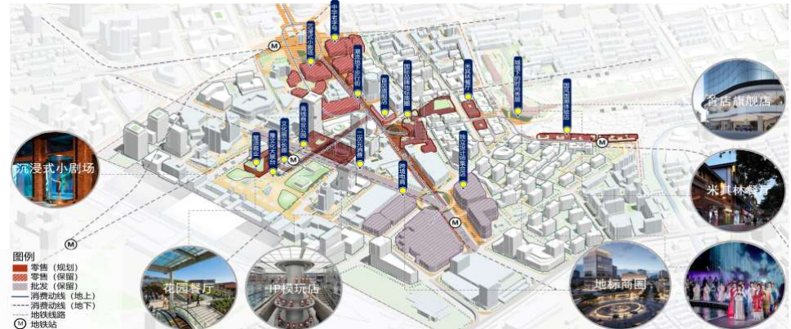
二 Experiences of Zhengzhou：Revive the vitality of the historic city
郑州经验：街区是可以漫步的、城区是有温度的
3. Focus on the development of rail transit stations to enhance the publicity of land use functions
3.围绕轨道交通站点进行重点开发，提升用地功能的公共性
Supported by Dehua Pedestrian Street and combined with the layout of subway stations, new consumer formats will be developed. The underground will mainly focus on trendy formats for young people, while the ground will create a landmark commercial district that gathers globally renowned brands, first stores, and first shows.
以德化步行街为支撑，结合地铁站点布局消费新业态，地下以面向年轻人的潮流业态为主，地面打造汇集全球知名品牌、首店、首秀的地 标商圈。

Slide 15
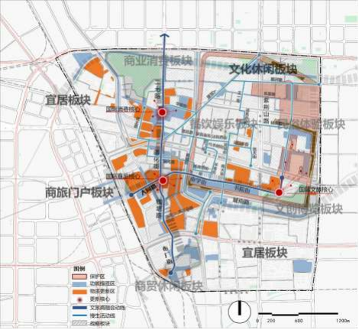
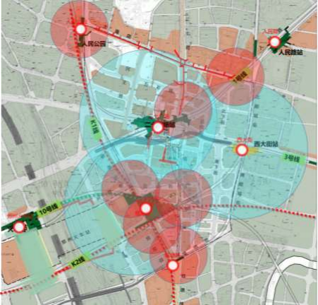
二 Experiences of Zhengzhou：Revive the vitality of the historic city
郑州经验：街区是可以漫步的、城区是有温度的
3. Focus on the development of rail transit stations to enhance the publicity of land use functions
3.围绕轨道交通站点进行重点开发，提升用地功能的公共性
Strengthen the integration of underground and above-ground traffic in rail transit stations, and combine commercial construction to build an integrated pedestrian system. The underground pedestrian system within the area can connect all rail transit stations and hubs, tourist attraction points, and over 70% of shopping malls.
 | 地下步行系统示意 图例 地下步行系统 。 轨道交通站点
慢生活动线示意图
加强轨道交通站点地下和 地上交通的融合，站点周边利 用支路系统串联林荫道、社区 服务、商业设施等活力点，形 成慢生活街巷。区域内地下步 行系统可连接所有枢纽、重要 景点和70%以上商场。

Slide 16
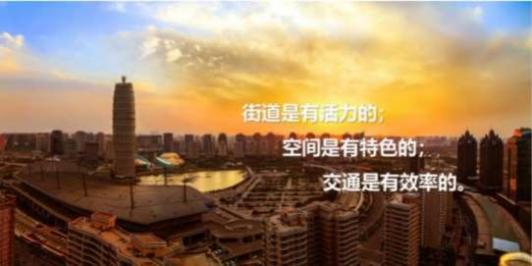
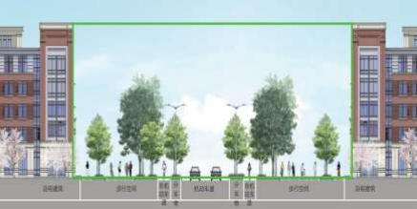
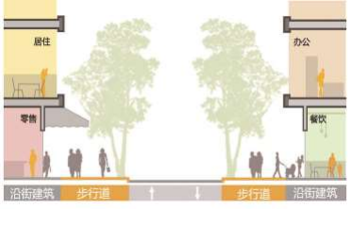
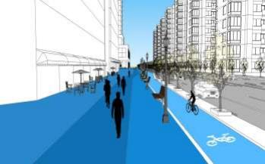
二 Experiences of Zhengzhou：Revive the vitality of the historic city
郑州经验：街区是可以漫步的、城区是有温度的
4. Carry out the street "U" type space renovation, and transform traffic space to the communication space
4.开展街道“U”型空间整治，实现交通空间向交往空间转变
The " Street Design Guidelines of Zhengzhou " was compiled.
In the "U" shaped space formed by the roads and buildings on both sides, joint design of roads, greenery, building facades, etc. is carried out to improve urban furniture, enhance the facade style of buildings along the street, enrich the urban landscape and pedestrian environment, and improve pedestrian comfort.
编制《郑州街道设计导则》 ，在道路和两侧建筑形成的“U”型空间内，对 道路、绿化、建筑立面等进行共同设计，突出完善城市家具，提升沿街建筑立面 风貌，丰富城市景观和步行环境，提升步行舒适度。
《郑州街道设计导则》
U型空间内的一体化统筹设计

Slide 17
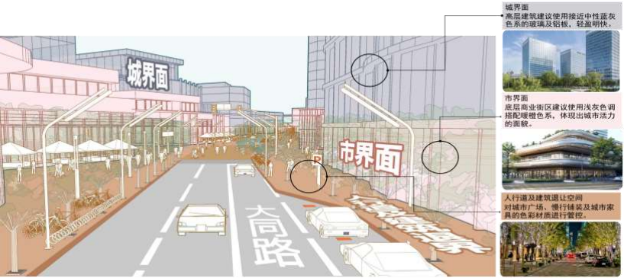
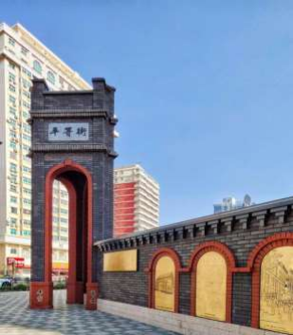
二 Experiences of Zhengzhou：Revive the vitality of the historic city
郑州经验：街区是可以漫步的、城区是有温度的
4. Carry out the street "U" type space renovation, and transform traffic space to the communication space
4.开展街道“U”型空间整治，实现交通空间向交往空间转变
Take the historic streets such as Shuyuan Street and Dongli Road as the core, strictly preserve the direction and width of their streets and alleys, maintain the traditional style of streets and alleys, introduce different commercial, cultural formats, and create a "walkable block" with a total area of about 40 hectares, stimulate the vitality of streets and cities.
结合书院街、平等街等历史街道，严格保留其街巷的走向、宽度，延续街巷传统风貌，以街道为核心整合沿线用地，引入不同商业、文化等 业态布局，打造总面积约40公顷的“步行化街区”，通过步行激发街道及城市活力。
平等街

Slide 18
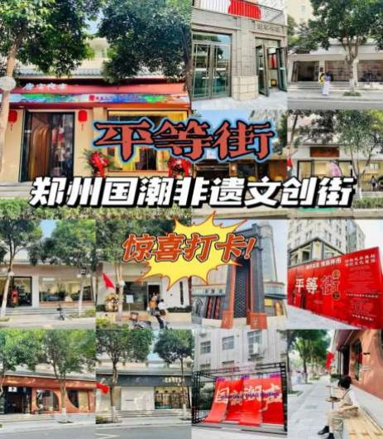
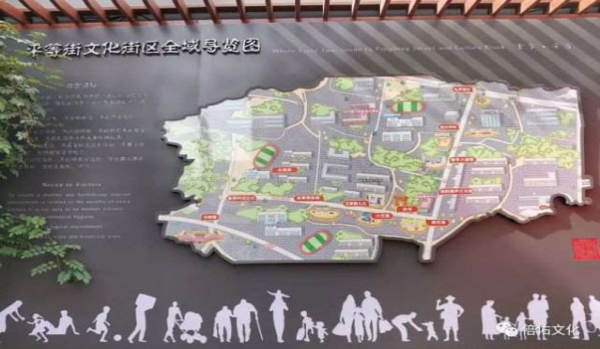
二 Experiences of Zhengzhou：Revive the vitality of the historic city
郑州经验：街区是可以漫步的、城区是有温度的
4. Carry out the street "U" type space renovation, and transform traffic space to the communication space
4.开展街道“U”型空间整治，实现交通空间向交往空间转变
Pingdeng Street won the championship in the "Zhengzhou Night
Economy Landmark" selection activity and was named the "Most Beautiful Public Cultural Space" in the province.
目前建成的平等街非遗文创街，在“郑州夜经济地标”评选活动中一举夺冠并获评 全省“最美公共文化空间”。

Slide 19
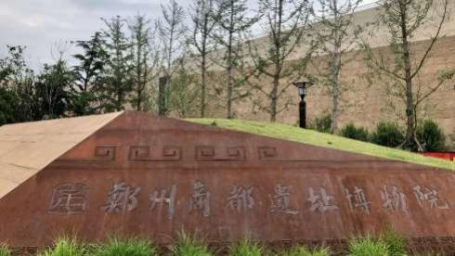
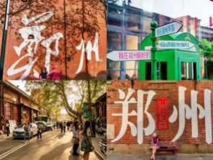
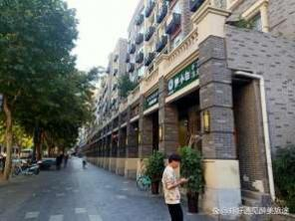
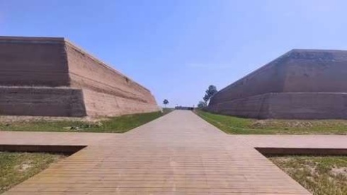
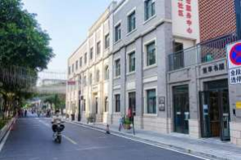
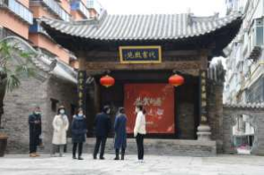
二 Experiences of Zhengzhou：Revive the vitality of the historic city
郑州经验：街区是可以漫步的、城区是有温度的
5. Emphasize the integration of culture and tourism, accelerate the transformation of historic urban areas
5.聚焦文旅、文创融合，加速历史城区蝶变
Launch a new roaming experience international routes of "
Shang Historical Memory"
推出“商都记忆”“市井烟火”漫游新体验国际线路。
商都遗址博物院
郑州记忆
管城街
平等街
代书胡同
商都国家考古遗址公园

Slide 20
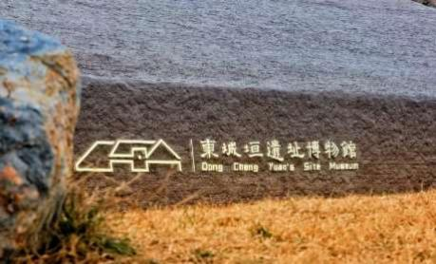
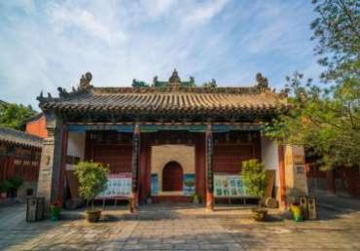
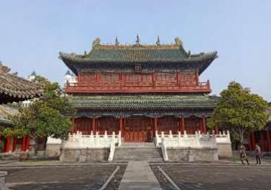
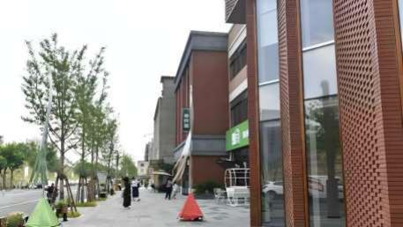
二 Experiences of Zhengzhou：Revive the vitality of the historic city
郑州经验：街区是可以漫步的、城区是有温度的
5. Emphasize the integration of culture and tourism, accelerate the transformation of historic urban areas
5.聚焦文旅、文创融合，加速历史城区蝶变
This international line product with international style, Chinese flavor and Henan charm, combined with on-site intangible cultural heritage display, opera and art performances, allow visitors to feel the broad and profound charm of the Shang Historical culture in the "city tour", and help create a national central city's high-quality cultural landmark.
这条具有国际范、中国味、河南韵的国际线路产品，结合现场非遗展示、戏曲文艺 演出等，让游客在“城市漫游” 中感受商城遗址文化博大精深的魅力，助力打造国家中心城 市高品位文化主地标。
东城垣遗址博物馆
城隍庙
文庙
阜民里

Slide 21
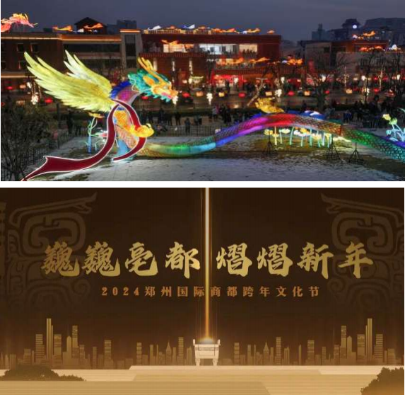
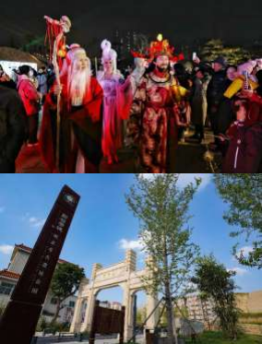
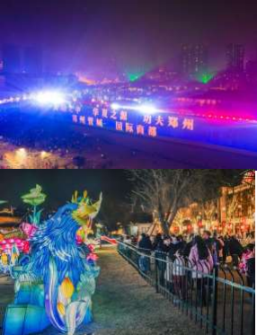
二 Experiences of Zhengzhou：Revive the vitality of the historic city
郑州经验：街区是可以漫步的、城区是有温度的
5. Emphasize the integration of culture and tourism, accelerate the transformation of historic urban areas
5.聚焦文旅、文创融合，加速历史城区蝶变
The 2024 Zhengzhou International New Year Cultural
Festival received 125000 visitors, ranking first among all New Year's Eve activity areas in our city, successfully enhanced the attractiveness of the historic urban area.
2024年郑州国际商都跨年文化节活动接待游客12.5万人次，居我 市各跨年夜活动区域首位，成功地提升了历史城区的吸引力。

Slide 22
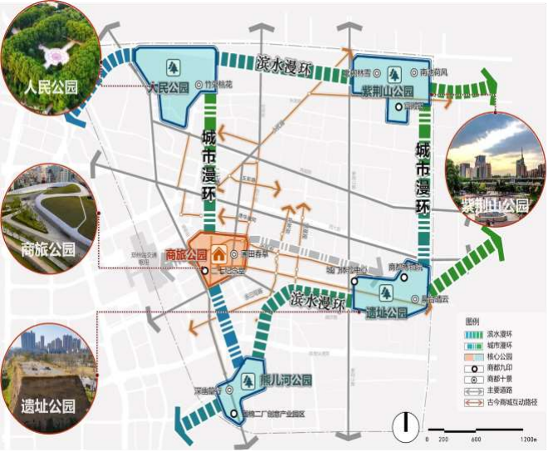
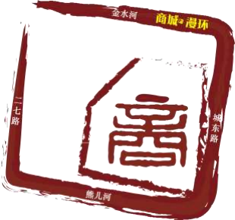
二 Experiences of Zhengzhou：Revive the vitality of the historic city
郑州经验：街区是可以漫步的、城区是有温度的
6. Create a livable city through a chain of urban greenways
6.通过城市绿道串景成链，打造宜居城市
Based on Jinshui River and Xiong'er River around
the Shang Dynasty Site, relying on the greenway, green space, important scenic spots, businesses, communities and other people gathering points in the historic urban area were connected to form an urban walking system.
以金水河、熊耳河为主线，依托绿道、绿地等， 串接商城遗 址历史城区内的重要景点、商业、社区等人流聚集点，形成“路 在林中、林在城中、绿不断线、景不断链”的漫步系统。
文旅商都空间结构示意图

Slide 23

二 Experiences of Zhengzhou：Revive the vitality of the historic city
郑州经验：街区是可以漫步的、城区是有温度的
6. Create a livable city through a chain of urban greenways
6.通过城市绿道串景成链，打造宜居城市
With the historical urban area of the Shang Historical Area as the core, the city will rely on the three-level walking system of "regional greenway - urban greenway - community greenway" to build a green road walking system that radiates the whole area, with a total length of about 3218 kilometers, and will form an urban pattern of "300 meters to see green, 500 meters to see garden", and actively build a pedestrian and livable city.
围绕商城遗址历史城区，规划“区域绿道-城 市绿道-社区绿道”三级休闲慢行体系，构建辐射
全域的绿道慢行系统，规划总长度约3218公里，形 成“300米见绿、500米见园”的城市格局，积极打 造步行城市、宜居城市。
Site
郑州城区绿道系统规划图

Slide 24

Welcome to Zhengzhou!

