Slide 1

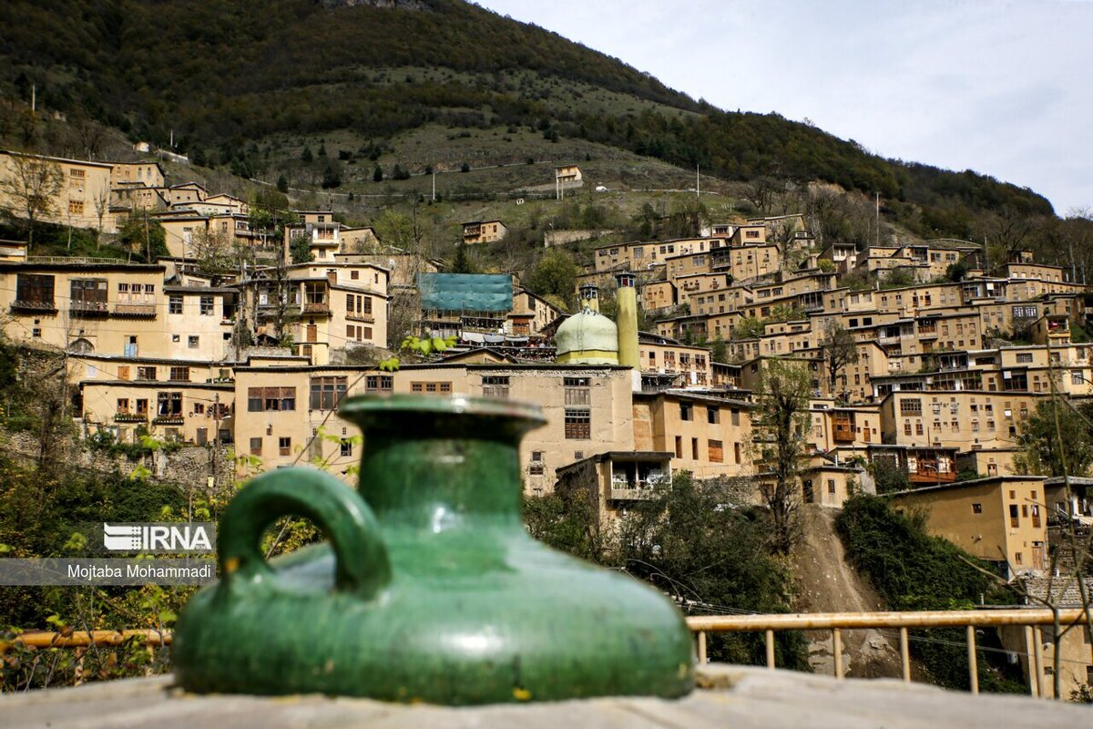
The Role of Walkability in the Quality and Appeal of Historical Areas
Focus on Masouleh
Masouleh is a historical city in Iran, famous for its unique terraced buildings and narrow streets, which give it a special charm.
As the first living historical city in northern Iran, Masouleh has a significant historical context and is visited by many tourists from both the country and around the world each year.
Improving walkability in such towns can help preserve their history and make them more attractive to visitors. This article examines how enhancing walkability can improve the quality of Masouleh and shares best practices for achieving this.

Slide 2
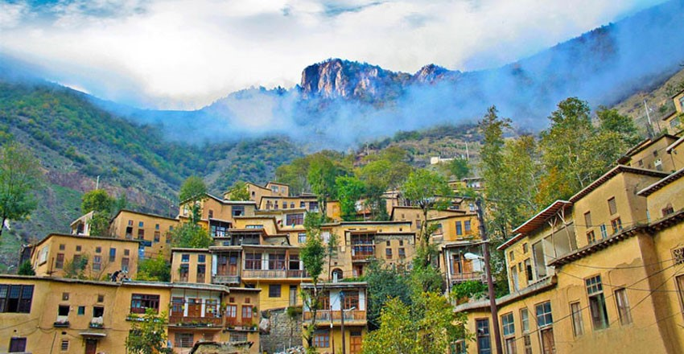
masouleh
historical
city
Masouleh is a historical city in Iran, is famous for its unique terraced buildings and narrow streets,
which give it a special charm.
Masouleh city as the first living historical city of iran in the north the country is located and has a special historical context, which is visited by many tourists from the country and the world every year

Slide 3
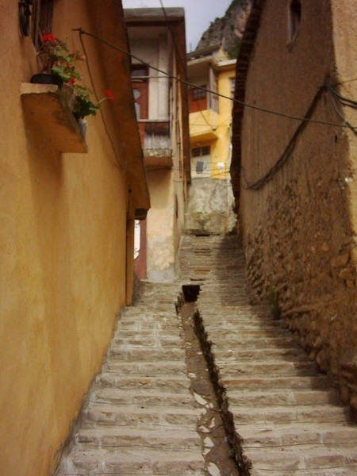
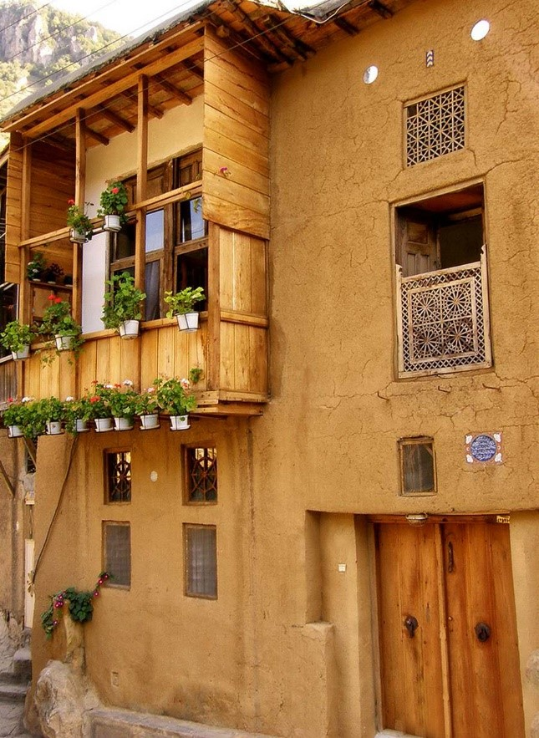
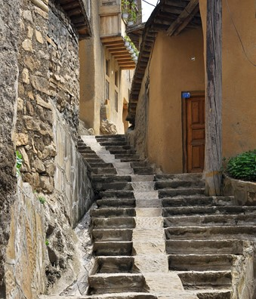
Preserving
Cultural
Heritage
Masouleh's unique architecture and narrow alleys are worth protecting. Creating better walking paths and maintaining historical streets can help preserve this cultural heritage. For example, in the city of Masoleh, there are no dead ends and the architecture of the buildings in this city is unique in the country, which increases the value of protection.

Slide 4
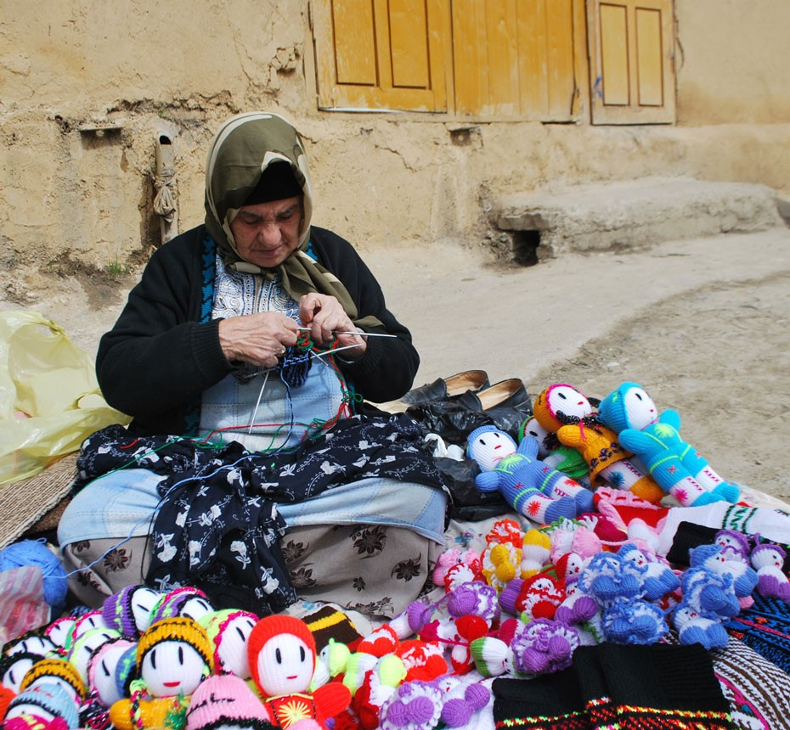
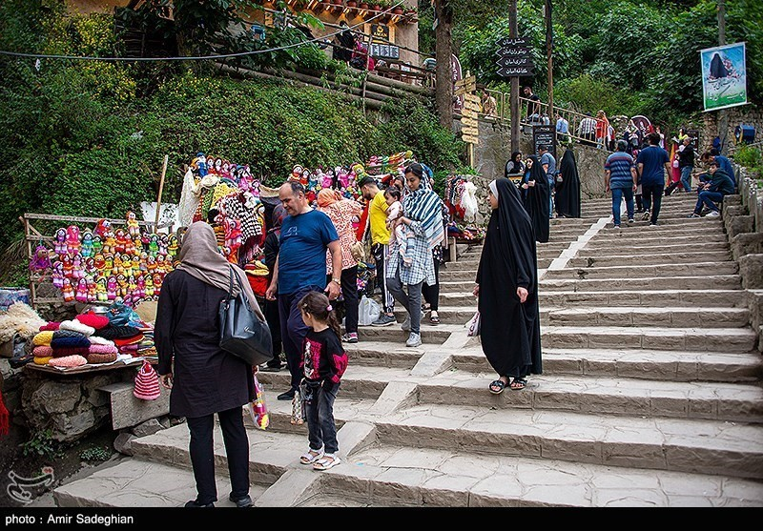
Increasing
Tourist
Appeal
Safe and appealing walking routes can attract more tourists, enhancing their experience and boosting the local economy. For example, the construction and reconstruction of sidewalks in the city of Masuleh and the designation of places by the municipality to support handicrafts and local products have been done, which can help the artists of the city.

Slide 5
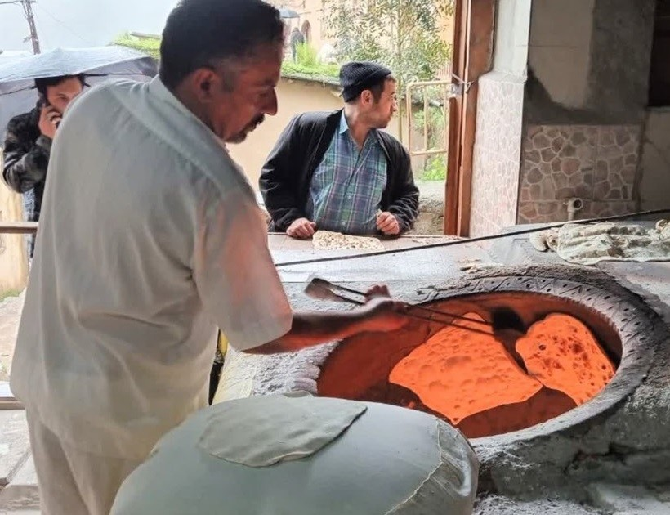
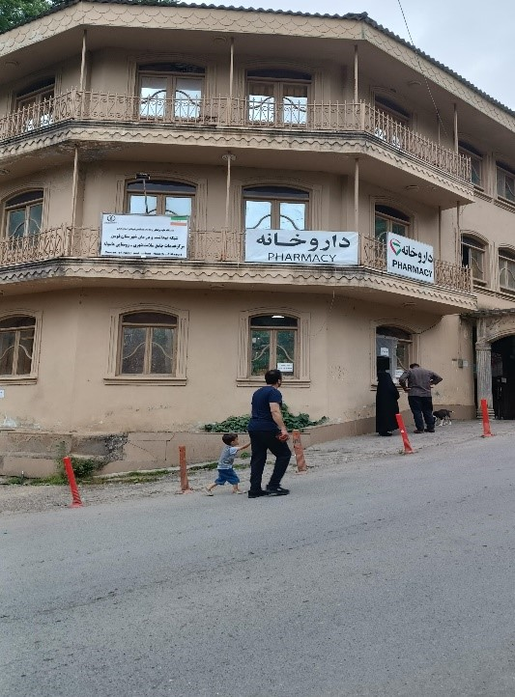
Improving
Residents
Quality of Life
Better walkability can improve daily life for Masouleh’s residents by providing easier access to services and amenities. For example, walking paths make it easy to access medical centers, bakeries and other service centers.

Slide 6
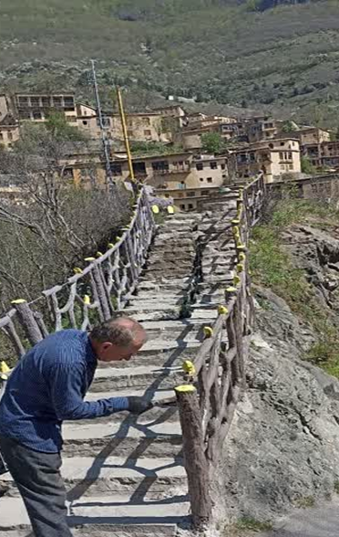
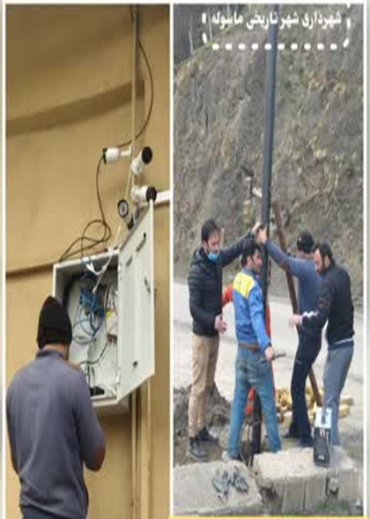
Creating
Safe
Walking Paths
Establishing specific walking paths can help both residents and tourists navigate the city and enjoy its scenery. In this regard, the municipality has taken measures to secure the dangerous routes and install cameras to ensure the safety of the roads.

Slide 7
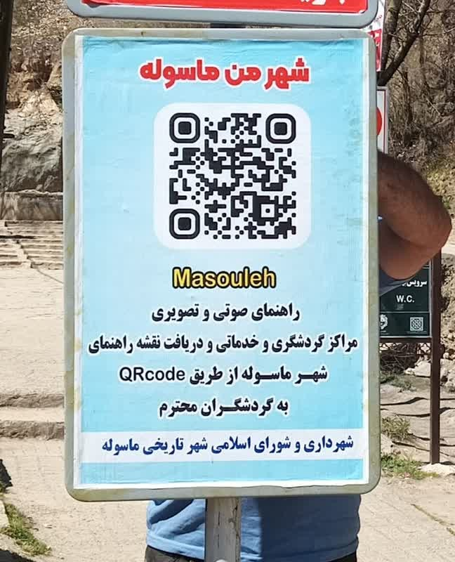
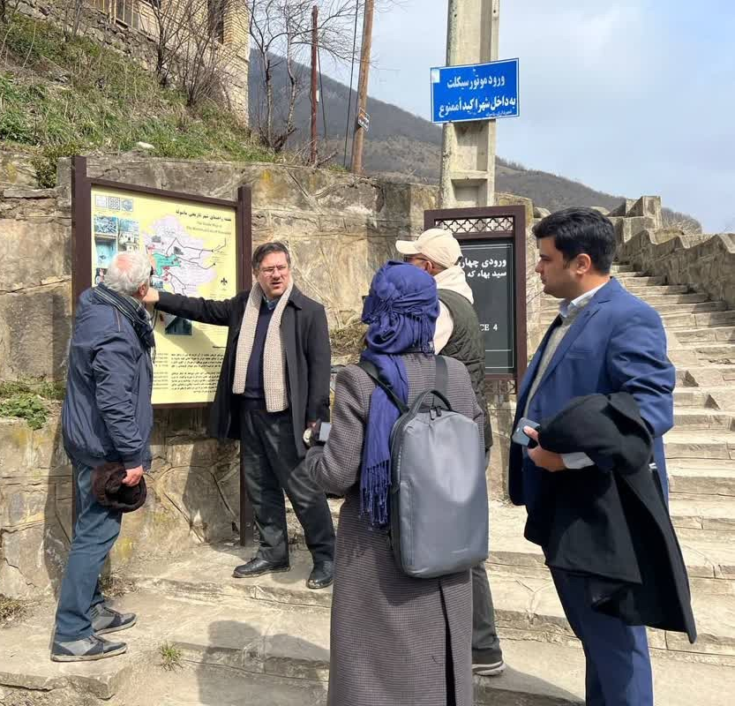
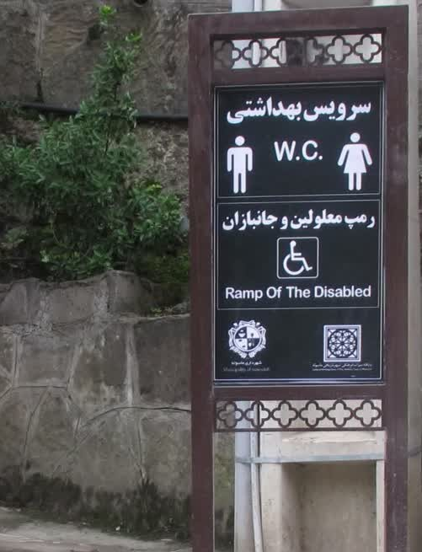
Installing
Guide
Signs
Putting up informational signs along walking routes can help tourists learn about Masouleh's history and find their way around. Also, the municipality has installed tourism maps and barcode reader boards in the city

Slide 8
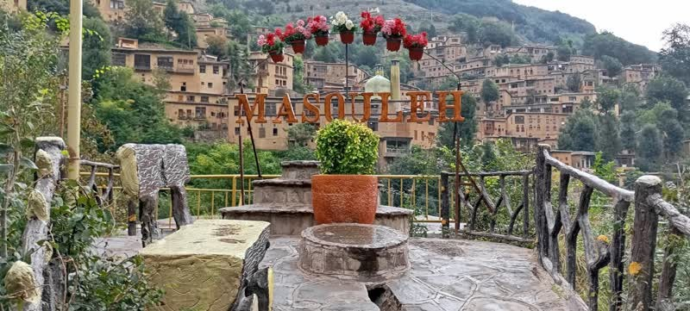
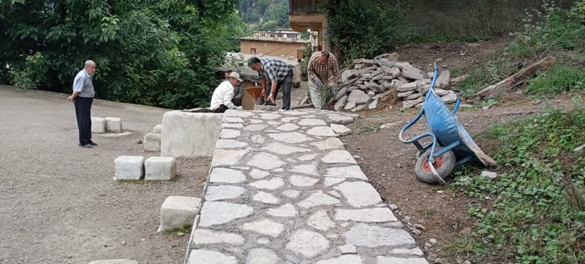
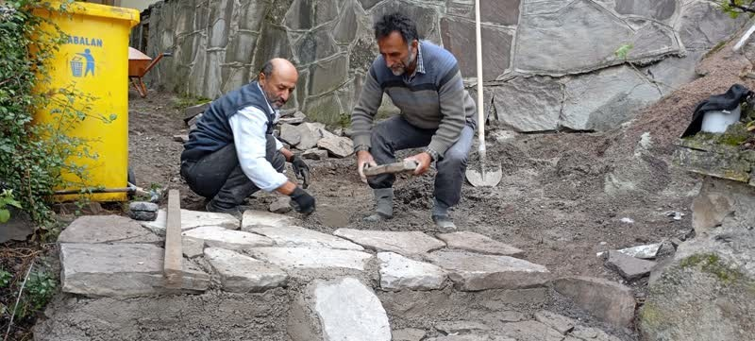
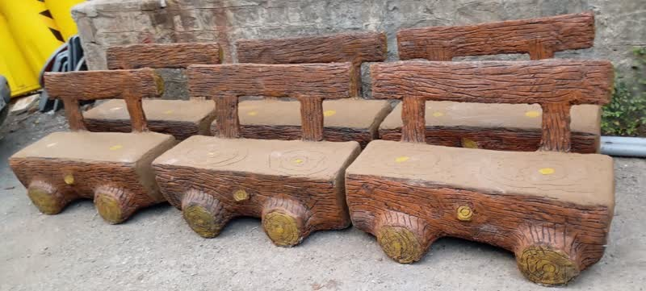
Renovating
Historical
Pathways
Regular maintenance of Masouleh’s old pathways can preserve the city's beauty and enhance the walking experience. Developing pedestrian walkways and leisure spaces, such as parks and well-lit areas, can create vibrant urban spots. In this context, the construction of a pedestrian pathway and a children's park is currently underway
.

Slide 9
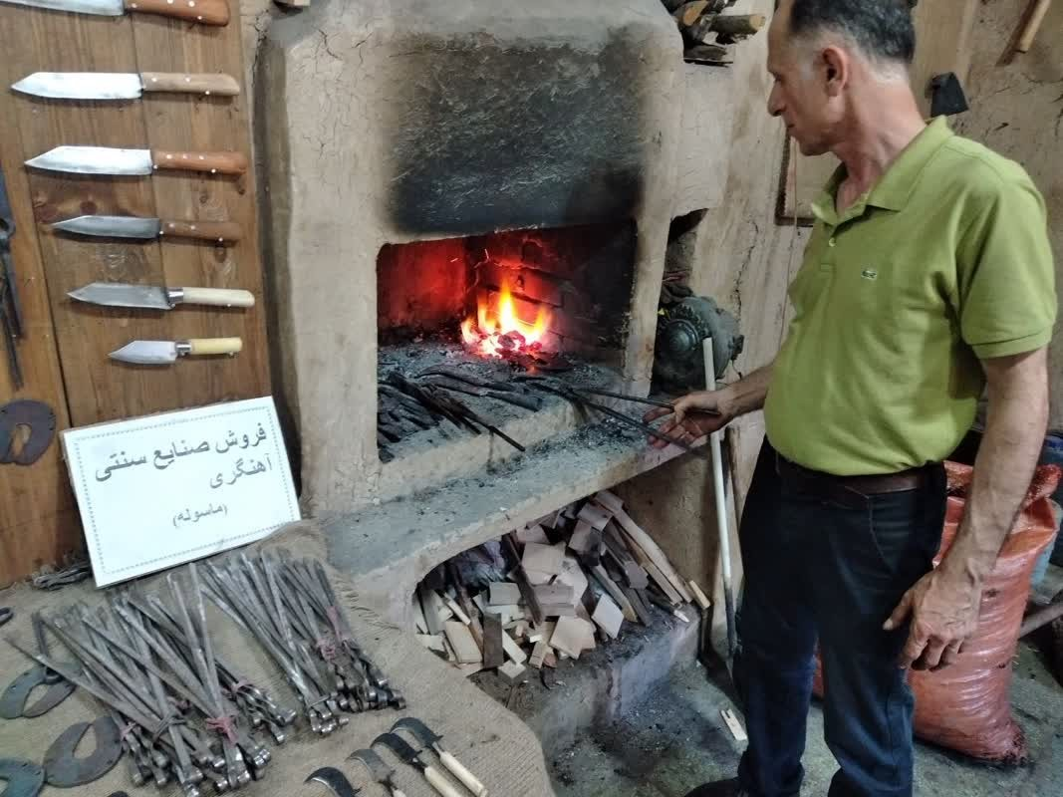
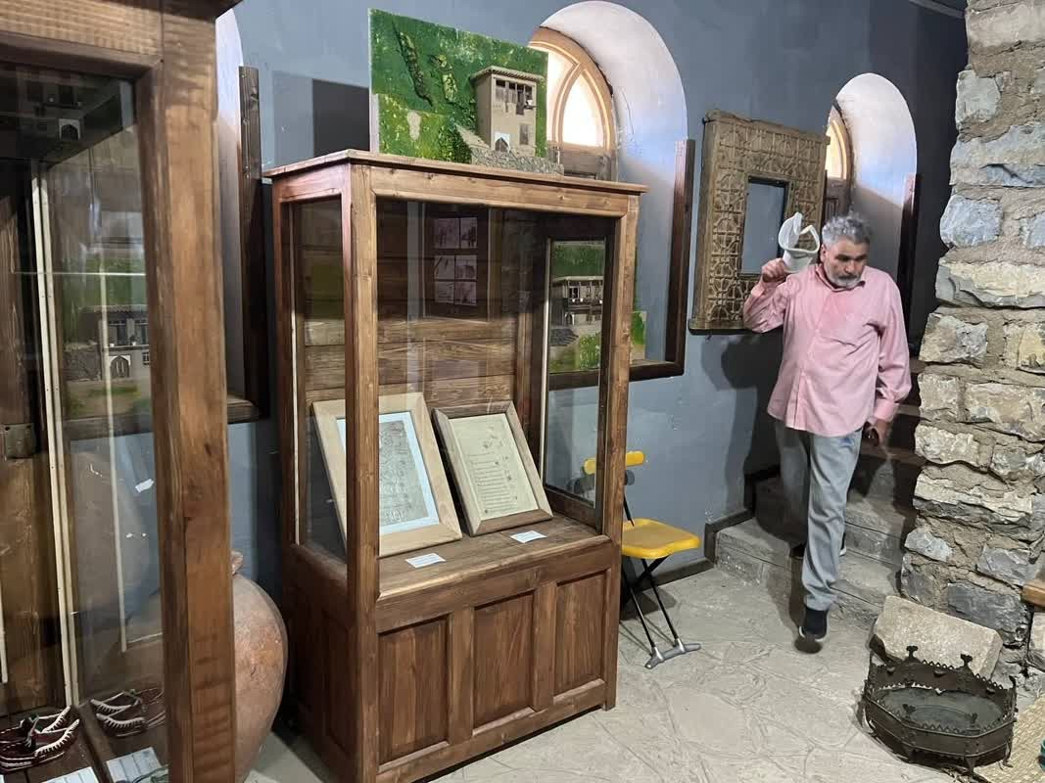
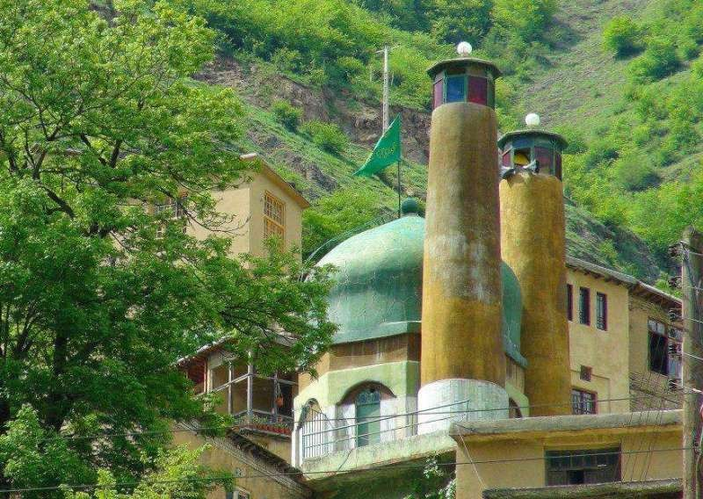
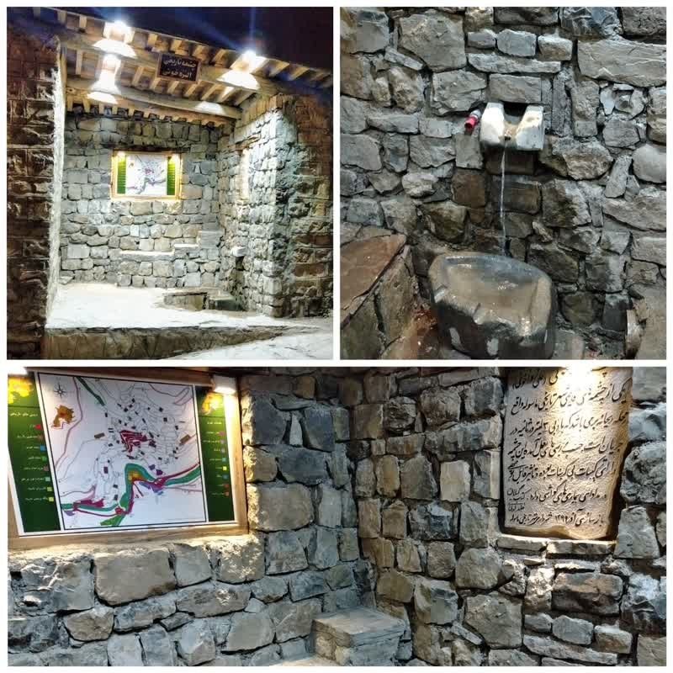
Revitalizing
Cultural
Venues
Establishing museums and centers for traditional crafts, such as blacksmithing and local footwear production, along with restoring important sites like mosques, can create vibrant cultural centers. By focusing on these improvements, Masouleh can enhance its appeal and quality of life for both visitors and residents. Restoration efforts have been completed for the museum, blacksmithing workshops, water mill, fountain, and historical mosques

Slide 10
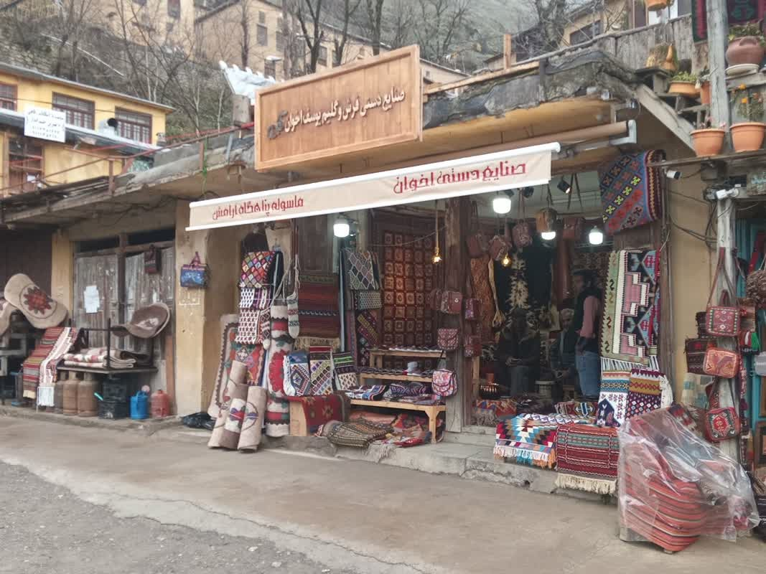
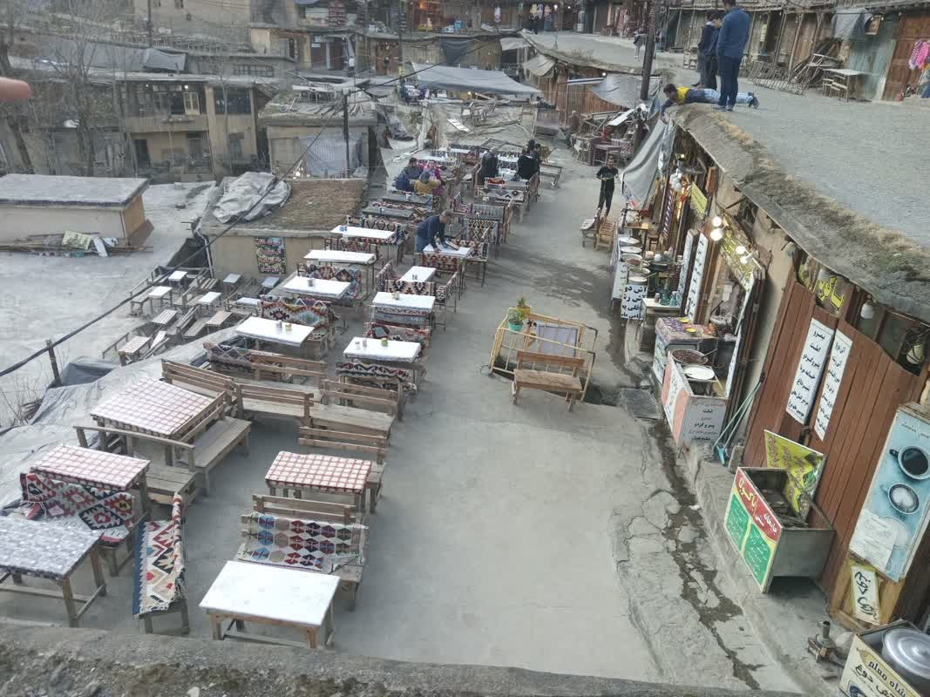
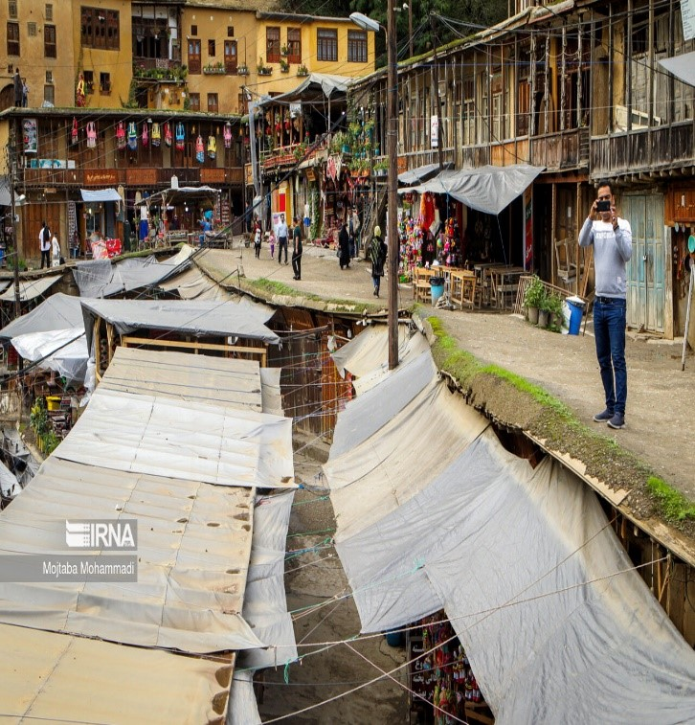
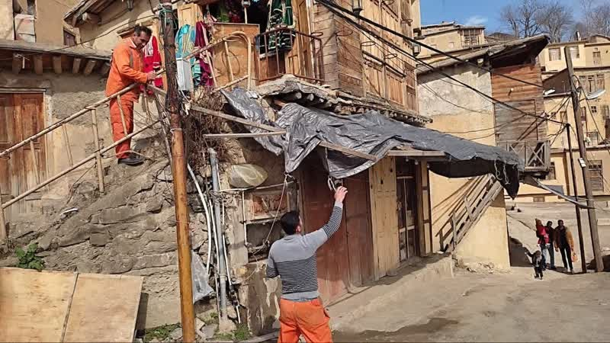
Collecting and Modifying
Market Combinations
and Heterogeneity
The bazaar is the center of gathering and economic activity. The presence of additional and unsightly elements caused visual damage. To create a better walking space, all the scaffolding and banners were removed and replaced with a new design

Slide 11
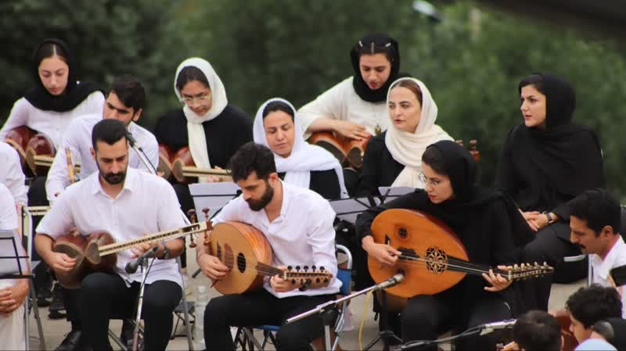
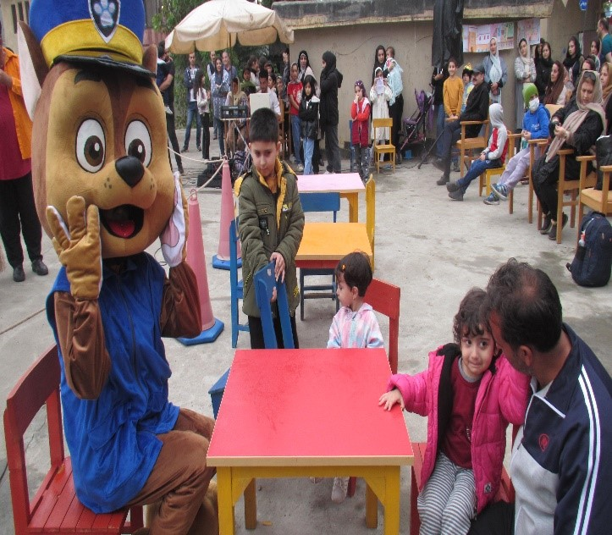
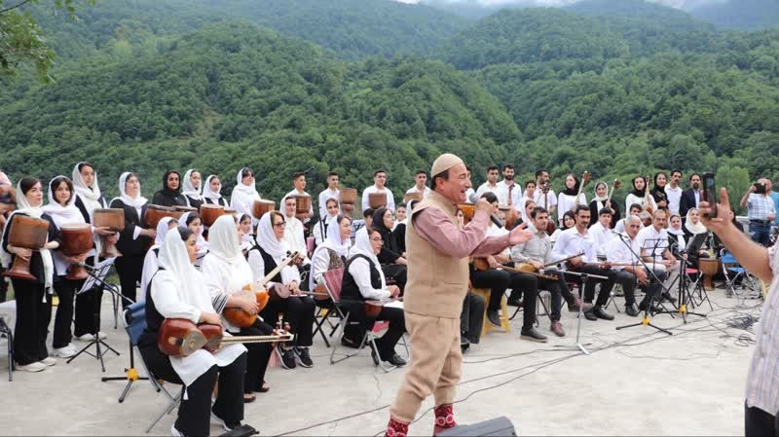
Holding Festivals
and Cultural Programs
in the City Center and Bazaar
On various occasions, the municipality organizes cultural programs, festivals, and special events for children in the city of Masuleh. These programs create a joyful atmosphere for citizens and improve the walking paths for both citizens and tourists.

Slide 12
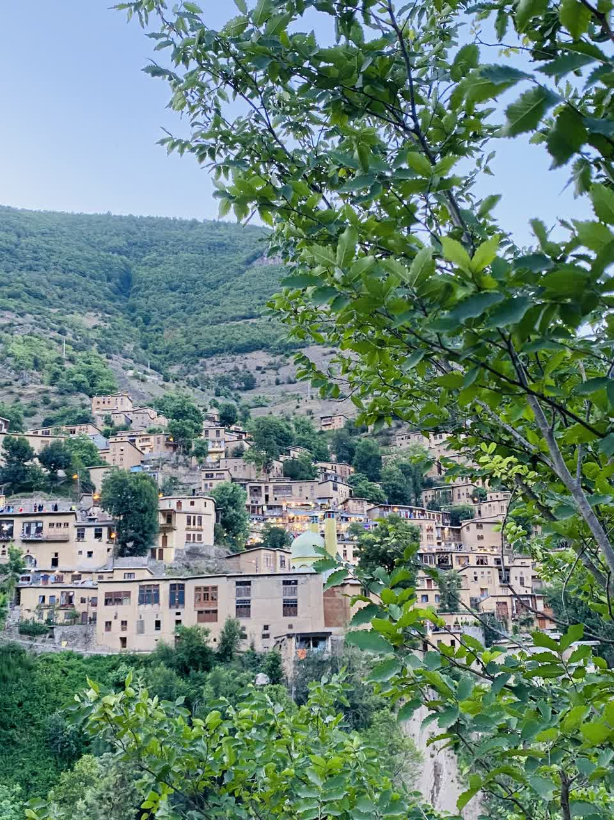
Sohrab Sepehri famous Persian poet said about Masouleh
"We came to Masouleh to write about it, but Masouleh cannot be written about; it must be seen. One should stand and gaze at all those houses perched on the green expanse of the mountain, to live and paint, to make a film, to write poetry
The end

